Slide 1
Constraining the Hadron-Quark
Phase Transition Chemical Potential
via Astronomical Observations
Zhan Bai(摆展)
Peking University
January 7th, 2018
Xiamen – CUSTIPEN Workshop

Slide 2
OUTLINE
Introduction and Motivation
Constructing Hadron-Quark Phase Transition
3. Hadron Model and Quark Model
4. Numerical Results
5. Summary

Slide 3
1. Introduction
• Exploring the phase structure of quantum chromodynamics (QCD) has long been one of the most exciting topics in the field of strong interaction physics, and the condition for which quark and gluon become deconfined is essential in the study of QCD phase structure.
• For the phase transition at low chemical potential and high temperature, we have data from heavy ion collisions. But for the phase transition at zero temperature and high density, we cannot rely on terrestrial experiment, and most data comes from the observation of compact stars.
• The most useful information is the mass, radius and tidal deformability of neutron stars.

Slide 4
1. Introduction
• On the theoretical side, although the best way to study phase transition is to find a way to describe hadron matter and quark matter unitedly, but for cold dense astronuclear matter, we are now unable to find a very satisfying theory.
• The most common way to study hadron-quark phase transition is to describe hadron and quark matter separately with models, and use different construction schemes to combine them and get the equation of state for hybrid stars.
• Next we are going to introduce some construction schemes and the one we use in this work.

Slide 5
OUTLINE
1. Introduction and Motivation
2. Constructing Hadron-Quark Phase Transition

Slide 6
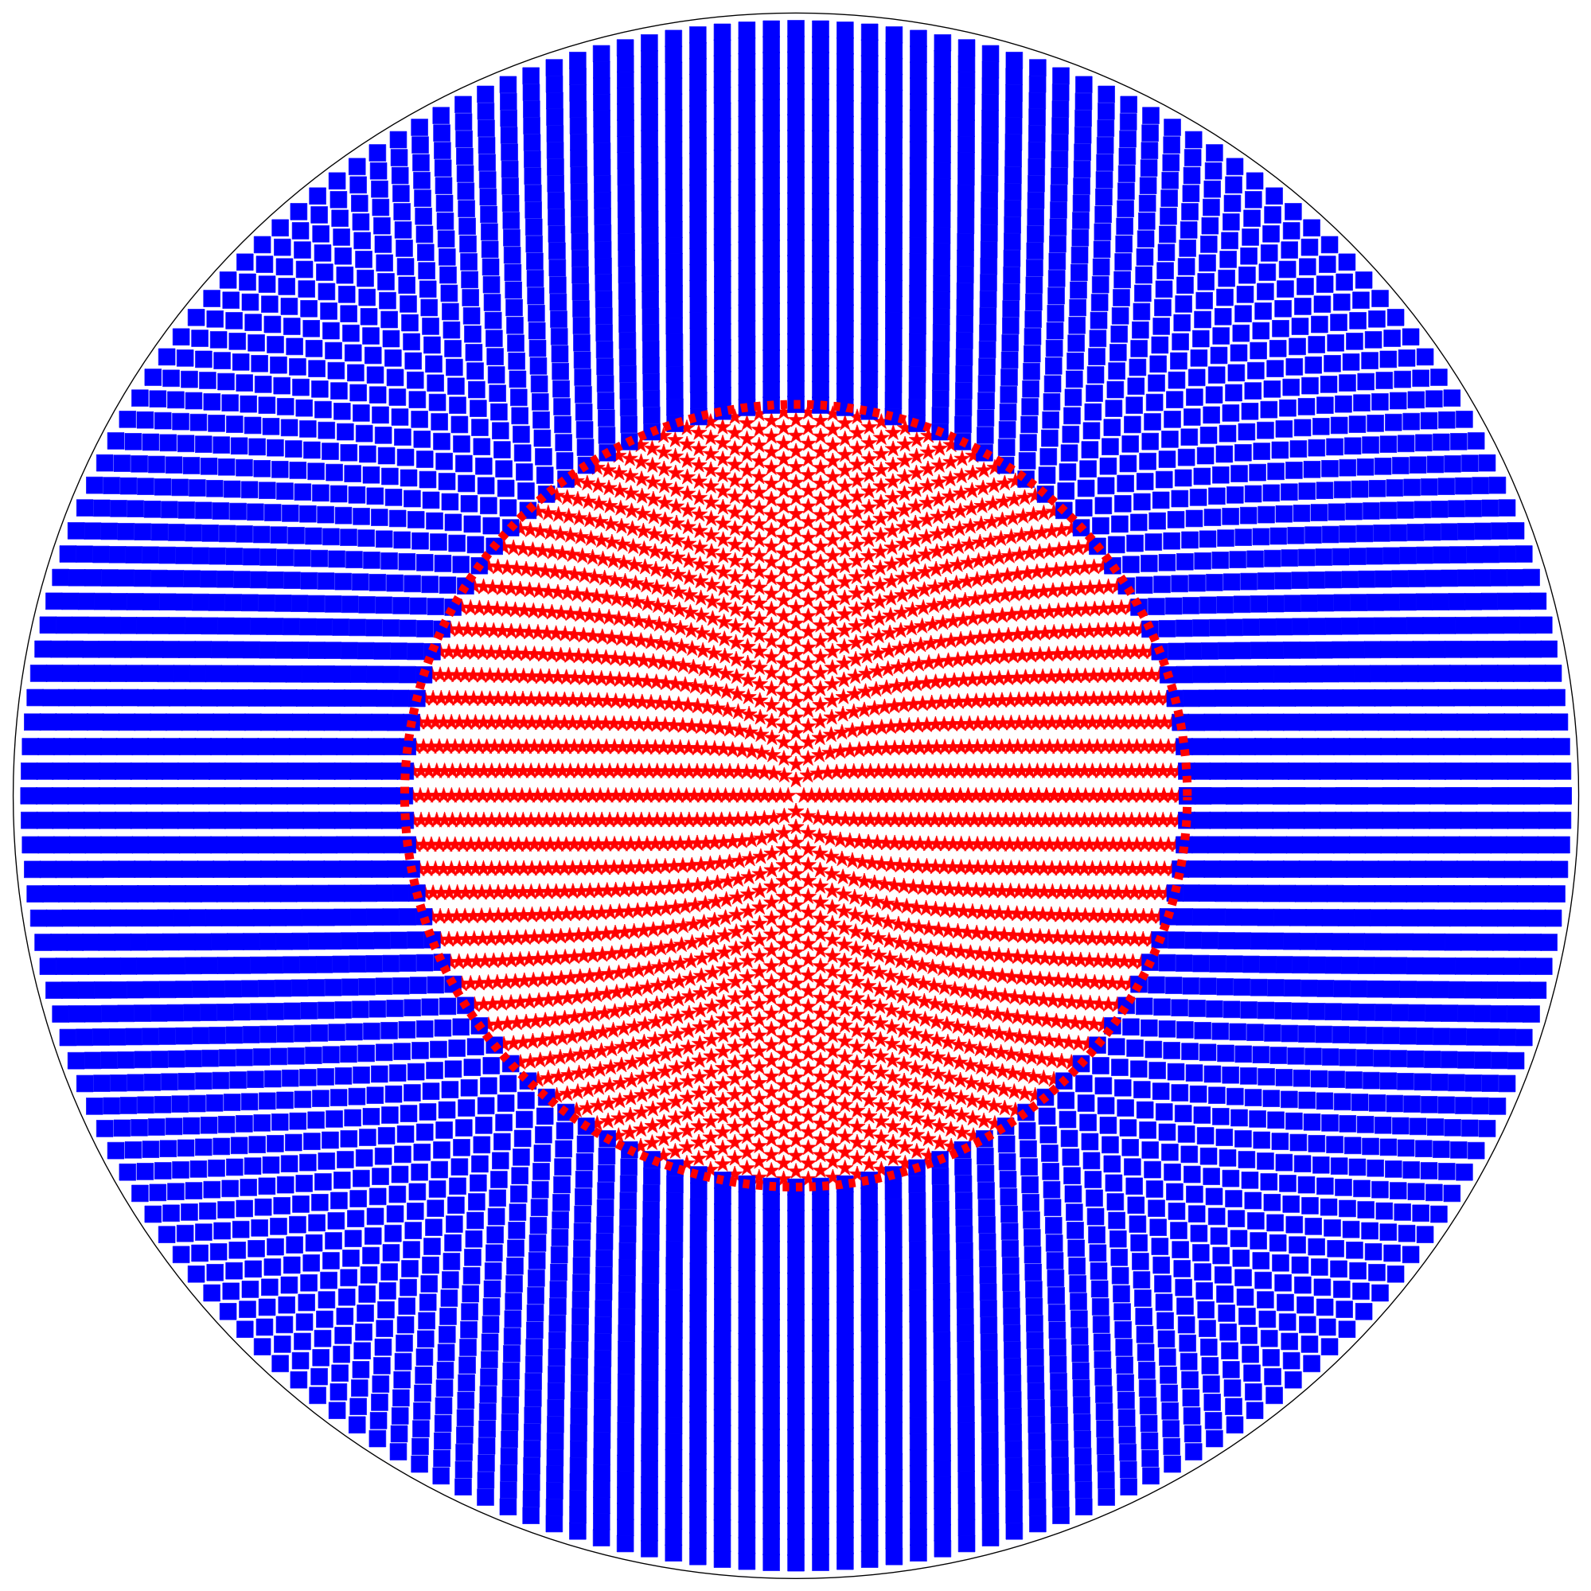
2 Constructing hybrid star: different schemes
Maxwell construction
● a clear phase boundary
● discontinuity in density and μe
● no mix phase
● Infinite surface tension
● happens when p and μB in two phases are equal

Slide 7
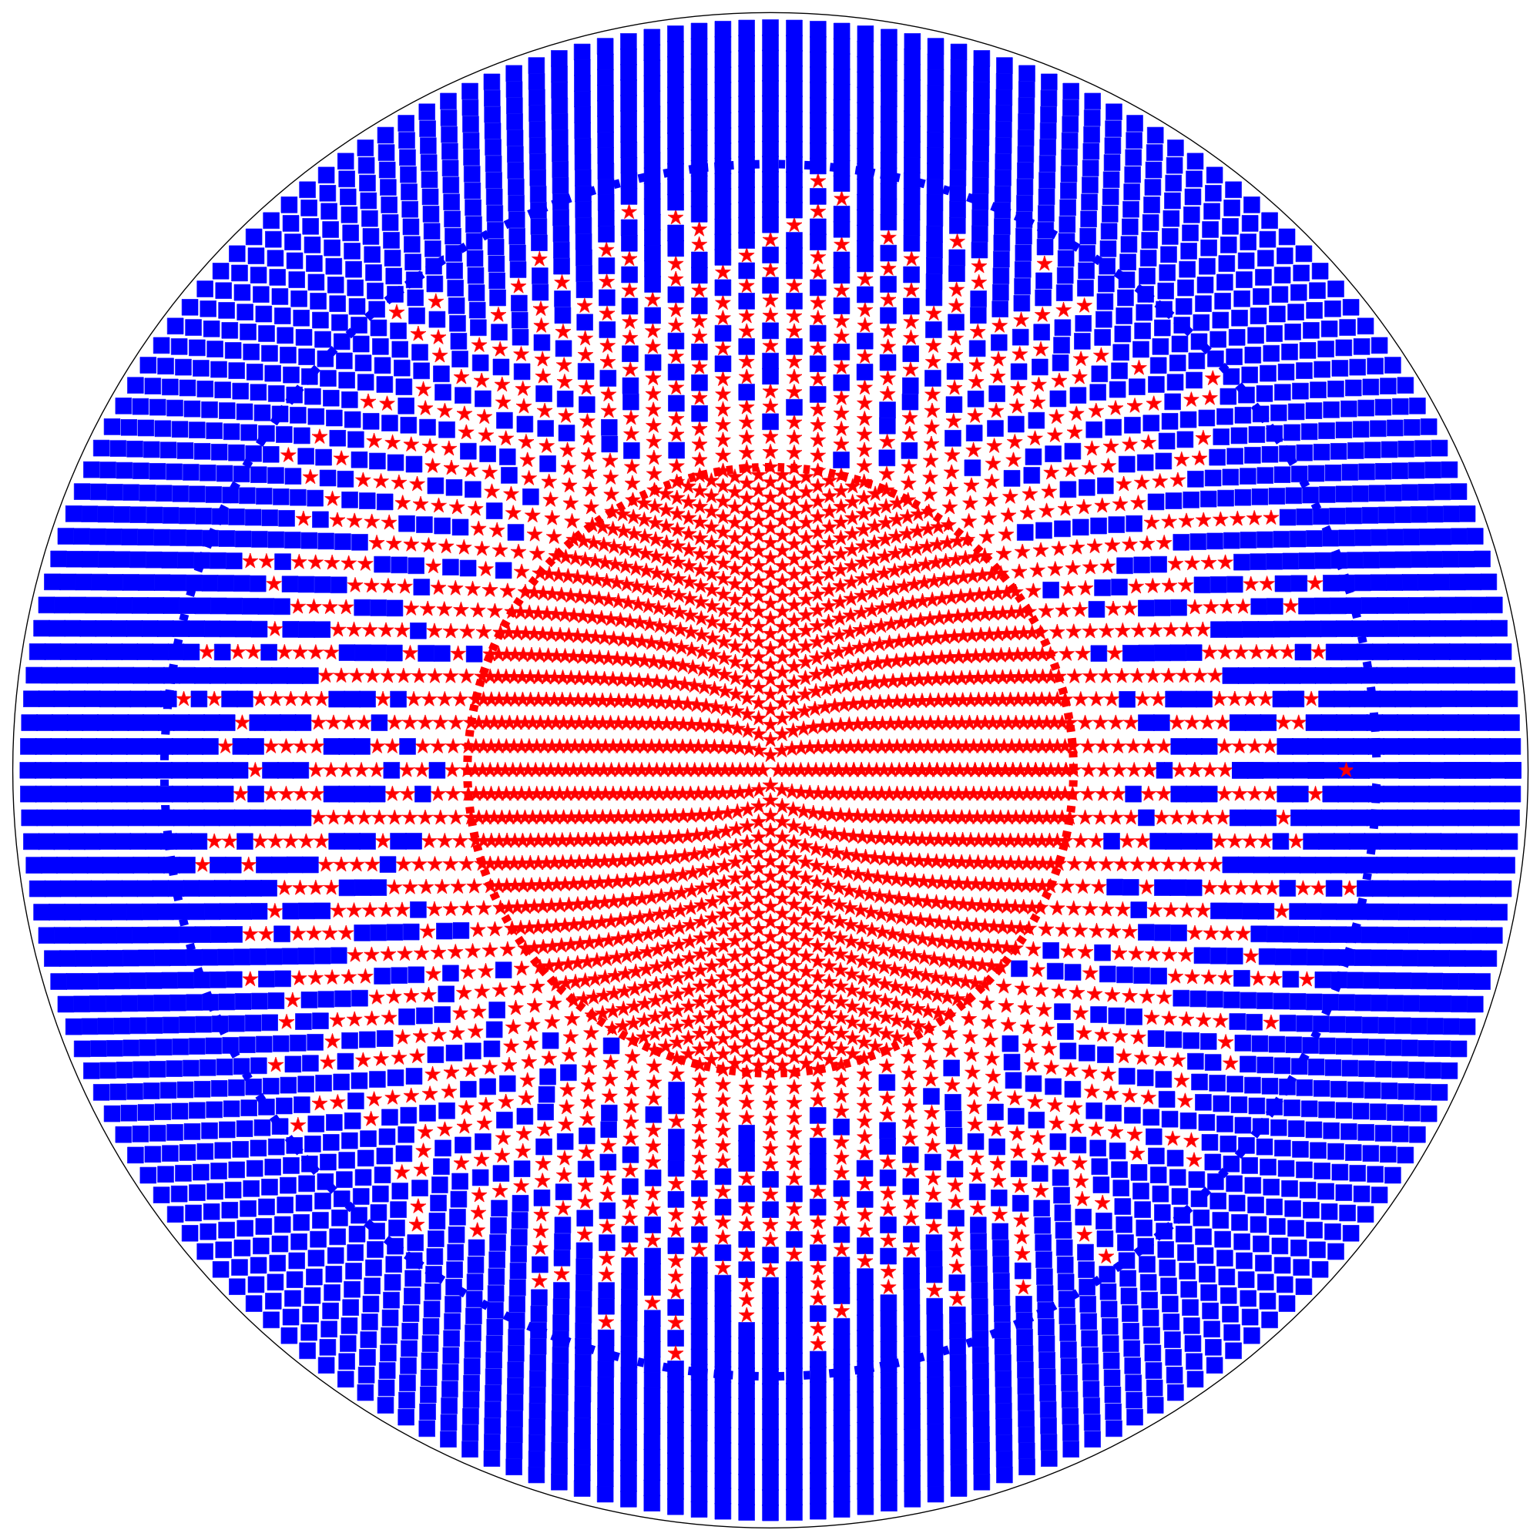
2 Constructing hybrid star: different schemes
● Hadron and quark models are inaccurate at phase transition region.
● In order to avoid this problem, 3-window construction was proposed.
Gibbs construction
● mix phase
● In mix region, quark and
hadron matter both charged but
cancel each other to be neutral globally
● phase transition occurs when
p, μB and μe are equal in two phases

Slide 8
2 Constructing hybrid star: different schemes
3-window construction
● Use interpolation to get EoS
at phase transition region.

Slide 9
2 Constructing hybrid star: different schemes
● Interpolating energy density with wight function[1]
● Interpolating pressure with polynomial function[2]
● Interpolating pressure with piecewise polynomial[3]
3-window construction
[1]K. Masuda et al, arXiv:1212.6803
[2]T. Kojo et al, arXiv:1412.1108
[3]E. Annala et al, arXiv:1711.02644

Slide 10
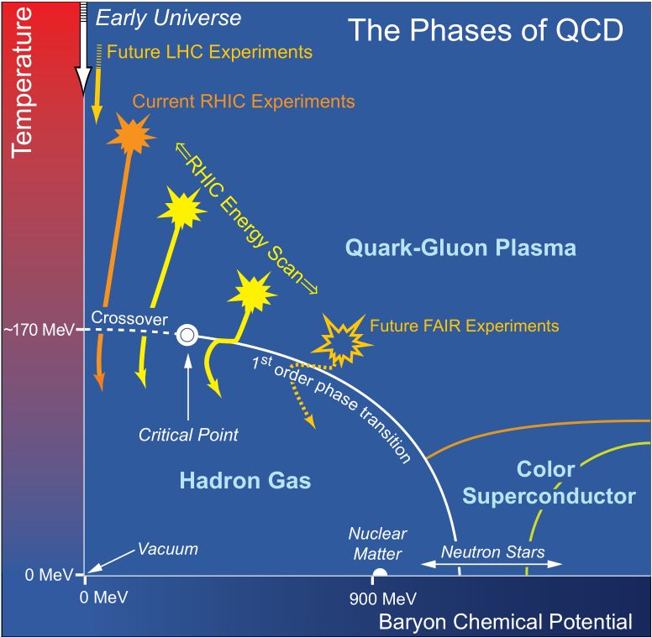
2 Constructing hybrid star: different schemes
3-window construction
● Use interpolation to get EoS
at phase transition region.
● Not explicitly include first order hadron-quark phase transition

Slide 11
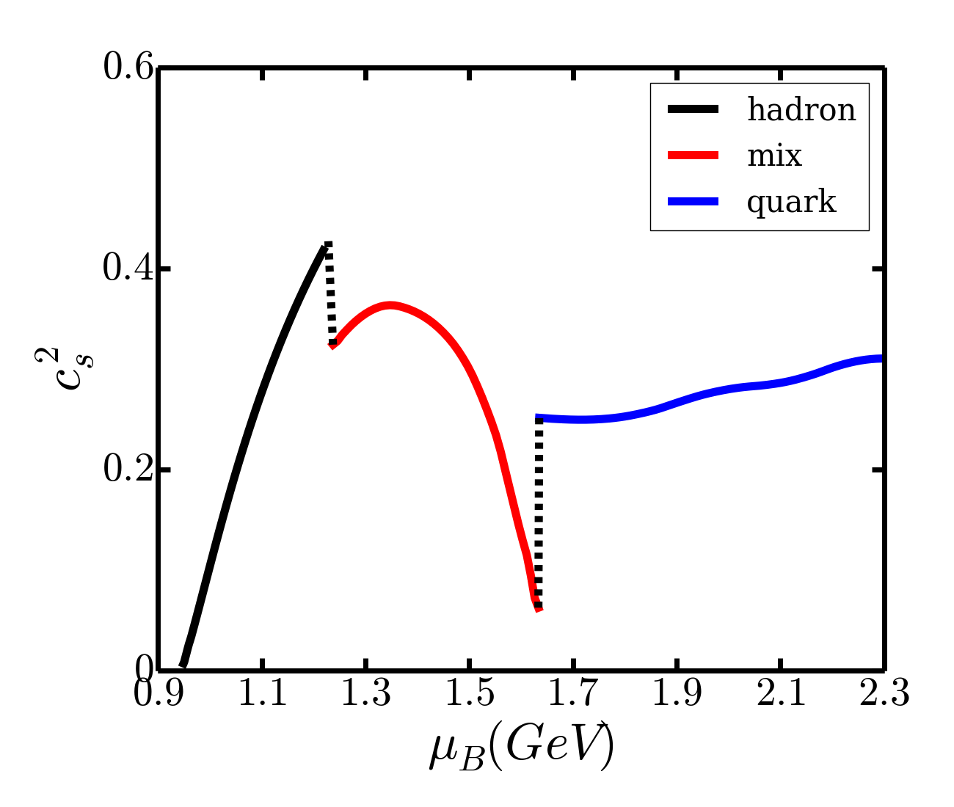
2 Constructing hybrid star: sound speed construction
●The discontinuity in the speed of sound is one of the key signature of first-order phase transition.
●For a phase transition with two chemical potentials(Gibbs construction), there are two discontinuities.
●If we have the speed of sound as a function of baryon chemical potential, we can calculate the EoS by solving differential equations.
sound speed under Gibbs constrction
Notes:
\frac{\partial n_{B}}{\partial \mu_{B}} = \frac{n_{B}}{\mu_{B}c_{s}^{2}(\mu_{B})}
\frac{\partial p}{\partial \mu_{B}} = n_{B},

Slide 12
2 Constructing hybrid star: sound speed construction
● We parameterize sound speed to interpolate the EoS.
● We use a quadratic function to describe sound speed in phase transition region.
There are five parameters for the construction: A, B and C for the quadratic function, and two chemical potentials describing the phase transition region.
Boundary Condition:
Notes:
\frac{\partial n_{B}}{\partial \mu_{B}} &= \frac{n_{B}}{\mu_{B}c_{s}^{2}(\mu_{B})}
\frac{\partial p}{\partial \mu_{B}} &= n_{B},

Slide 13
2 Constructing hybrid star: sound speed construction
● The solution of differential equation may not approach quark EoS at high density. We must introduce additional constraints:
● We can use these two constraints to fix two of the A,B and C parameter from quadratic function, and there are three free parameters left for the construction scheme.
● In practice, we choose the following three parameters: the chemical potential corresponding to the starting and ending of the phase transition, and the sound speed at the center of the phase transition region.
Notes:
\frac{\partial n_{B}}{\partial \mu_{B}} &= \frac{n_{B}}{\mu_{B}c_{s}^{2}(\mu_{B})}
\frac{\partial p}{\partial \mu_{B}} &= n_{B},

Slide 14
OUTLINE
1. Introduction and Motivation
2. Constructing Hadron-Quark Phase Transition
3. Hadron and Quark Model

Slide 15
Hadron Model: Relativistic Mean Field Theory[1]
1) Under mean field approximation, the system is assumed to be in a static and uniform ground state. The partial derivative of the meson field disappear.
2) Use Euler-Lagrange equation to get field equation.
3) The equation of state can be calculated from lagrangian.
[1] S. Typel and H. H. Wolter, Nucl. Phys. A, 656, 331-364 (1999)

Slide 16
Quark Model: Dyson-Schwinger Equation
● We have the lagrangian and action for QCD:
The lagrangian includes quark, gluon and ghost fields.
● The generating functional is a functional integral of action:
Notes:
S_{\textrm{E}}=\int\d^{4}x(\mathcal{L}_{0}+\mathcal{L}_{1})
\mathcal{L}_{0}=\sum_{f=1}^{N_{f}}\bar{q}^{f}(\gamma_{\mu}D_{\mu}+m_{0}^{f})q^{f}+\frac{1}{4}F_{\mu\nu}^{a}F_{\mu\nu}^{a},
\mathcal{L}_{1}=-\frac{1}{2\xi_{0}}(\partial_{\mu}A_{\mu}^{a})^{2}+\partial_{\mu}\bar{\omega}_{a}(x)(\delta^{ab}\partial_{\mu}-g_{0}f^{abc}A_{\mu}^{c}(x))\omega^{c}(x).
Z[\eta,\bar{\eta},J,\sigma,\bar{\sigma}]=\int\mathcal{D}[q,\bar{q},A_{\mu},\omega,\bar{\omega}]\exp[-S_{\textrm{E}}+S_{\textrm{C}}],

Slide 17
Quark Model: Dyson-Schwinger Equation
● Just like standard calculus, the functional integral of a total functional derivative is zero,
given appropriate boundary conditions:
● Choosing different field to differentiate with, and after some mathematical efforts, we can get the equations for quarks, gluons and so on. These equations are called Dyson-Schwinger equations (DSEs).
● The DSE corresponds to the Euler-Lagrange equation in standard calculus.
● The DSE is a set of infinite coupled equations. In order to solve the quark equation, we usually assume the form for gluons and interactions, so that we can cut off the infinite tower of DSEs.

Slide 18
Quark Model: Dyson-Schwinger Equation[1]
[1]H. Chen et al, Phys. Rev. D, 84, 105023(2013)
DSE for quarks
Gluon:
Assumption
for
interaction
Notes:
对于袋常数，我们取 “steepest-descent” 近似（最速下降）
P[S] = Tr log(S^{-1})-\frac{1}{2}Tr[\Sigma S]
B = P[S_N]-P[S_W]
n_q(\mu)=6\int\frac{d^3p}{(2\pi)^3}f_q(|\vec{p}|;\mu)
f_q(|\vec{p}|;\mu)=\frac{1}{4\pi}\int dp_4 \textrm{tr}_{\textrm{D}}\left[-\gamma_4S_q(p;\mu)\right]
P_q(\mu_q)=\int_{\mu_{q,0}}^{\mu_q}d\mu n_q(\mu)
P_Q(\mu_u,\mu_d,\mu_s)=\sum_{q=u,d,s}P_q(\mu_q)-\mathcal{B}

Slide 19
Quark Model: Dyson-Schwinger Equation[1]
equation of state
[1]H. Chen et al, Phys. Rev. D, 84, 105023(2013)
DSE for quarks
Gluon:
Assumption
for
interaction
DSE for quarks
Notes:
对于袋常数，我们取 “steepest-descent” 近似（最速下降）
P[S] = Tr log(S^{-1})-\frac{1}{2}Tr[\Sigma S]
B = P[S_N]-P[S_W]
n_q(\mu)=6\int\frac{d^3p}{(2\pi)^3}f_q(|\vec{p}|;\mu)
f_q(|\vec{p}|;\mu)=\frac{1}{4\pi}\int dp_4 \textrm{tr}_{\textrm{D}}\left[-\gamma_4S_q(p;\mu)\right]
P_q(\mu_q)=\int_{\mu_{q,0}}^{\mu_q}d\mu n_q(\mu)
P_Q(\mu_u,\mu_d,\mu_s)=\sum_{q=u,d,s}P_q(\mu_q)-\mathcal{B}

Slide 20
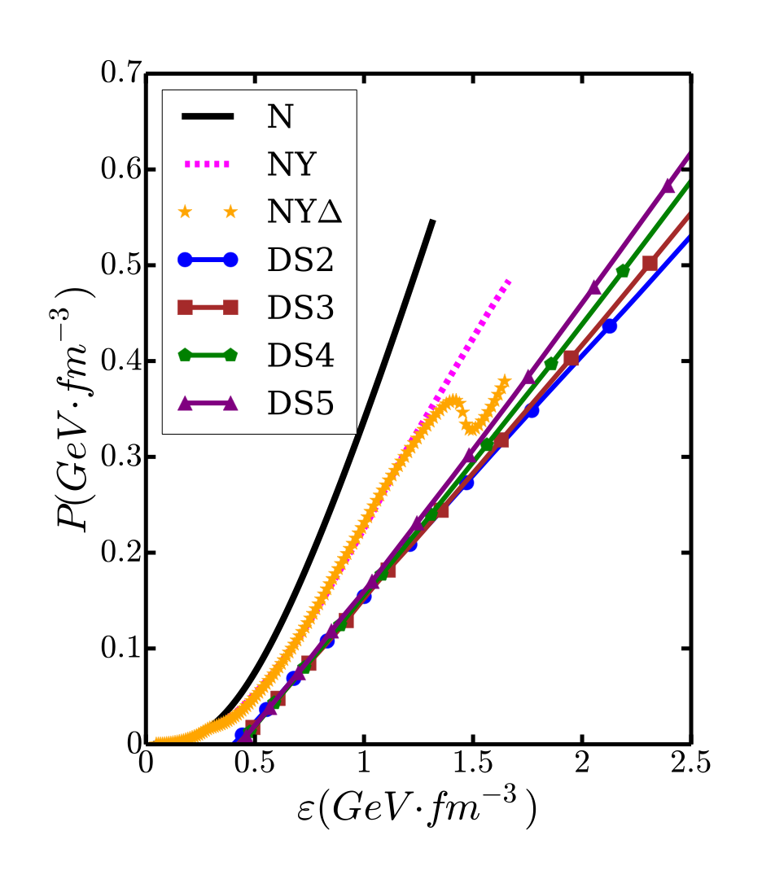
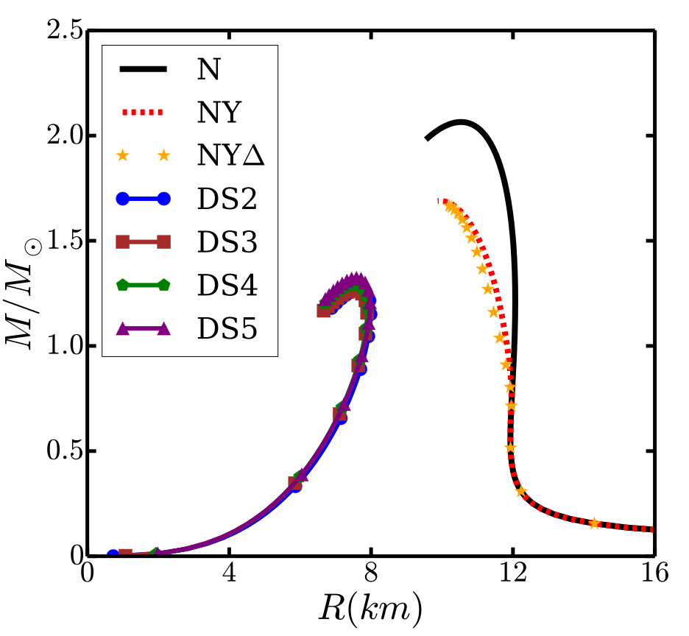
Hadron and Quark Model: EoS and Mass-Radius
●We plot the EoS and mass-radius relation calculated using hadron and quark model separately[1]. The maximum mass for neutron star with hyperon and quark star is less than 2-solar-mass. This means we must consider the phase transition.
[1]Z. Bai, H. Chen and Y. X. Liu, Phys. Rev. D, 97, 023018 (2018)

Slide 21
OUTLINE
1. Introduction and Motivation
2. Constructing Hadron-Quark Phase Transition
3. Hadron and Quark Model
4. Numerical Results

Slide 22
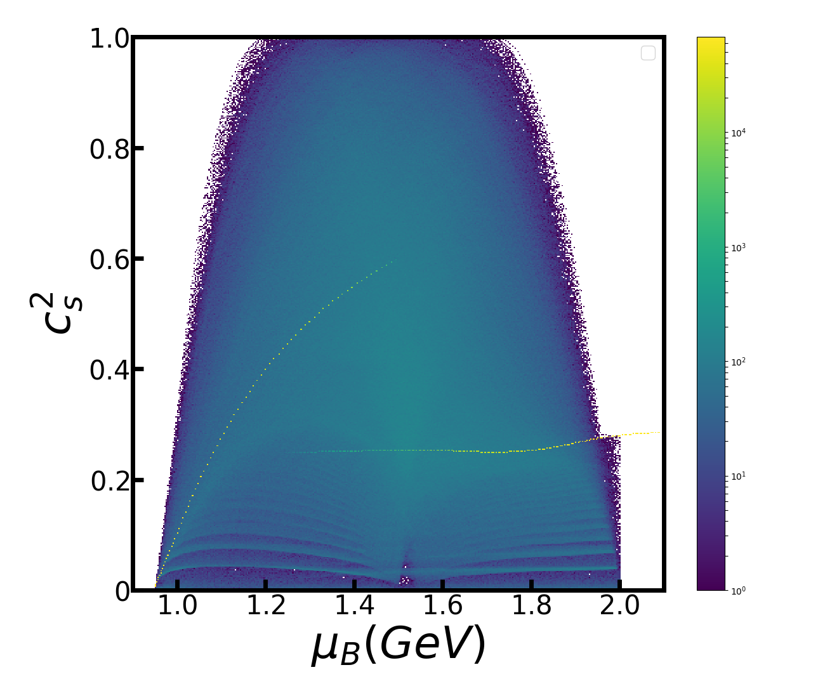
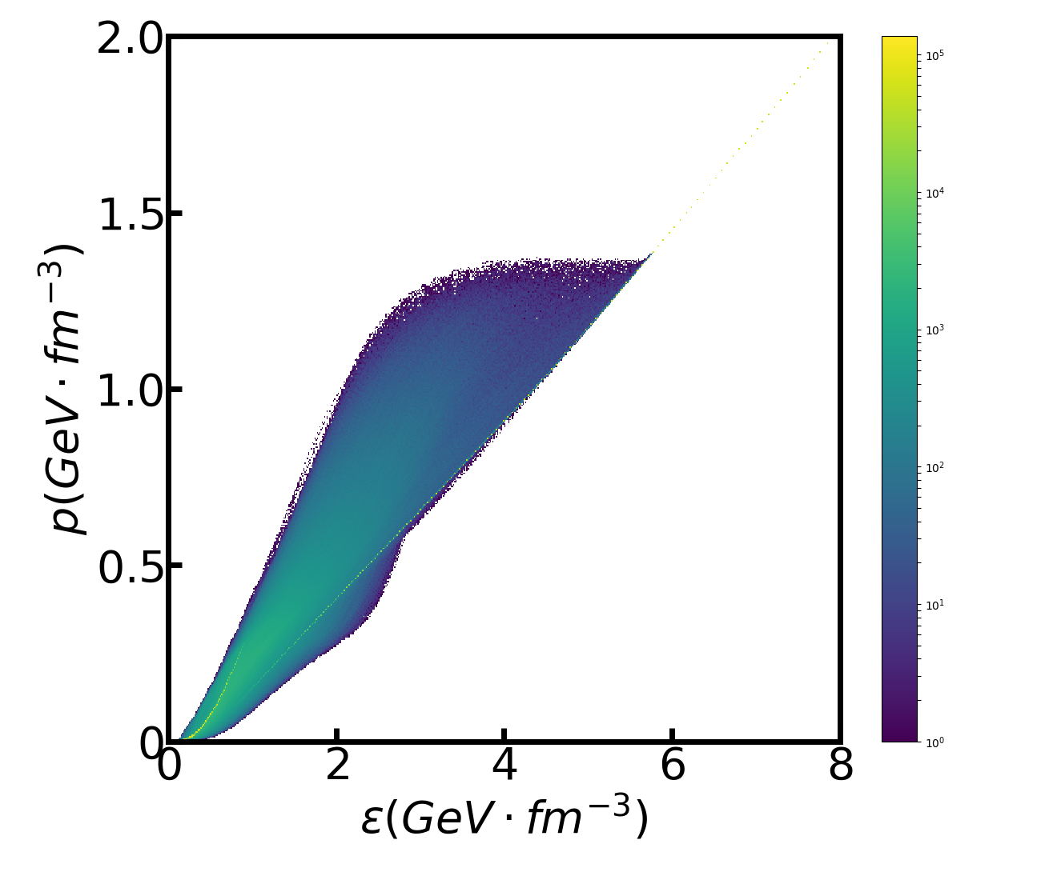
4. Numerical Results
● We use RMF for hadron, DSE for quark, and sound speed construction for phase transition.
● For RMF, we include only p and n. For DSE, we take α=2.
● Using different parameters, we construct about 200000 EoS. All the parameters are
uniformly distributed in their range.

Slide 23
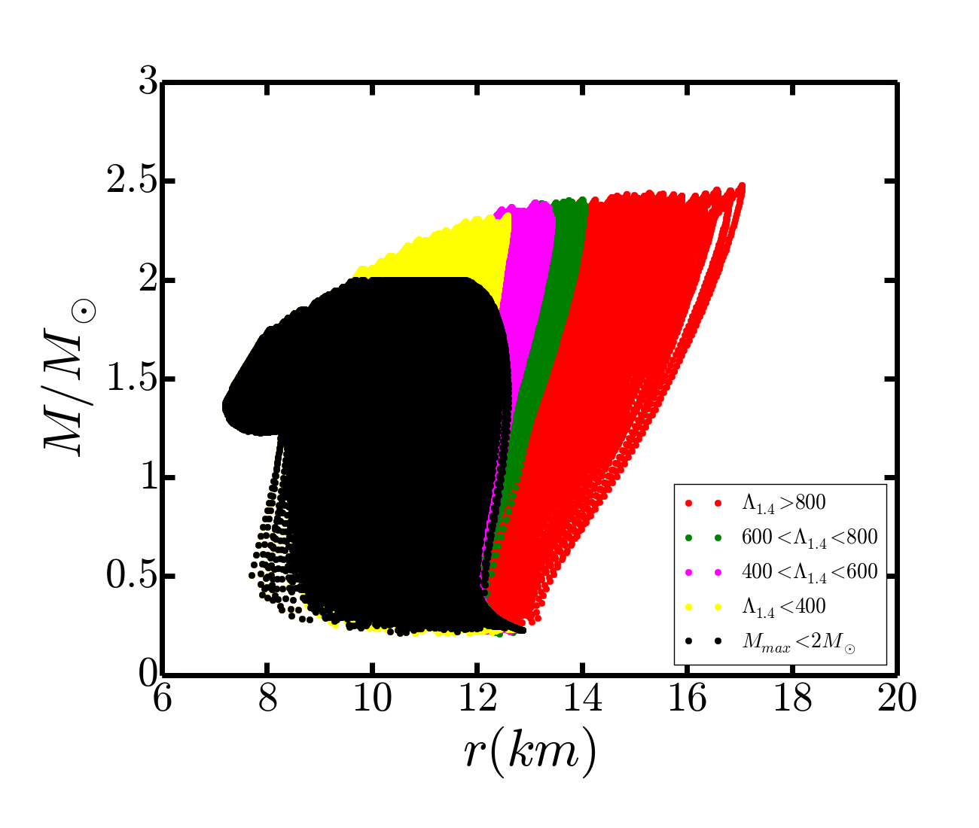
4. Numerical Results: Mass-Radius
● For every EoS, we can plot the mass-radius relation for hybrid stars.
The Maximum mass of our construction is:
For a 1.4-solar-mass hybrid star, the range of radius and tidal deformability are:
(Notice these ranges are not our prediction. On the contrary, we are going to tighten these ranges in order to constrain our parameters.)

Slide 24
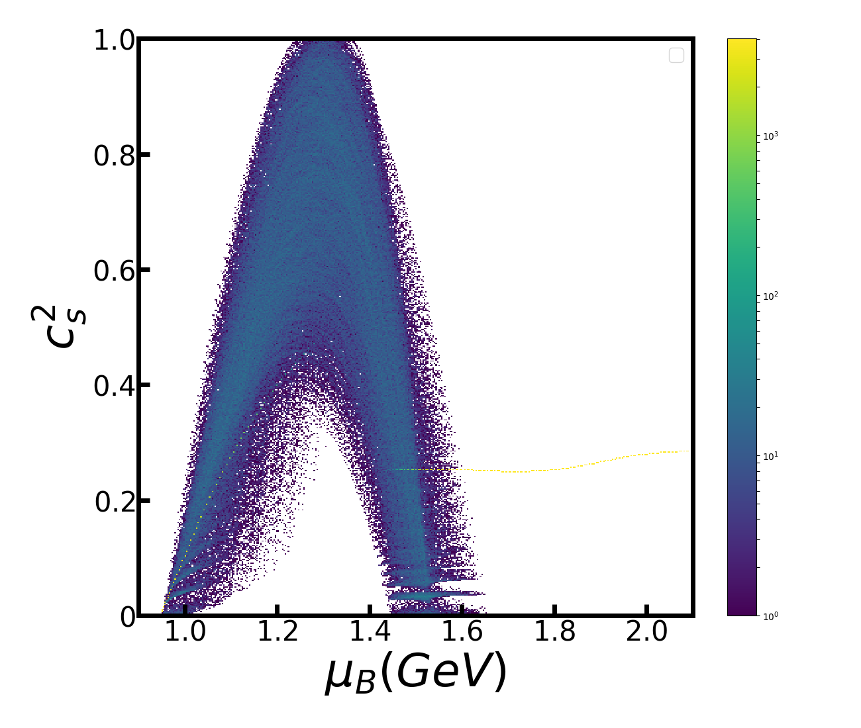
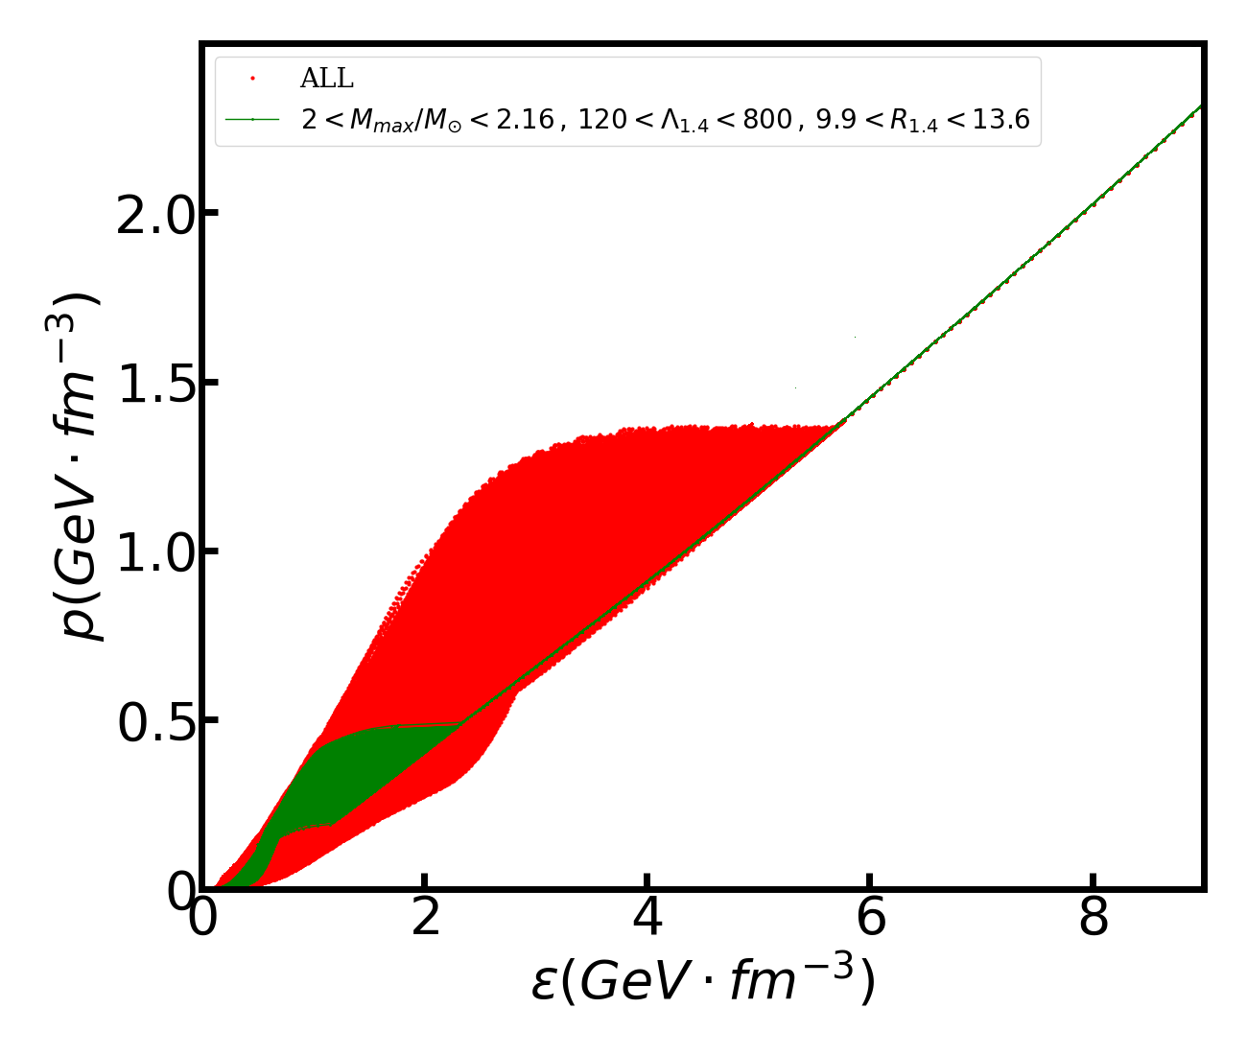
4. Numerical Results
[1]B. Margalit and B. Metzger, Astrophys. J. 850, L19 (2017)
[2]E. Annala et al, Phys. Rev. Lett., 120, 172703 (2018)
● We use the following constraints to exclude most of the constructed sound speed and EoS .
[1]
[2]
[2]
● The remaining sound speed and EoS are plotted as follow.
Notes:
2<\frac{M_{\textrm{max}}}{M_{\odot}}<2.16
120<\Lambda_{1.4}<800

Slide 25
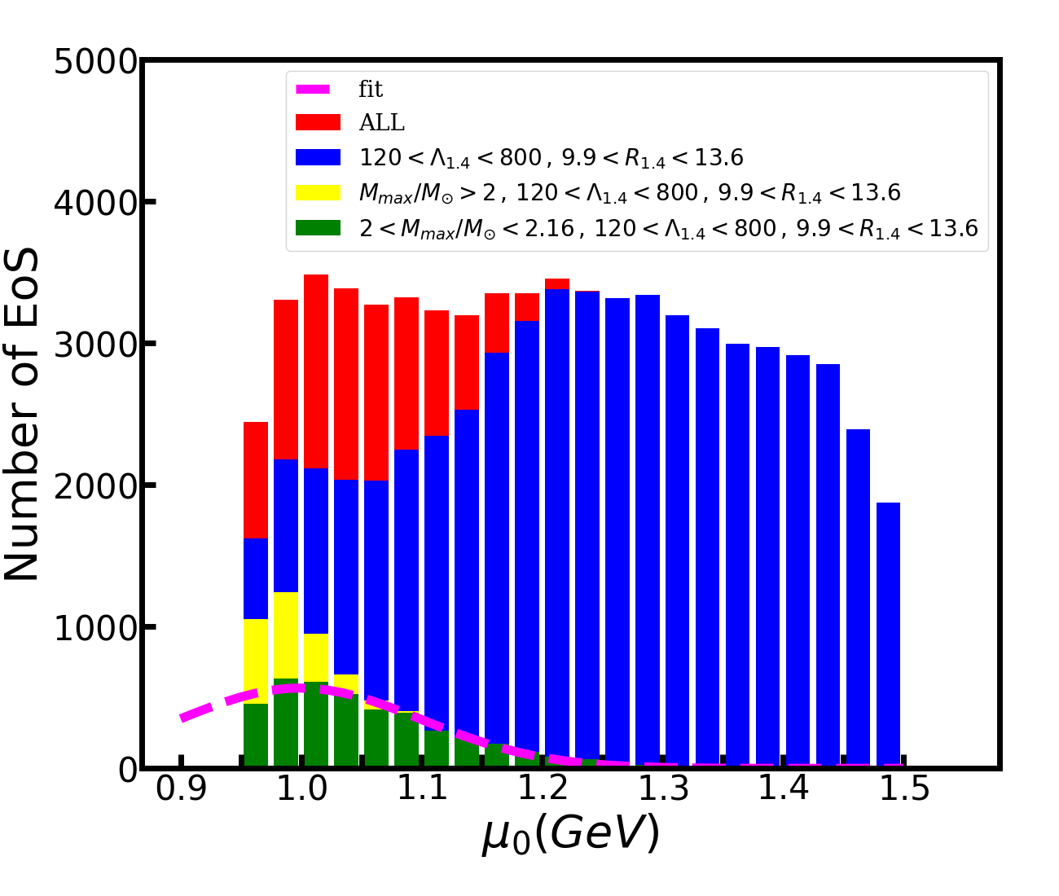
4. Numerical Results: PT chemical potential
● Next, we see how the astronomical observation can restrict our parameters.
● In this figure we plot the number of EoS with μ0 taking different values, where μ0 is the chemical potential corresponding to the starting of phase transition.
● The constraints on tidal deformability and radius do not change the range of μ0
● An lower boundary of maximum mass sets the upper limit of μ0
● The lower limit of μ0 cannot be determined by astronomical quantities.

Slide 26
4. Numerical Results: PT chemical potential
● The upper limit of μ0 is 1.34 GeV, which corresponds to a baryon number density of 4.26ns, where ns is the saturation density.
● Since all of our parameter are uniformly distributed in the beginning, after constrained by astronomical quantities, the number of EoS can be explained as distribution. We use a Gaussian distribution to fit the green bars, and the result is plotted as the pink dashed line.
● The center value of fitting function is .
which corresponds to 1.50ns.

Slide 27
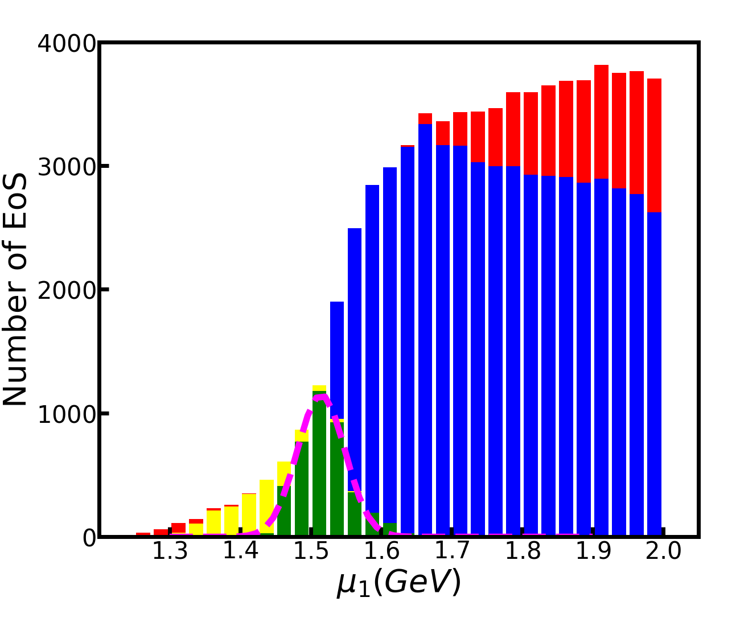
4. Numerical Results: PT chemical potential
● Next, we look through the chemical potential corresponding to the end of phase transition.
● The range of μ1 does not change much when applying the tidal deformability and radius constraints.
● The lower boundary of maximum mass sets the upper and lower limit of μ1.
● The upper boundary of maximum mass further sets the lower limit of μ1.

Slide 28
4. Numerical Results: PT chemical potential
● The range of μ1 is:
and the corresponding range in baryon number density is:
● By fitting the green bars, we have the center value of the fitting function:
and the corresponding baryon number density is 7.90ns.

Slide 29
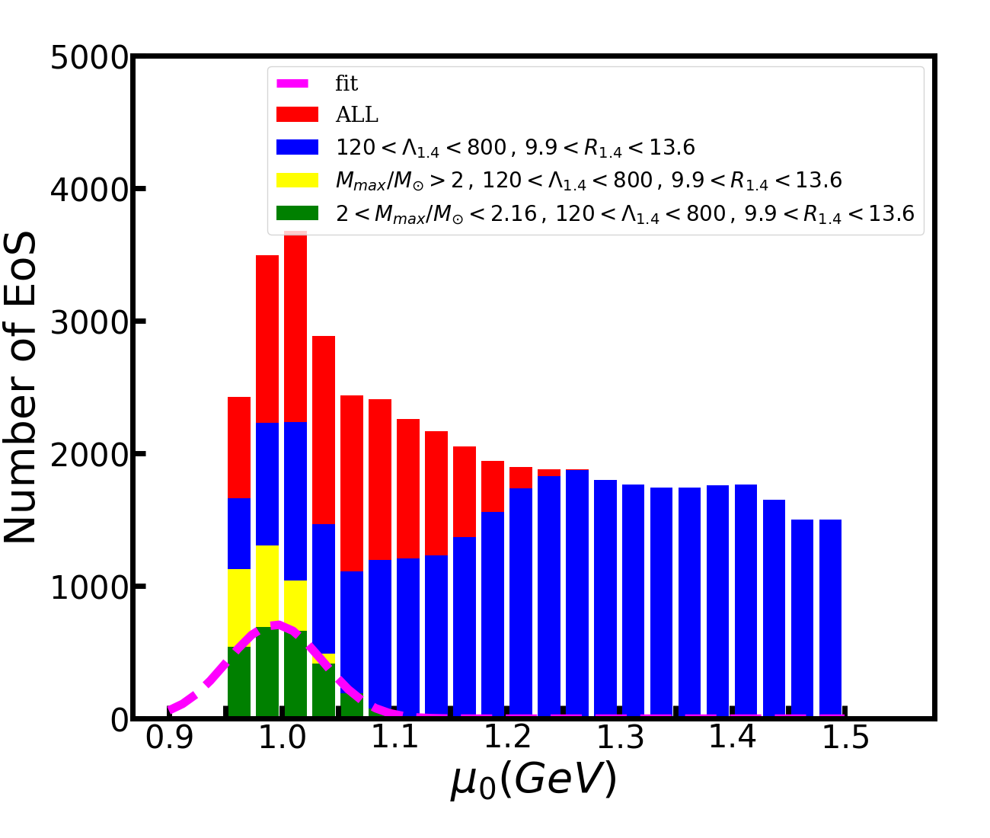
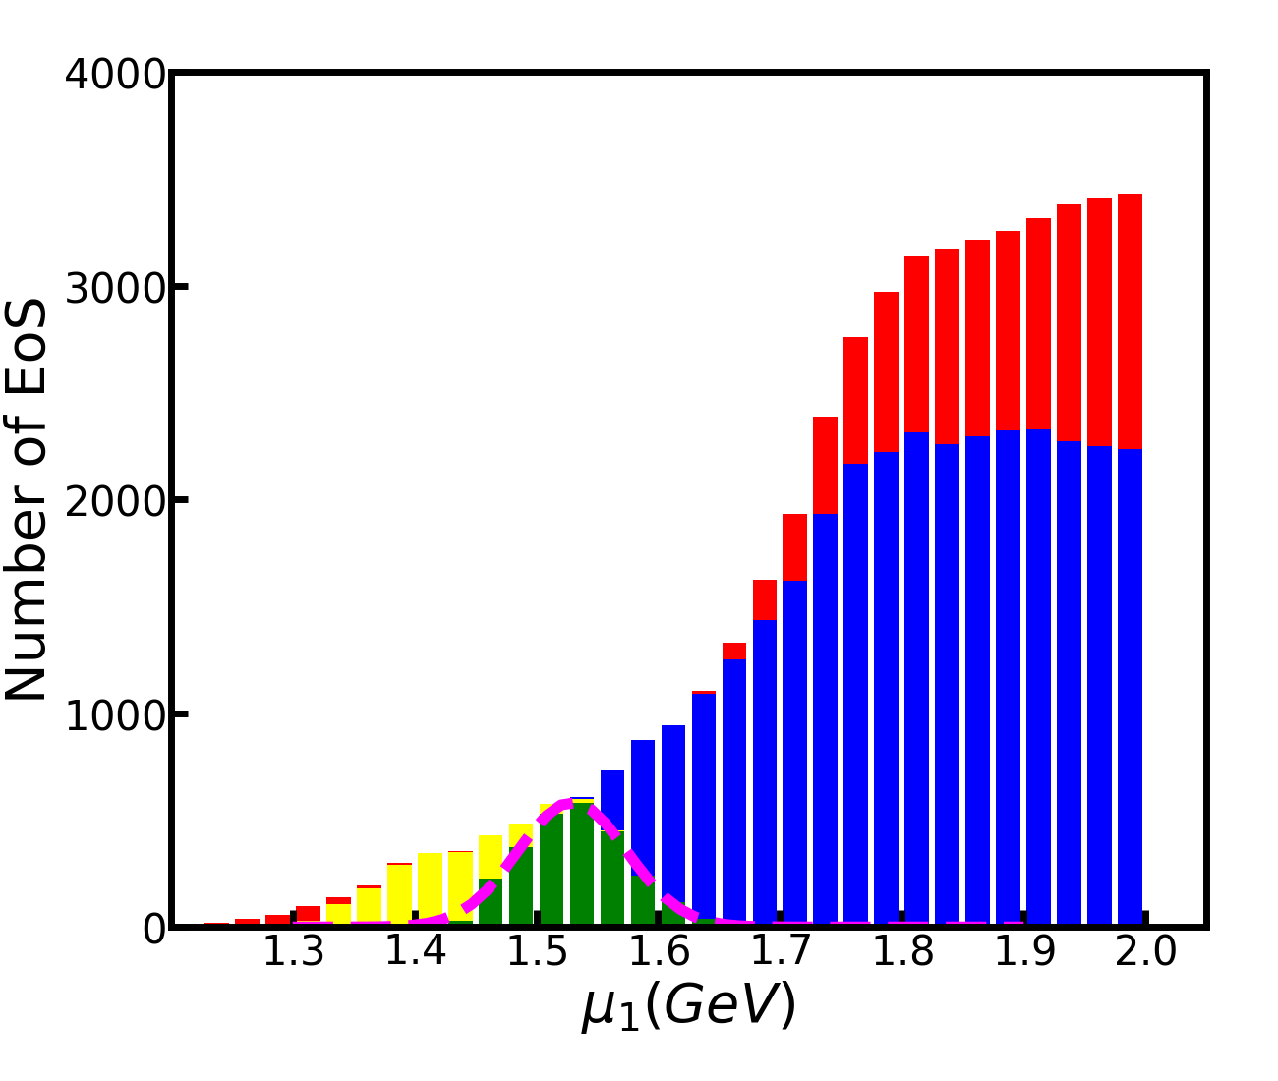
4. Numerical Results: inclusion of hyperon
● Now we see the effect of hyperon. Applying the same constraints, we have:

Slide 30
4. Numerical Results: inclusion of hyperon
● The inclusion of hyperon greatly reduces the upper limit of μ0.
● The range of μ1 is slightly larger after including hyperon.

Slide 31
4. Numerical Results: various constraint conditions
● The upper limit of maximum mass sets the lower limit of μ1.
● The lower limit of tidal deformability greatly changes the upper limit of μ1.
When hyperon is included, it also changes the upper limit of μ0.
● A smaller range of radius slightly changes the upper limit of μ1.
Astronomical Observation |  |  | Parameter Restriction
Mmax | Λ1.4 | R1.4 |  | μ0max | n0max | μ1min | μ1max | n1min | n1max
2-2.16 | 120-800 | 9.9-13.6 | Nq | 1.34 | 4.26 | 1.44 | 1.66 | 6.41 | 11.27
 |  |  | NYq | 1.12 | 3.15 | 1.42 | 1.67 | 6.07 | 11.64
2-2.35 | 120-800 | 9.9-13.6 | Nq | 1.34 | 4.26 | 1.31 | 1.66 | 4.58 | 11.27
 |  |  | NYq | 1.12 | 3.15 | 1.31 | 1.67 | 4.57 | 11.64
2-2.16 | 344-800 | 9.9-13.6 | Nq | 1.34 | 4.26 | 1.44 | 1.56 | 6.41 | 8.93
 |  |  | NYq | 1.04 | 2.15 | 1.42 | 1.57 | 6.07 | 9.05
2-2.16 | 120-800 | 10.62-12.83 | Nq | 1.34 | 4.26 | 1.44 | 1.62 | 6.41 | 10.38
 |  |  | NYq | 1.12 | 3.15 | 1.43 | 1.62 | 6.28 | 10.47
2-2.16 | 344-580 | 10.62-12.83 | Nq | 1.34 | 4.26 | 1.44 | 1.56 | 6.49 | 8.93
 |  |  | NYq | 1.04 | 2.15 | 1.44 | 1.57 | 6.48 | 9.05

Slide 32
Thank You!
5. Summary
● We use the sound speed interpolation to construct the EoS of hybrid star.
The sound speed interpolation can consider the first-order phase transition while avoiding using hadron and quark model in the phase transition region where they are unreliable.
● For hadron matter, we use relativistic mean field theory. For quark matter, we use the Dyson-Schwinger equation approach.
● We construct the EoS with different parameters, and use astronomical observables(mass, radius and tidal deformability of neutron star) to constrain the range of parameters.
● With the most strict constraints, the range of the phase transition region is:
without hyperon,
with hyperon.
● The upper bounds of maximum mass and lower bounds of tidal deformability are very important in constraining the parameters. The range of radius also has some effects on the width of the phase transition region.

