Slide 1
R-mode instability in compact stars
Xia Zhou（周霞）
Xinjiang Astronomical Observatory, CAS

Slide 2
Outline
Why are we interested in R-mode
What we did
Summary

Slide 3
Way R-modes could be interesting
R-modes instability can produce Gravitational waves
direct way to probe the interior/structure of compact stars
Notes:
Why are we interested in this

Slide 4
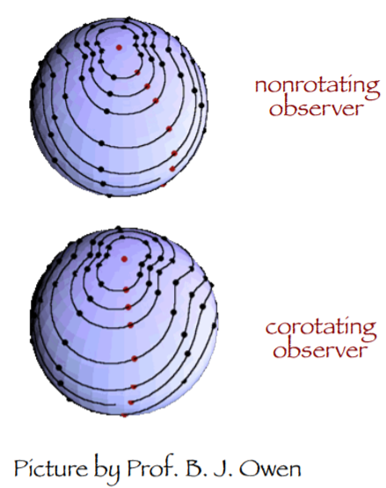
R-mode oscillation
R-modes in a rotating perfect fluid compact star arise due to the action of the Coriolis force with positive feedback
succumbing to gravitational radiation driven by CFS mechanism
  (Chandrasekhar-Friedman-Schutz )
Notes:
R-modes in a rotating perfect fluid compact star arise due to the action of the Coriolis force with positive feedback
succumbing to gravitational radiation driven by Chandrasekhar-Friedman-Schutz instability

Slide 5
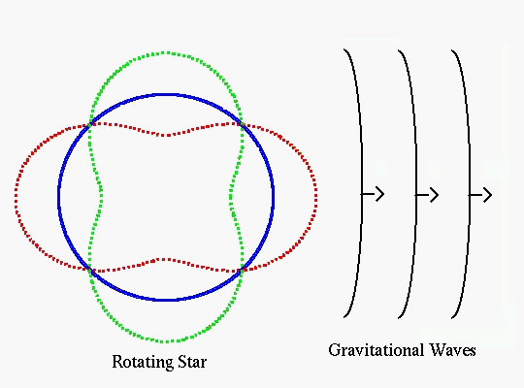
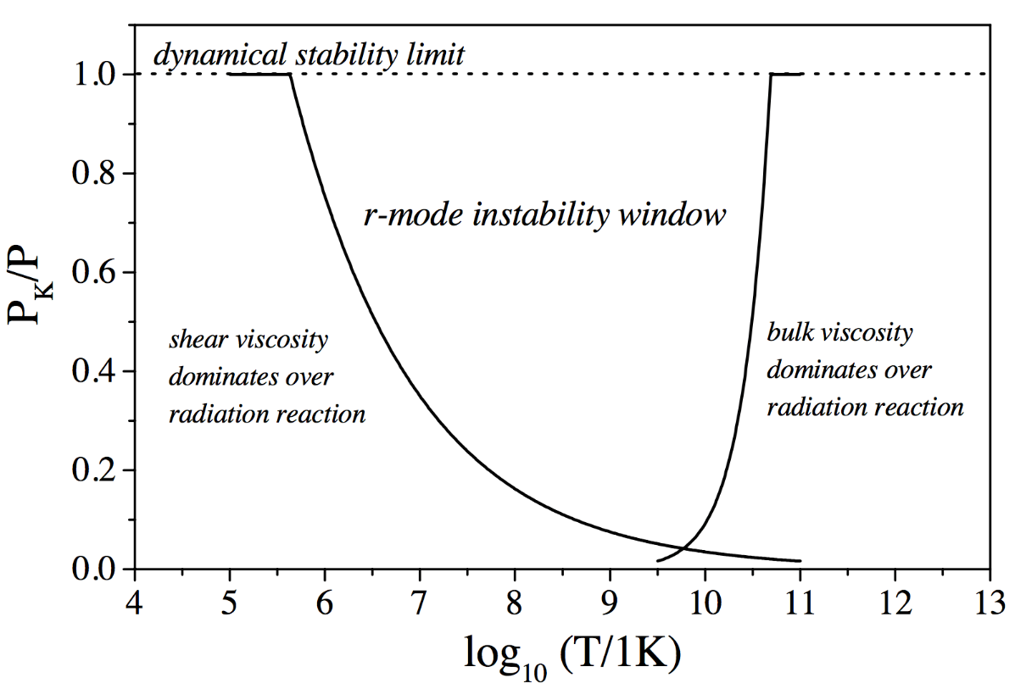
R-mode instability
GR tends to drive all rotating stars unstable!
Internal dissipations in the star can suppress the instability
N. Andersson & K.D.Kokkotas, IJMPD, 2001
K.D.Kokkotas & K. Schweizer, EPJA, 2016

Slide 6
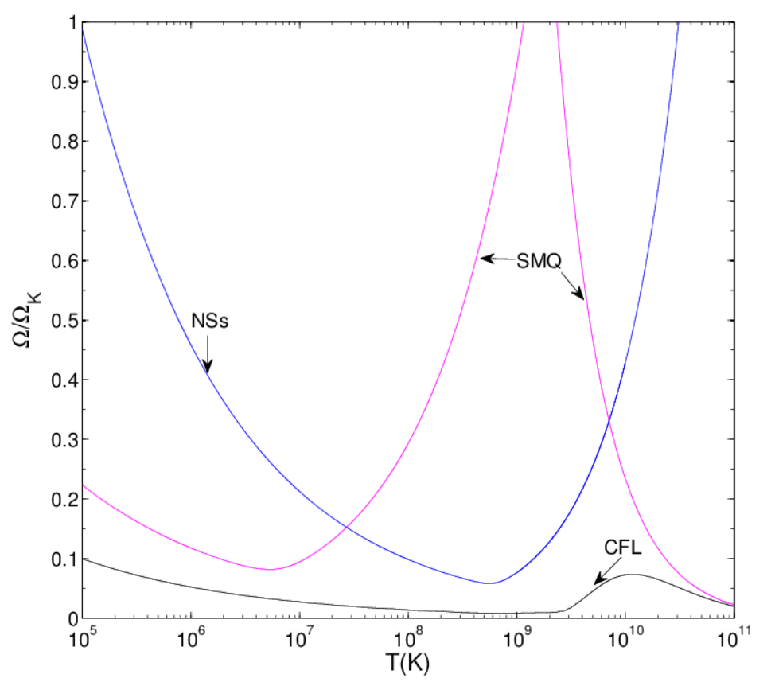
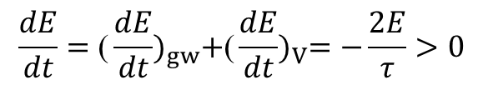
R-mode instability window
competition between the destabilizing effect of GR and the damping effect of viscosity
$$\frac{dE}{dt}={\text{(}\frac{dE}{dt})}_{gw}+{\text{(}\frac{dE}{dt})}_{V}=−\frac{2E}{τ}>0$$
N. Andersson & K.D.Kokkotas, IJMPD, 2001
Exemplary instability windows of NS, SS

Slide 7
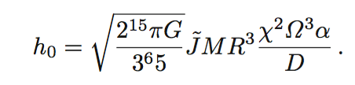
R-mode gravitational wave scenarios
gravitational wave strain amplitude
newly formed compact stars and young sources
sources in LMXBs and millisecond pulsars
Exemplary r-mode gravitational wave emission scenarios
Kokkotas & Schwenzer 2016
Notes:
The r-mode emission from compact sources is significantly more diverse than the emission due to ellipticity since it strongly depends on the evolution of a source and thereby on its age and its internal composition
there are four classes of sources in which r-modes could be unstable, namely,

Slide 8


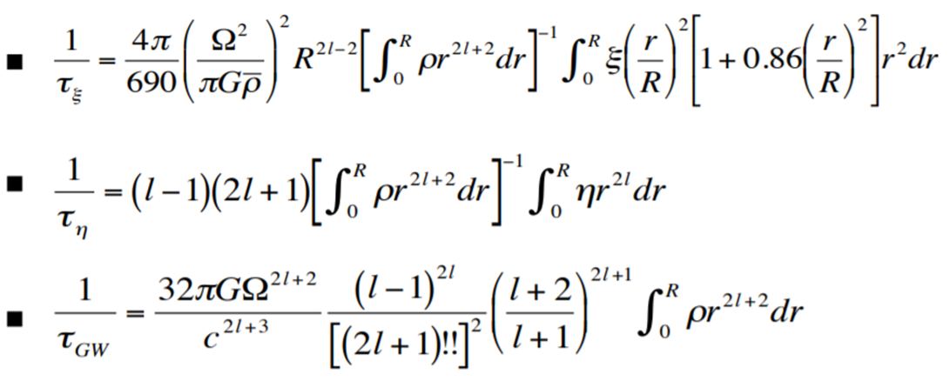
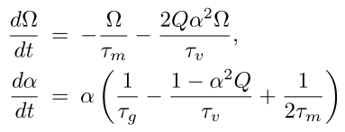
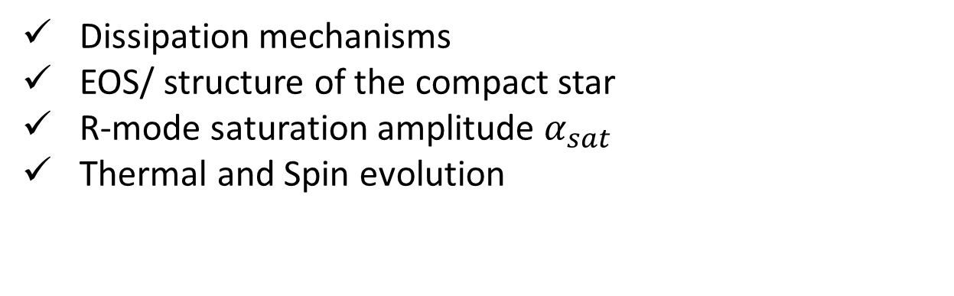
R-mode instability and GW emission
Dissipation mechanisms
EOS/ structure of the compact star
R-mode saturation amplitude $α_{sat}$
Thermal and Spin evolution

Slide 9
1. Magnetic damping mechanism
Cao et al.,2015,Sci China-Phys Mech Astron
Notes:
Transient gw

Slide 10
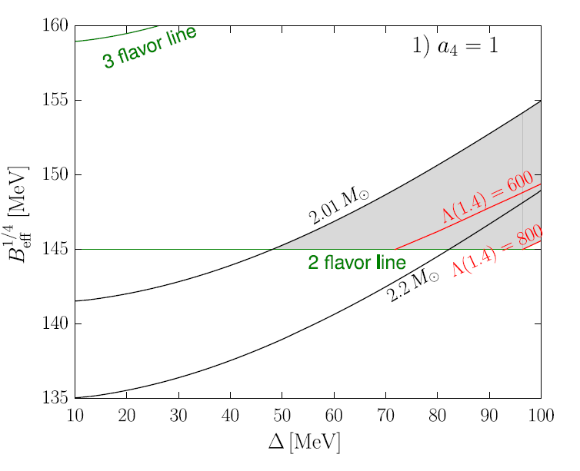
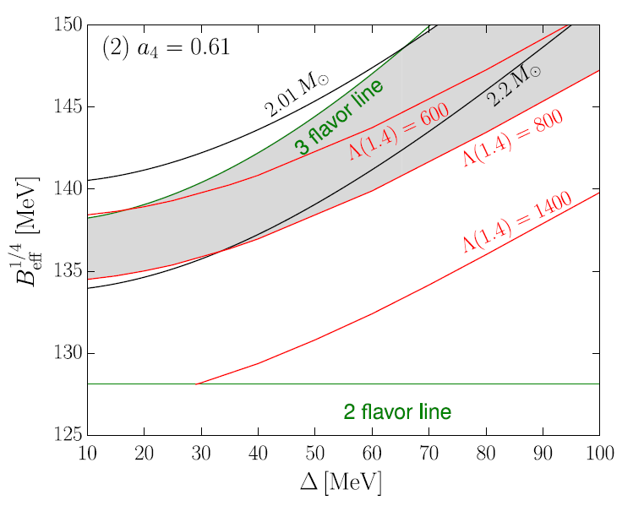
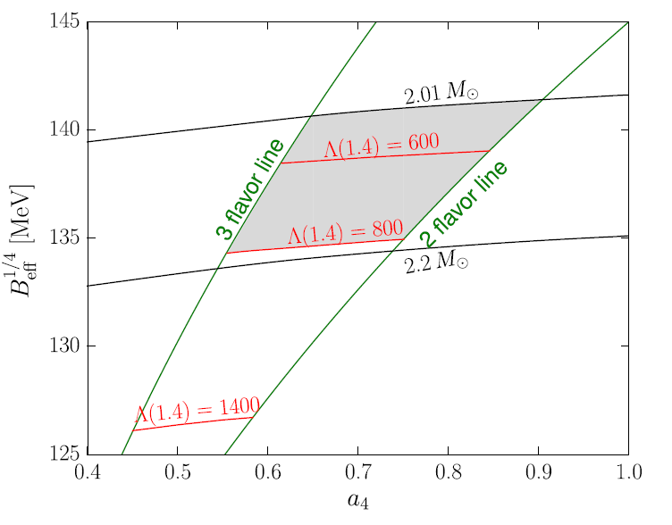
2. R-mode instability window of strange stars
R-mode instability windows of strange stars with unpaired and color-flavor-locked phase strange quark matter, shear viscosities due to the exist of the crust are considered.
Considering the constraints on interquark interaction parameters with GW170817 and two-solar-mass pulsar observations(Zhou et al. 2018, PRD)
Small mass pulsar like compact objects(Zhou et al., 2017, MNRAS)
Zhou et al. 2018, PRD

Slide 11
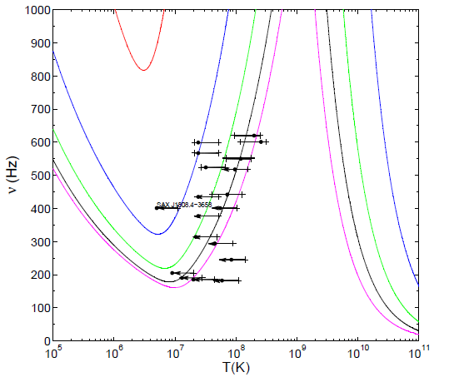
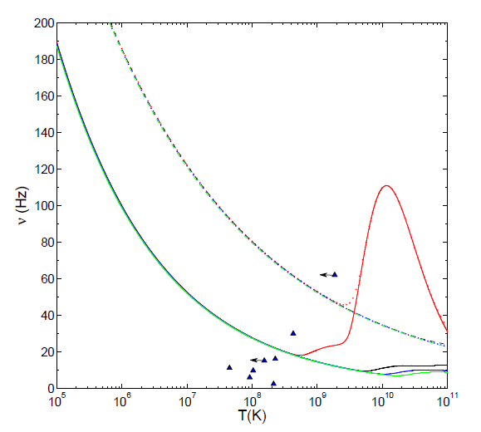
2. R-mode instability window of strange stars
the effects of EoS of unpaired strange quark matter are only dominated at low temperature, but it do not have significant effect on CFL phase strange star.
The dissipations enhanced by crust are important in CFL phase strange stars
PSR J0537-6910 is a primary source for detecting the gravitational wave from rotating strange stars
Wang et al. 2019, RAA

Slide 12

3.Effect of R-mode instability on the spin and thermal evolution of CFL phase strange stars
Open questions: $α_{sat}$ , Δ
Observation: constraint the parameters
    1. Period, Period derivative
    2. Surface temperature/Luminosity
    3. Upper limit on gravitational-wave amplitudes
Notes:
The most important thing is that the parameters of physical models in this work
are constrained in a reasonable regime by the different bands observational data. Different from
the work of [], PBF processes in color superconducting quark matter are considered

Slide 13

3.Effect of R-mode instability on the spin and thermal evolution of CFL phase strange stars
R-mode instability windows and evolution of CFL phase strange star, PBF processes are considered.
∆ = 1, 10, 100MeV,
α_{sat}=10⁻⁴,10⁻³, 10⁻², 0.1, 1
From the aspects of spin evolution, we could get
$α_{sat}$>=0.01 for young pulsars
Zhou et al. 2019, in preparation
Notes:
If we want the R-mode instability spin-down the pulsars efficiently at its chacteristic age

Slide 14
3.Effect of R-mode instability on the spin and thermal evolution of CFL phase strange stars
Too small or too large energy gap is disfavored
Zhou et al. 2019, in preparation
Notes:
big bump during the first hundred years are disappeared. The thermal evolution
curves predicted by the model within an acceptable parameter regime probably cover the young
and hot pulsars in the Ts-t panel. Moreover, due to the leaving of r-mode instability window,
a steep decay are predicted in their thermal evolution curves, which may indicate that the color-flavor-
locked phase can exist in strange stars.

Slide 15

4. Spin evolution of The Slowest Radio Pulsar PSR J0250+5854
$P=23.5s, \dot{P}=2.7×{10}^{−14}s s^{−1}$, 85eV
Preliminary
Zhou et al. 2019, in preparation
Notes:
the slowest-spinning radio pulsar by now
^{Upper limit 1.5*1032 erg/s}

Slide 16
Summary
Using multiple observational data to constrain the model parameters in a reasonable regime
A more realistic structure of compact stars
Braking index ~7(PSR J0537-6910, Andersson, 2018, ApJ)
gravitational wave emission

Slide 17

