Slide 1

What is S(ρ) at ρ<ρ_{o} and how does provide the pressure and density of the crust-core transition?
Topics
Equation of State, symmetry energy and neutron stars.
Laboratory constraints on the symmetry energy at ρ<ρ₀
Crust-core transition.
The energy/nucleon of nuclear matter ε(ρ,δ) is our equation of state:
ε (ρ,δ)=E/A (ρ,δ) = E/A (ρ,0) + δ²•S(ρ)
δ= (ρ_{n}- ρ_{p})/ (ρ_{n}+ ρ_{p}) = (N-Z)/A
S(ρ) is the symmetry energy in neutron matter.
S(ρ) is poorly constrained.
E/A(ρ,0) is well constrained.
I will use an empirical (fitted) equation of state to obtain the crust core transition density and pressure in the neutron star:

Slide 2
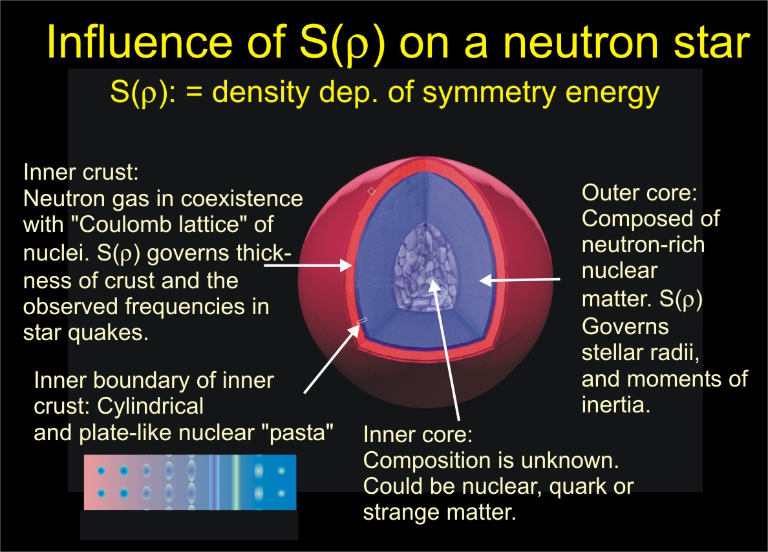
c
ρ < ρ₀
ρ > ρ₀
At the crust-core boundary uniform matter becomes adiabatically unstable to break into isolated liquid structures surrounded by neutron-rich gas.
Notes:
Two regions of neutron star are connected to NP.
Inner crust, low density EoS determines the crust core transition density and the thickness of the inner crust, frequency of crustal oscillations observed in magnatars
Core, EOS determins m vs. r and moment of inertias

Slide 3
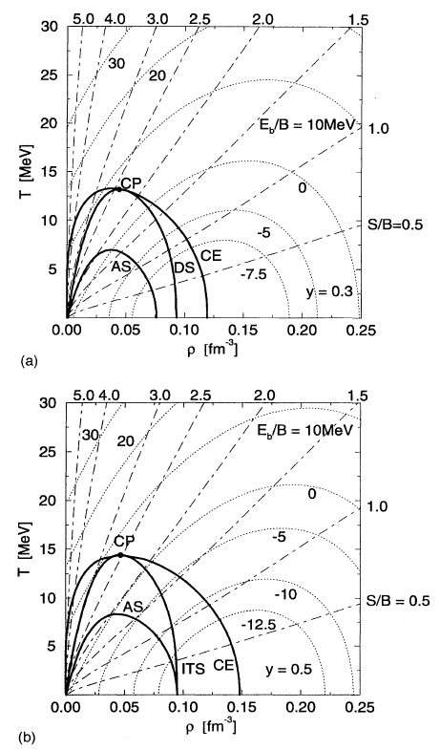
Adiabatic instability and spinodal decomposition
As a function of temperature and density, the nuclear matter phase diagram has regions of gas, liquid, and mixed phases.
These are shown for two different values of the proton fraction: y=ρ_{p}/(ρ_{p} +ρ_{n} ). y=0.3 and y=0.5.
Inside the mixed phase region (in pink), there is the adiabatic spinodal “AS” within which uniform matter becomes mechanically unstable. (compressibility becomes negative) This defines the crust-core boundary in the thermodynamic limit.
The region of the adiabatic spinodal gets smaller and the boundary at T=0 moves towards ρ=0.08 fm⁻³ (1/2 saturation density) and perhaps even beyond with decreasing y.
y=0.3
T (MeV)
gas
liquid
Műller and Serot, PRC 51 (1995) 2072.
crust-core transition
y=0.5
gas
liquid
T (MeV)
ρ (fm⁻³)

Slide 4
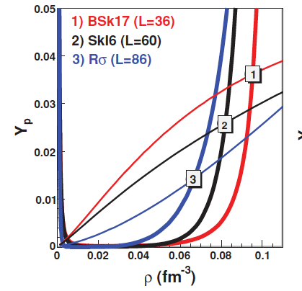
Conditions of the crust core boundary
from adiabatic spinodal
Inside a neutron star nuclear matter is highly frustrated. The Coulomb interaction requires similar proton and electron Fermi momenta, but the associated electron Fermi energy drives matter toward pure neutron matter. The nuclear matter EoS strongly prefers symmetric matter.
This trade-off between symmetry energy and electron Fermi energy sets the asymmetry. It therefore depends on the nuclear interaction and the matter density.
The crust core transition occurs at the density where the proton fraction at the adiabatic spinodal equals that given by beta equilibrium. This occurs around ρ≈0.8fm⁻³ and depends on the density dependence of the symmetry energy.
We therefore need to know the symmetry energy very well near ρ=0.8fm⁻³ .
from beta equilibrium
Ducoin et al, C 83, 045810 (2011)

Slide 5
Densities and probes
Now I will summarize some past and current efforts to constrain the symmetry energy at various densities
To make reference to existing work, I will make use of the Taylor expansion about ρ₀ ≈0.16fm⁻³, and the expansion parameters S₀, L and K_{sym}
Many theoretical analyses of experimental data have focused on determining that values for S₀ and L that correspond to the theoretical interactions that best describe the experimental data.
Later, I will discuss expanding about 2/3ρ₀.
J
\

Slide 6
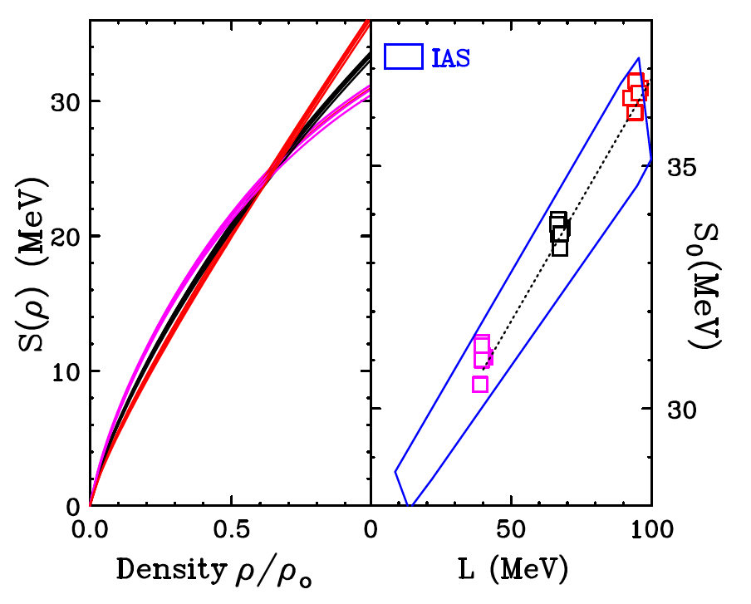
Masses
Alex Brown fit the masses of doubly closed shell nuclei, while setting different values for the neutron skin thickness of ΔR_{np}=0.16, 0.20 and 0.24 fm.
All Brown fits provide S(ρ)=24.8±0.7 MeV at ρ/ρ₀=0.63±.03 as shown at left.
B.A. Brown, Phys. Rev. Lett. 111, 232502 (2013)
(31, 40)
The values for S₀ and L lie on a line in the S₀ and L plane along which S(0.63ρ₀) remains constant. This line lies perpendicular to the gradient of S(0.63ρ₀) in the the S₀ and L plane. The slope, M, of the line and the form of the function is sufficient to determine ρ/ρ₀=0.63±.03 and S(ρ)=24.8 ±0.7 MeV.
From the slope of the IAS contour (in blue) one similarly obtains ρ/ρ₀=0.66±.04 and S(ρ)=25.5 ±1.1 MeV.

Slide 7
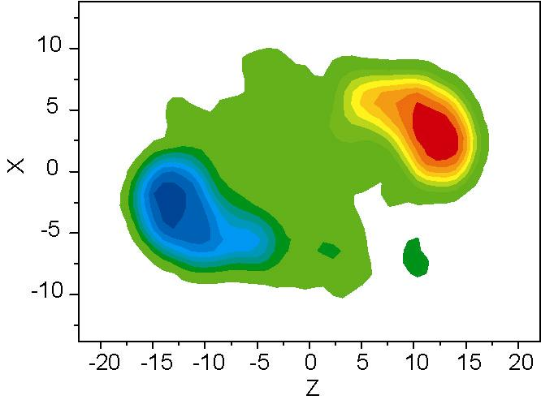
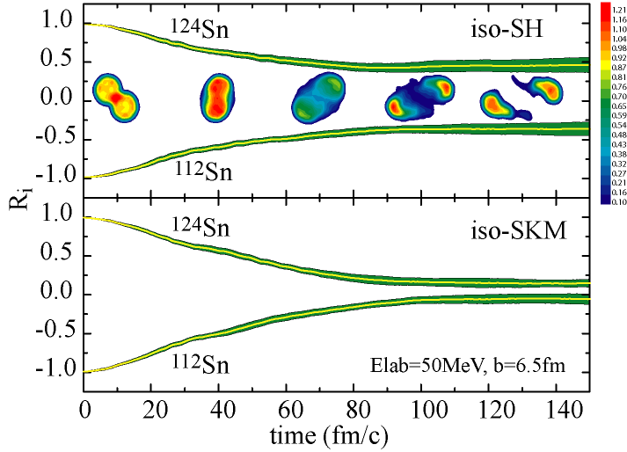
Probe: Isospin diffusion in peripheral collisions
Collide projectiles and targets of differing isospin asymmetry
Probe the asymmetry δ=(N-Z)/(N+Z) of the projectile spectator during and after the collision.
{
mixed ¹²⁴Sn+¹¹²Sn
n-rich ¹²⁴Sn+¹²⁴Sn
p-rich ¹¹²Sn+¹¹²Sn
Systems
Tsang et al., PRL 92 (2004) 062701
Neutron-rich projectile
R=1 no diffusion
¹²⁴Sn
Larger L
δ
R= -1: no diffusion
Smaller L
¹¹²S
R= 0 equilibrium
Neutron-deficient target
R= 0: equilibrium
measure asymmetry after collision
Notes:
Now we want to ultimately constraint the Symmetry energy at high densities with HIC, so we started at low densites.
I want desribe isospin diffusion.
gas in the room analogy
two nuclei one neutron rich and the other neutron deficient. are put in contact, symmetry energy speed s the equilibration process. How much this speed it is assessed by comparing collsions of neutron-rich with nuetonr deficeint to neuton rich on neutron rich.
isospin transport ratio measures the degree to which equilibrum is achieve 0 = equilibrum 1 is no difussion.
Mainly sensitive to symmetry energy in between, which is a subsaturation. If the symmetry energy is larger in this subsaturation region, then the diffusion is faster. This is true for the softer Symmetry energy, because less rapidly with decreasing density.
Transport calcuatlinos show this effect.

Slide 8
Consider the EoSs for which the agreement is at the 2σ boundaries of the constraint contour
High L boundary
Low L boundary
Diffusion ends when the density becomes low enough that the symmetry energy gradient across neck becomes negligible
L-S₀ constraint contour actually corresponds to a constraint of S(ρ_{s})=10.6± 1 MeV at ρ/ρ₀=0.24±0.07.

Slide 9
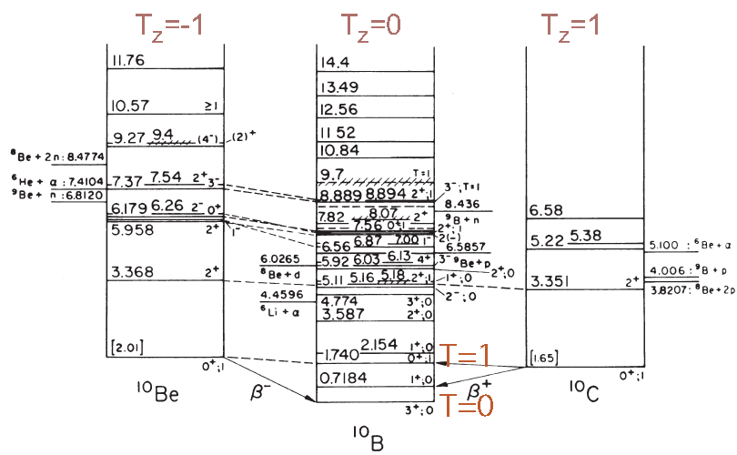
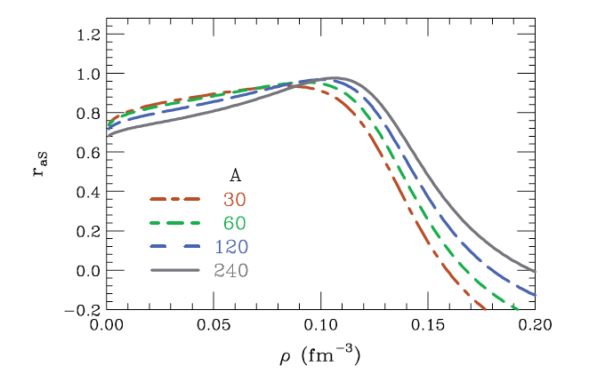
Isobaric Analog states
Information that is equivalent to the isotopic dependences of the masses can be by fitting the energies of ground and isobaric analog states within the same nuclei.
If all states are fitted together, one obtains ρ/ρ₀=0.66±.04 and S(ρ)=25.5 ±1.1 MeV.
Fitting different mass ranges maps to different density ranges. By fitting Isobaric Analog States with 30≤A≤240, Danielewicz obtained constraints on the symmetry energy over a range of densities using a Pearson correlation technique. Light nuclei are sensitive to lower densities than are heavy nuclei.
P. Danielewicz, and J. Lee, Nucl. Phys. A 922, 1 (2014).
Danielewicz (2006)
Notes:
Danielewicz and play an extra click just like to point out using isospin symmetry you realize that you can extract the symmetry energy by just comparing the energy of ground state’s analog states than the coulomb doesn’t matter. Of course isospin symmetry says this energy component is proportional to the square of the isospin not just the Z. component cf. reformulate a little your symmetry energy. But small correction mainly important for any posting nuclei and it basically takes care of the figures are large extent if you then applied nuclear symmetry energy which has both surface and volume components as a function of mass you can isolate the volume of the symmetry in surface symmetry energy components that was done here this figure laterin our final lecture I’ll show you what that means in terms of this of the symmetry energy term of the equation of state

Slide 10
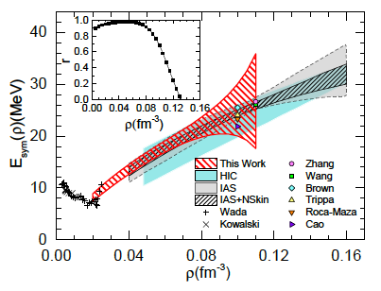
Electrical dipole polarizability
Zhang PRC 92, 031301 (2015).
The dipole polarizability of a nucleus tells how the ground state energy changes in a dipole electric field. Perturbation theory tells us
  Large contribution from GDR
  Low energy non-collective excitations have enhanced importance.
  Latter measured by (p,p’) coulex.
Analyzed by Pearson correlation technique.
S(ρ)
The red contour shows the constraint on S(ρ) consistent with the α_{D} measurement. The best determined value is S(ρ)=15.9±1.0MeV at ρ=0.05 fm⁻³, which is marked as the yellow square point in the figure.

Slide 11
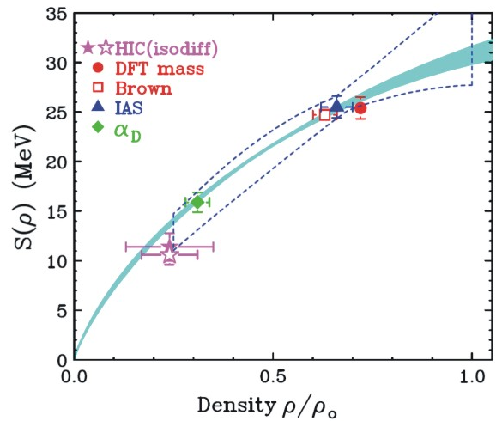
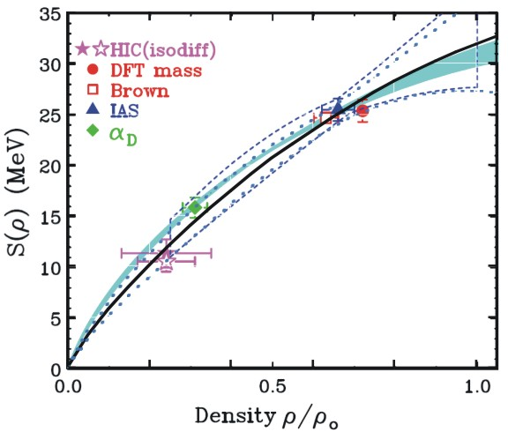
Combining constraints
Lynch and Tsang (2018)
The individual points give the best values from masses, IAS, isospin diffusion and α_{D}.
Blue shaded region is CEFT prediction by Drischeler et al., The dashed region is the Pearson analysis of Danielewicz for the IAS data.
Following Ducoin et al, C 83, 045810 (2011) you can fit these five points to obtain a best fit Taylor expansion of S(ρ) about ρ=0.1/fm³ Ducoin et al, showed that such an expansion can be used to obtain the crust-core transition density and pressure.
The result of the fit are shown as the solid line. The dashed lines show the 2σ boundaries for S(ρ). The constraint is remarkable similar to that of Danielewicz to IAS data.

Slide 12
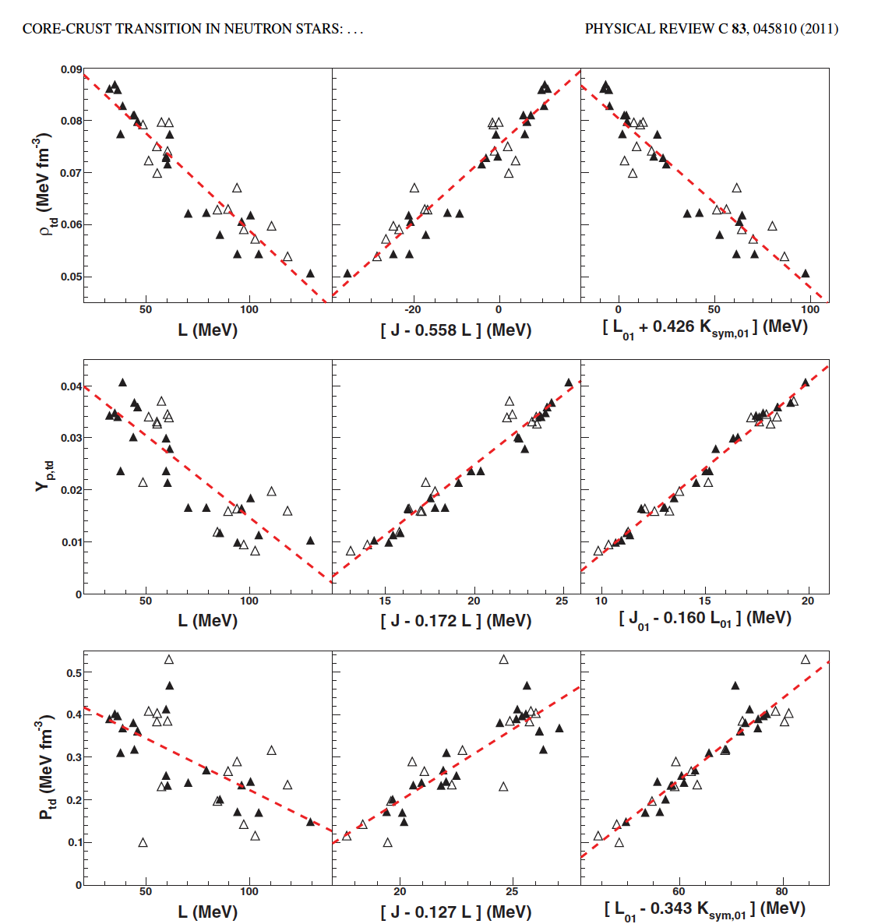
For crust core transition, is it better to expand around 2/3ρ₀?
Ducoin et al. calculated crust-core transitions for about 50 Skyrme and RMF interactions.
Figure shows the correlation between Y_{p,td}, P_{td} and ρ_{td} and coefficients of Taylor expansion about ρ₀ (J, L, K_{sym}) and about 2/3ρ₀ (J₀₁, L₀₁, K_{sym01}).
Solid points are for EoS from Skyrme interactions and open are from relativistic mean field (RMF) interactions.
The expansions about 2/3ρ₀ provide more precise constraints on the crust-core transition because that point is closer to the actual crust-core transition density.
Our most precise constraints are at 2/3ρ₀ , so that is also the most precise point about which to expand.
expand
about ρ₀
expand
about 2ρ₀/3
asljsafl

Slide 13
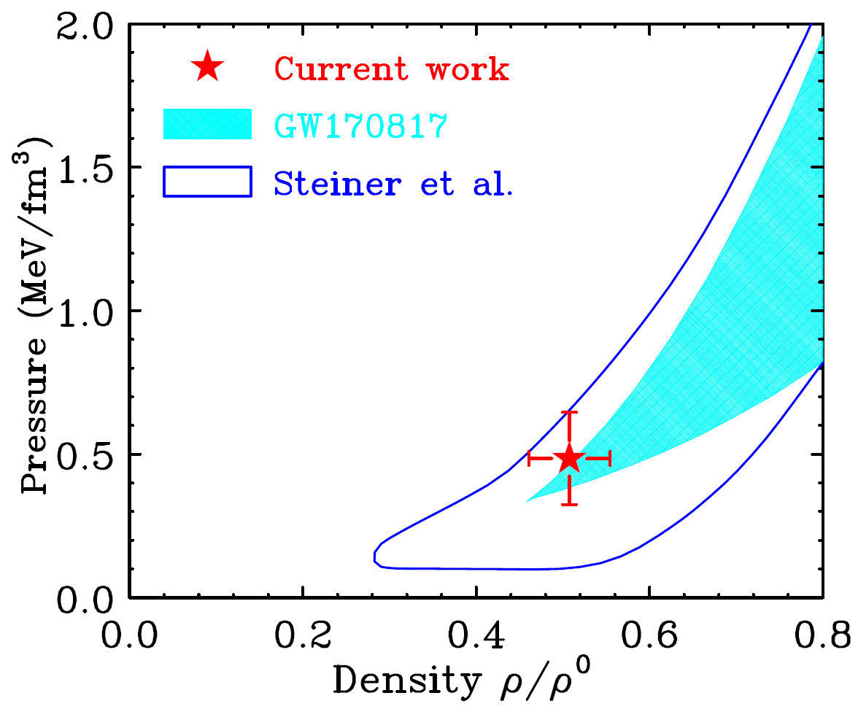
Combining constraints
The individual points give the best values from masses, IAS, isospin diffusion and α_{D}.
Blue shaded region is CEFT prediction by Drischeler et al., The dashed region is the Pearson analysis of Danielewicz for the IAS data.
Following Ducoin et al, C 83, 045810 (2011) you can fit these five points to obtain a best fit Taylor expansion of S(ρ) about ρ=0.1/fm³ Ducoin et al, showed that such an expansion can be used to obtain the crust-core transition density and pressure.
The location for the crust-core transition density is shown as data point. The contours are pressure contours obtained from NS mass-radius correlation (Steiner et al.) and from neutron star mergers (Abbot et al).
Can we get more points to improve the crust core transition density and pressure?
Lynch and Tsang (2018)
x
x
Lynch and Tsang (2018)

Slide 14
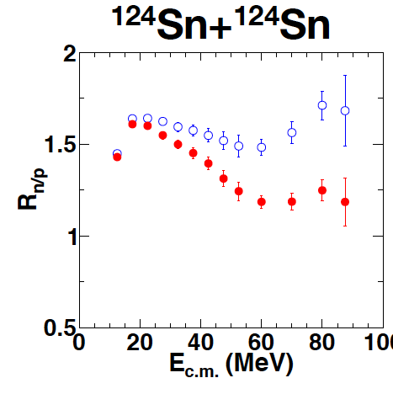
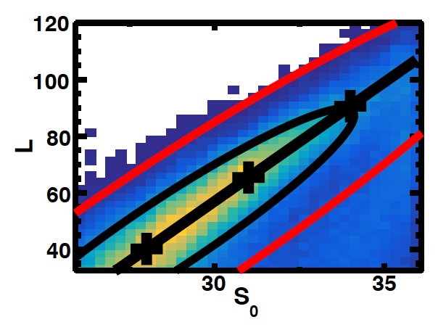
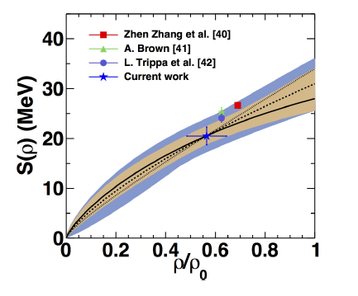
Constraints from ratios of neutron/proton spectra in central ¹²⁴Sn+¹²⁴Sn and ¹¹²Sn+¹¹²Sn collsions
P. Morfouace et al., (2018)
P. Morfouace et al., (2018)
P. Morfouace et al., (2018)
Four dimensional Bayesian analyses of spectral ratios using Madai:
Parameters: S₀, L, and
We obtain ρ_{S}/ρ₀= 0.56±0.9 and S(ρ_{S}) = 20.5±1.9 MeV. Δm*_{np}=(0.03±0.08)δ
Somewhat lower than the trend of global fit, but within uncertainties.

Slide 15
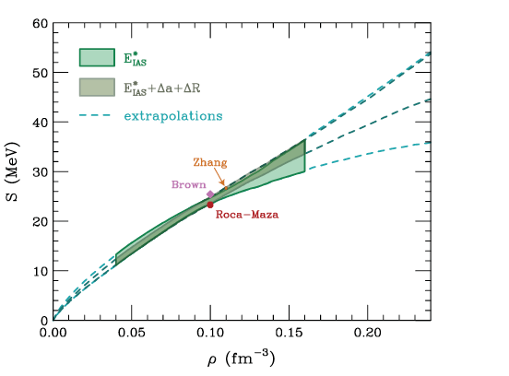

Pointing towards higher densities
Neutron and Asymmetry skins
Concerning asymmetry skins, Danielewicz and Lee extracted the asymmetry skins and included them as constraint on S(ρ).
It would be interesting to see how this extra constraint changes the crust core transition density and pressure.
With increasing value of L, the neutron matter distribution shifts to larger radii, which has two effects:
  Neutron skin – Δ_{n-p}
  Asymmetry skins: shift between radii and diffuseness of isoscaler and isovector potentials.
    Determined by fitting optical potentials for elastic scattering and charge exchange.
We can expect the current information about neutron skins to improve from new measurements including PREX 2 and CREX.

Slide 16
Summary
Most nuclear observables probe sub-saturation densities.
It is useful to determine the sensitive density probed by each observable and then extract the symmetry energy at that density. This extraction is less model dependent than generally expected.
This provides constraints on S(ρ) for 0.25<ρ/ρ₀<0.75 that are remarkably consistent with those extracted from Pearson correlation analyses of IAS.
These experimental constraints are precisely what is needed to determine the crust-core transition asymmetry, pressure and density.

