Slide 1
Results of Insight-HXMT Observations on Neutron Stars and Stellar Mass Black Holes
& several future missions
Shuang-Nan Zhang (张双南) zhangsn@ihep.ac.cn
Institute of High Energy Physics
Chinese Academy of Sciences

Slide 2
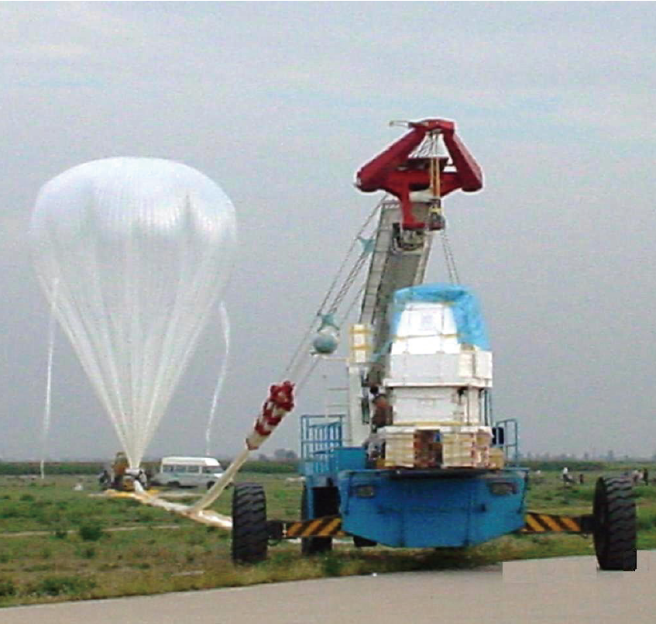
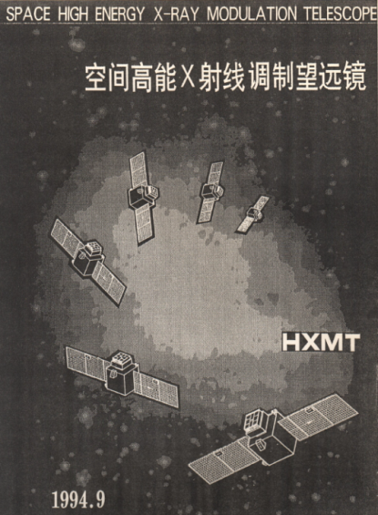
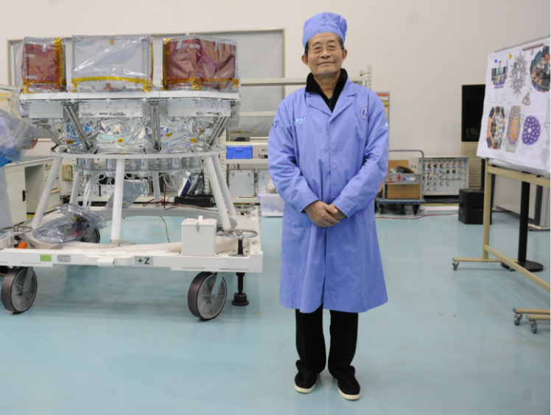

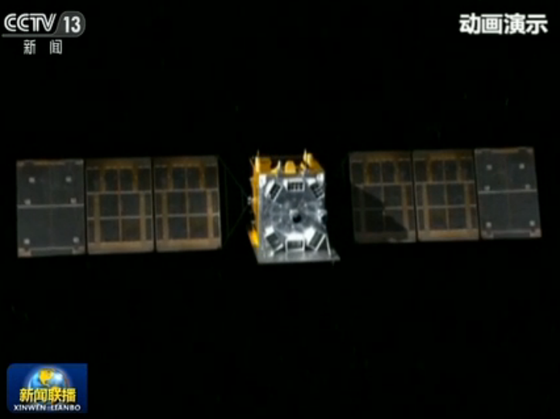
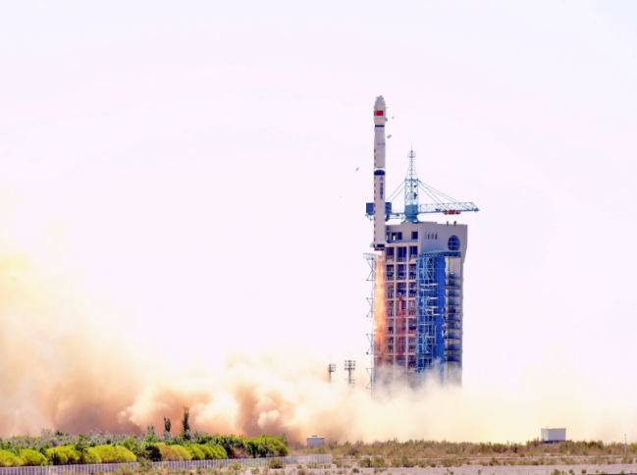
History of 慧眼Insight-HXMT
1970-80s balloon flight
1993 first proposal, 2011 funded
李惕碚院士Prof. Ti-Pei Li
In honor of
何泽慧 Ho Zah-wei (1914-2011)
“慧眼” Insight
2017.6.15 Launched in Jiuquan, China

Slide 3
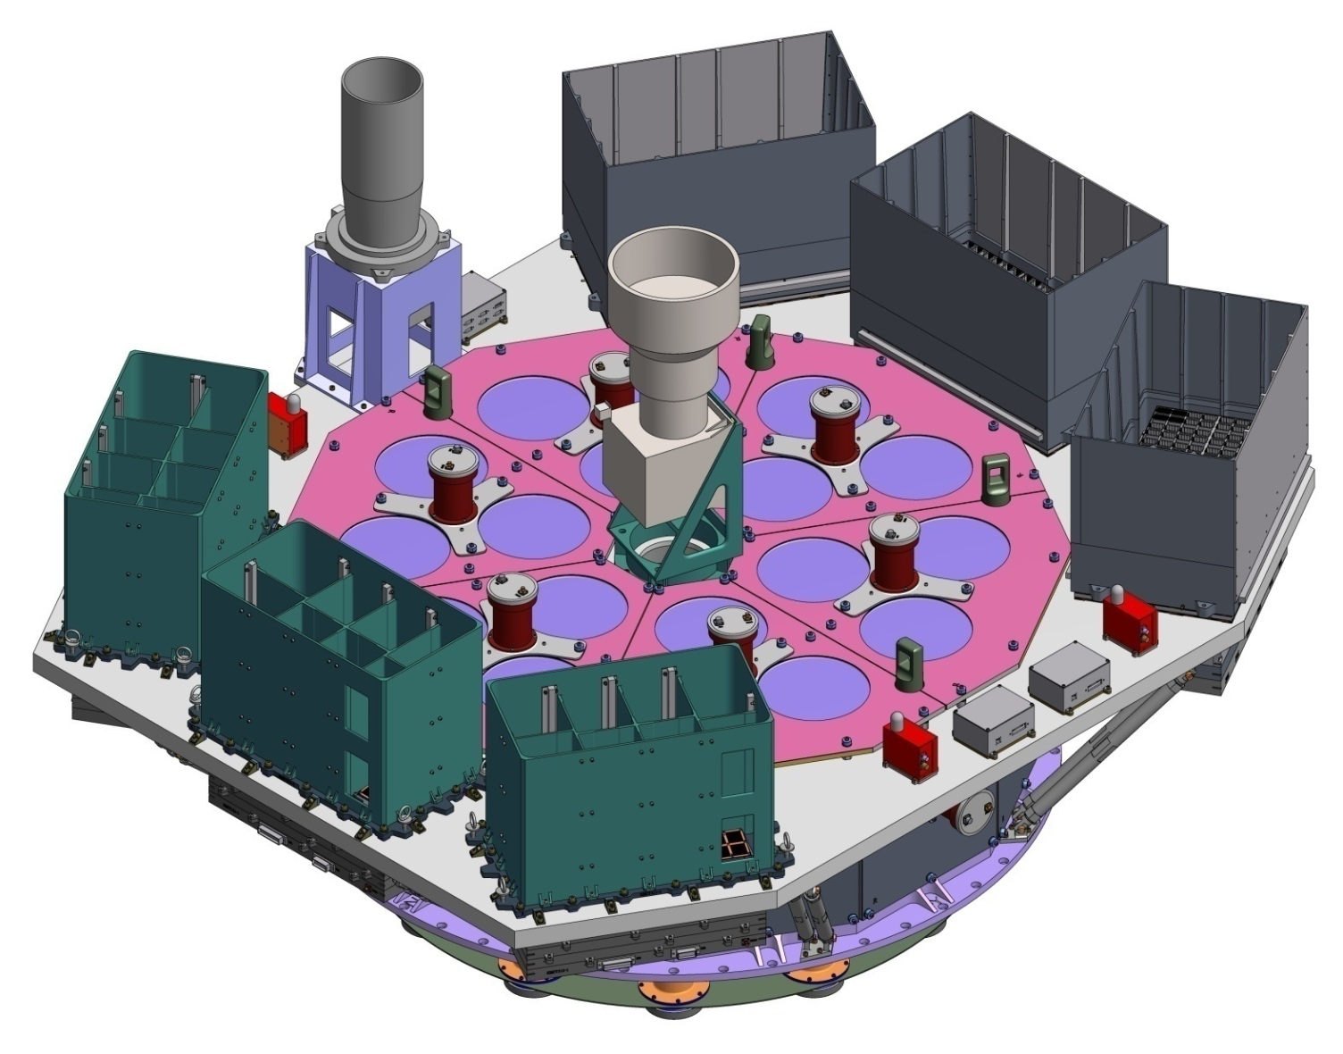
Science payloads
ME:Si-PIN,5-30 keV, 952 cm²
Star tracker
LE:SCD,1-15 keV, 384 cm²
HE: NaI/CsI, 20-250 keV, 5000 cm²
Notes:
China’s first X-ray astronomy satellite
already launched in this June
Three main payloads
Non-imaging instrument; use collimators to confine FoV
Scanning mode and pointing mode

Slide 4
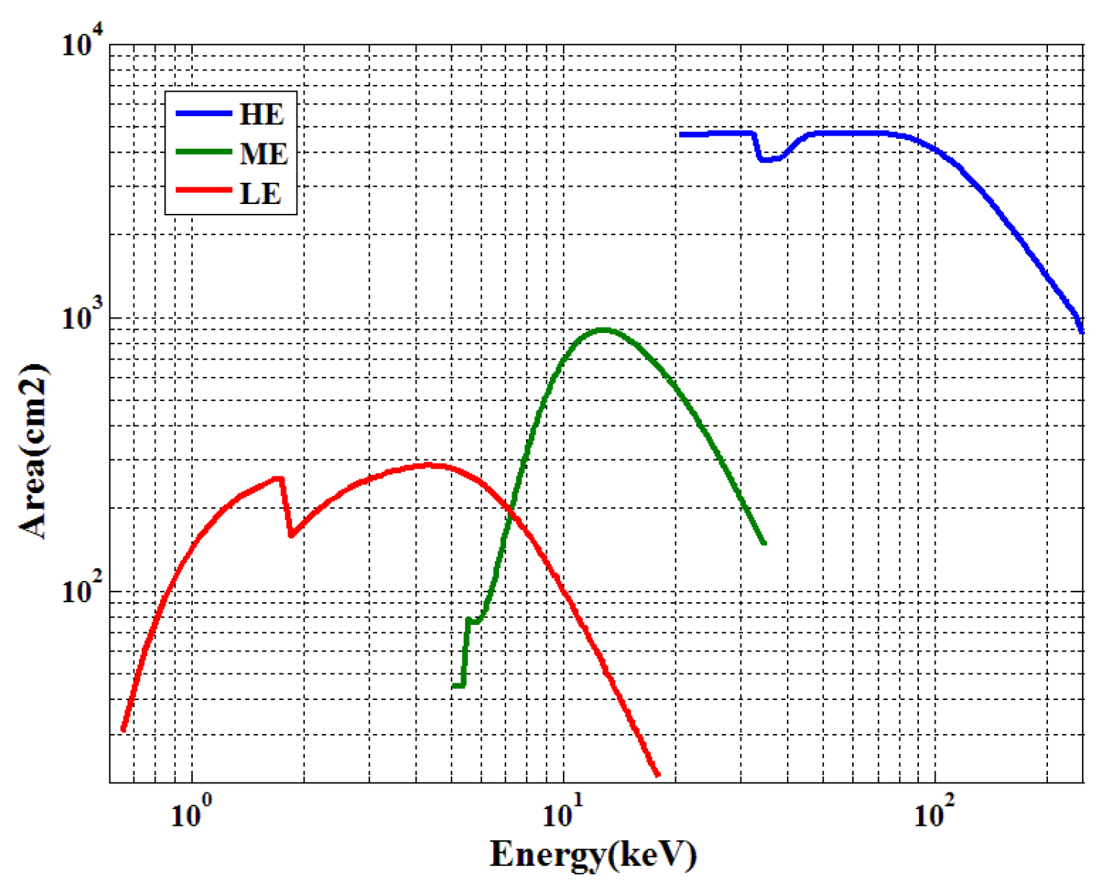
Effective area

Slide 5
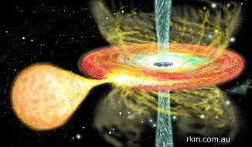
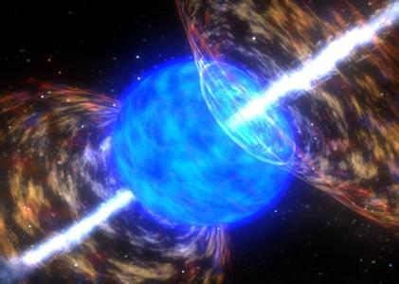
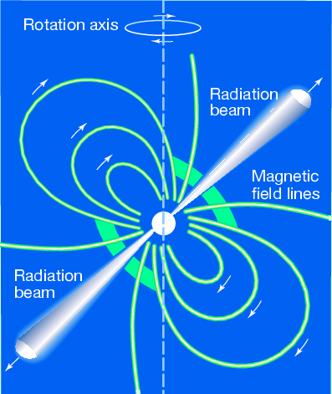
Core sciences
Galactic plane scan and monitor survey for more weak & short transient sources in very wide energy band (1-250 keV)
Pointed observations: High statistics study of bright sources and Long-term high cadence monitoring of XRB outbursts
Multi-wavelength observations with other telescopes
GRBs, GW EM, FRB, etc.

Slide 6
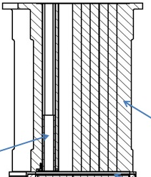
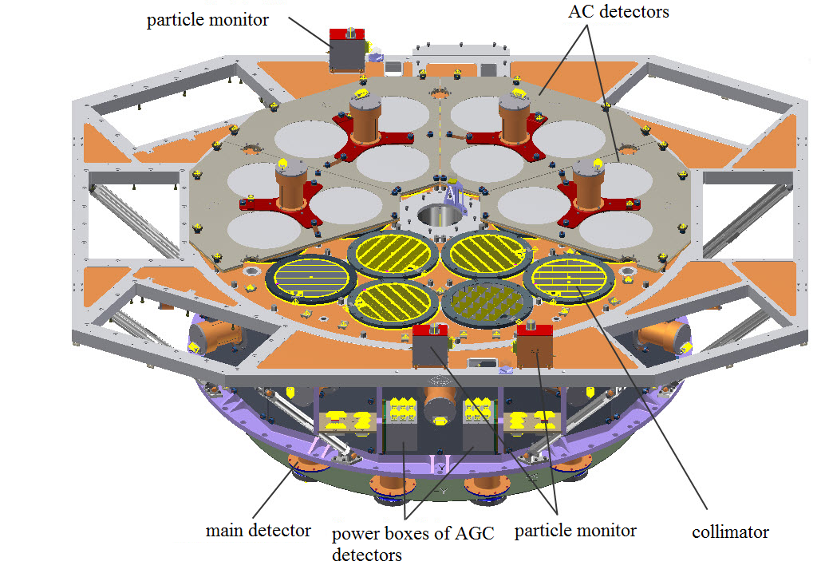
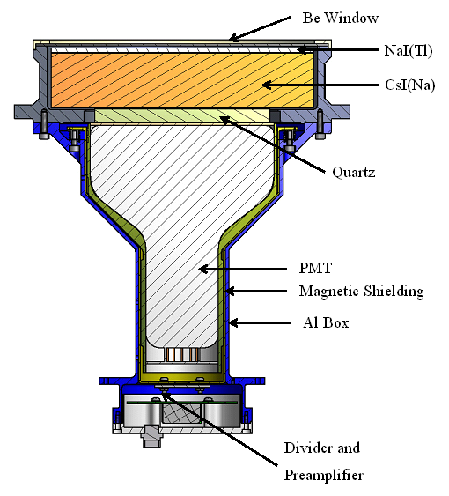
Regular observation vs. GRB observation
X/gamma photons within FOV
Collimator
NaI
CsI
Gamma-rays
（> ~200 keV）

Slide 7
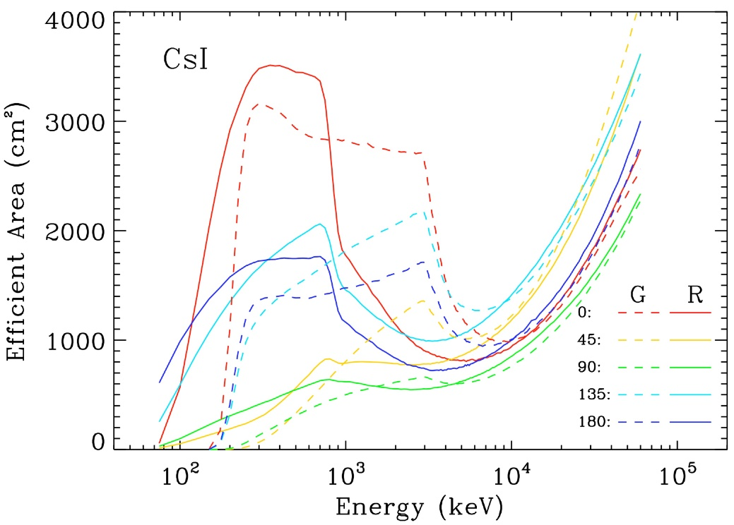
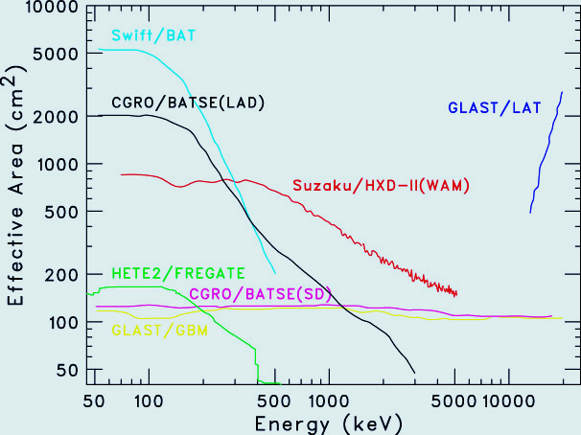
Effective Area for GRBs
Can detect GRBs in both regular & GRB modes (lower HV for PMT)
GRB monitoring FOV: all sky un-occulted by the Earth
HXMT
500~3000 cm² ~ MeV range with single photon counting and energy measurement, ~largest ~ MeV GRB monitors ever flown

Slide 8
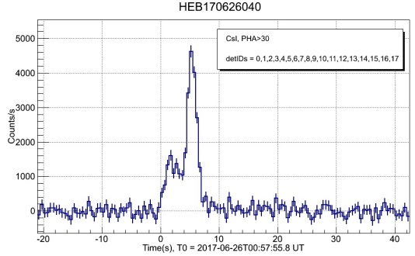
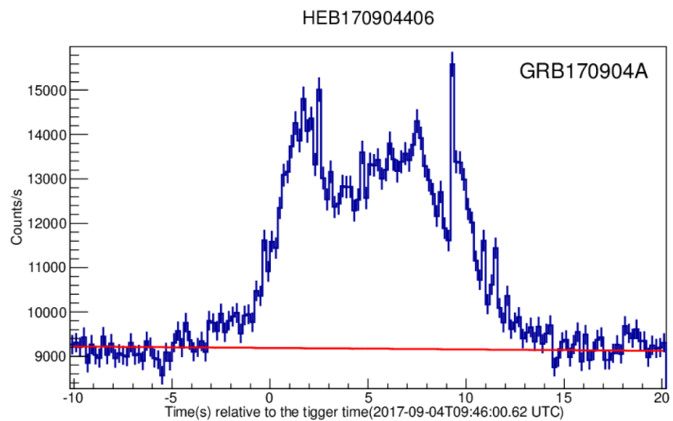
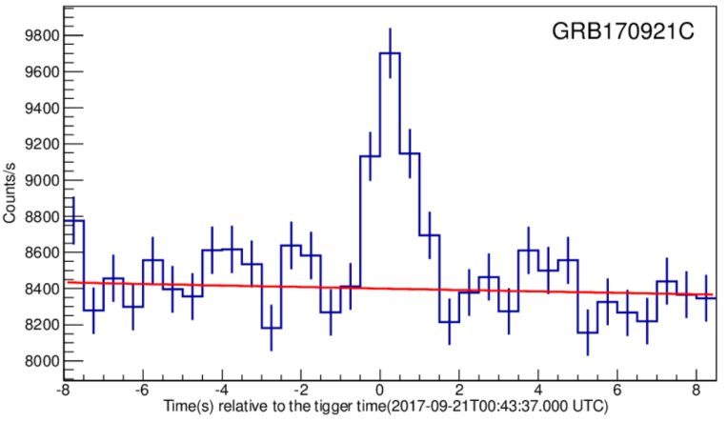
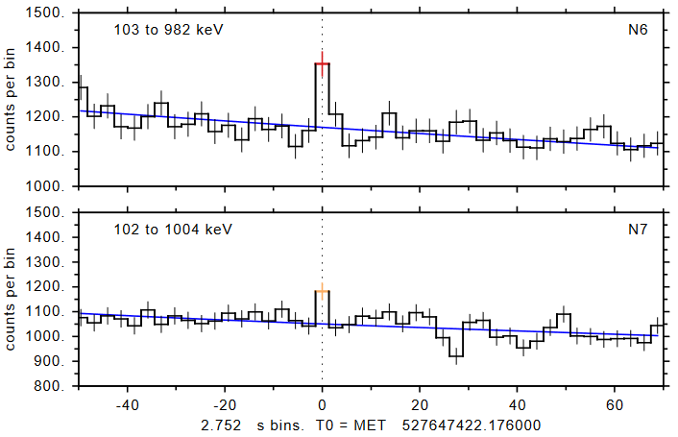
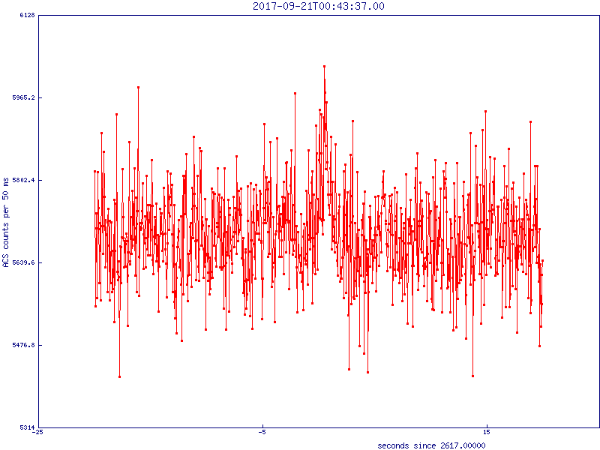
GRBs detected
~100 GRBs per year
GRB 170626B
1st Insight-HXMT GRB
High statistics in
MeV light curve
Sensitive @MeV: short/hard GRBs
  Sig: HXMT=12，GBM=8，SPI-ACS=4 (no spectrum)
HXMT
GRB 170921C
GBM
SPI-ACS

Slide 9
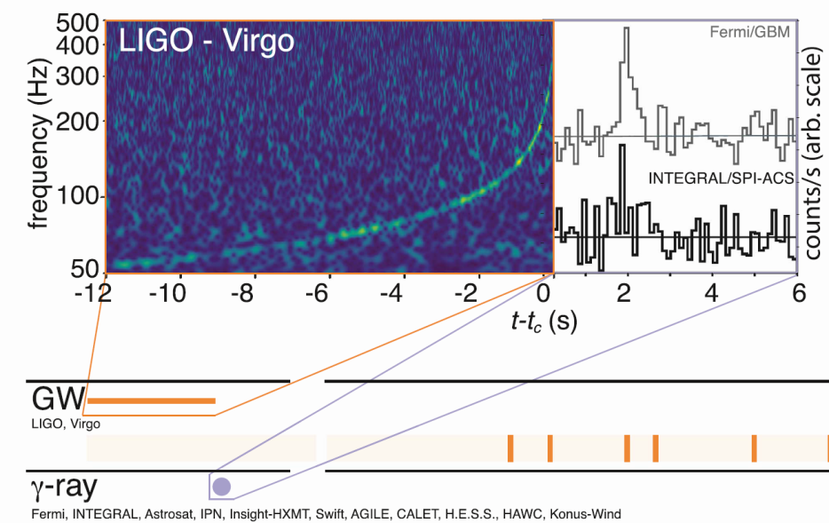
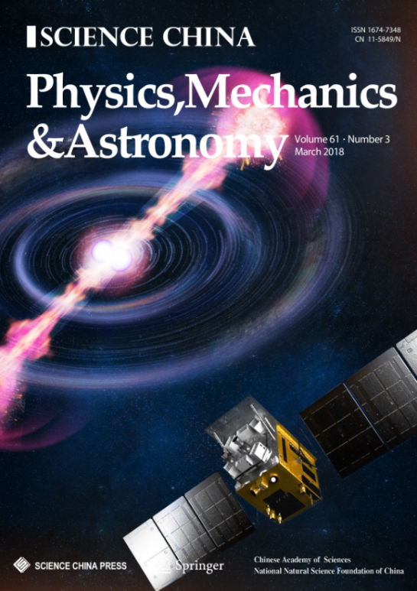
GW EM observations
Monitored 6 GW triggers
  Reported observation results in LVC GCNs
Monitored the first BNS GW event GW170817
  GRB170817A was not detected in MeV range, including HXMT
  Stringent upper limit constraint between 200 keV to 5 MeV
  Joined the MMA paper and published detailed results in Science China

Slide 10
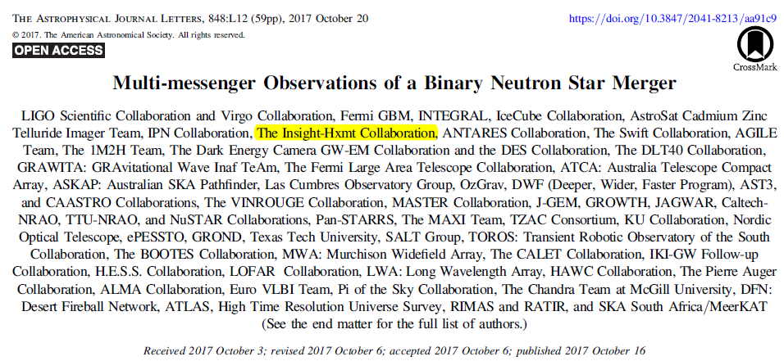
Insight-HXMT joined the MMA paper
Quick response, reported HXMT observation by LVC GCN
Only 4 X/gamma telescopes monitored the GW source throughout the trigger time
  Fermi/GBM, SPI-ACS, Konus-Wind, Insight-HMXT
  HXMT has the largest eff. Area & time resolution in MeV
Reported observation results in main context and table of MMA

Slide 11
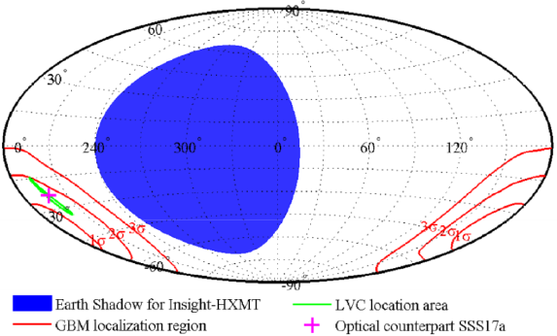
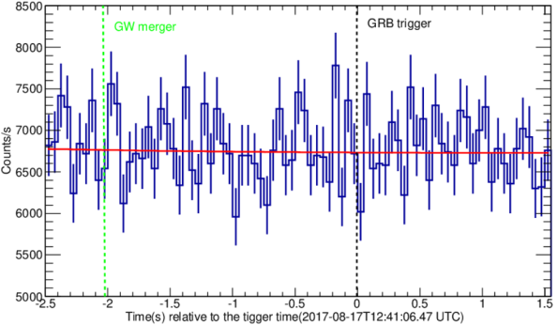
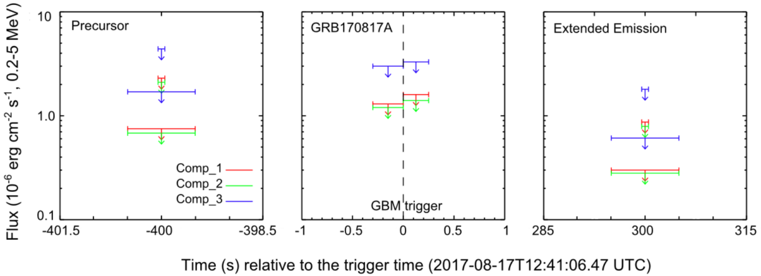
Insight-HXMT observation to DNS GW-EM
Monitored the entire GW area
Light curve around trigger time
3 σ upper limits for Comptonized models
T. P. Li, et al, Sci. China-Phys. Mech. Astron. 61(3), 031011 (2018)

Slide 12
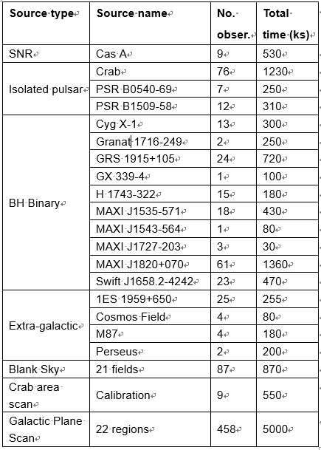
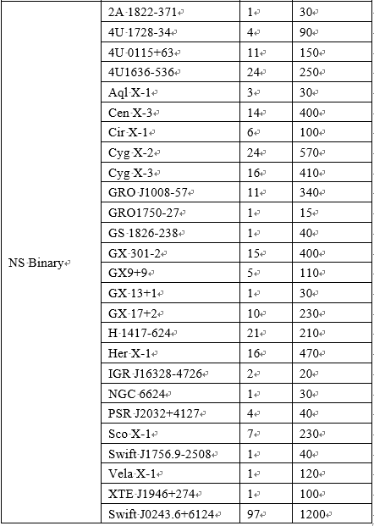
1st yr HXMT observations

Slide 13
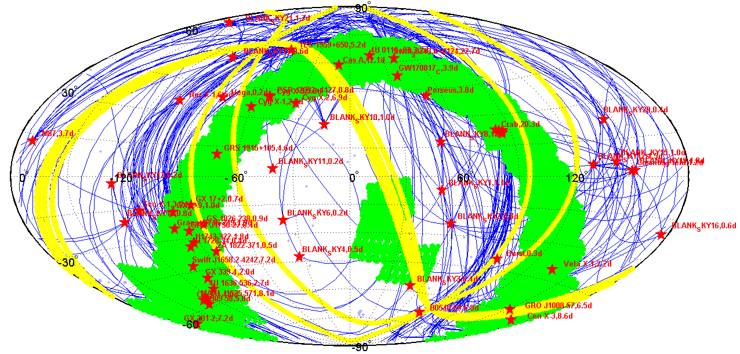
Distribution of 1st yr HXMT observations
Red stars: pointed observations
Green regions: small area scan
Blue lines: slew between different pointing obs.
Yellow belts: test of the all-sky scanning mode

Slide 14
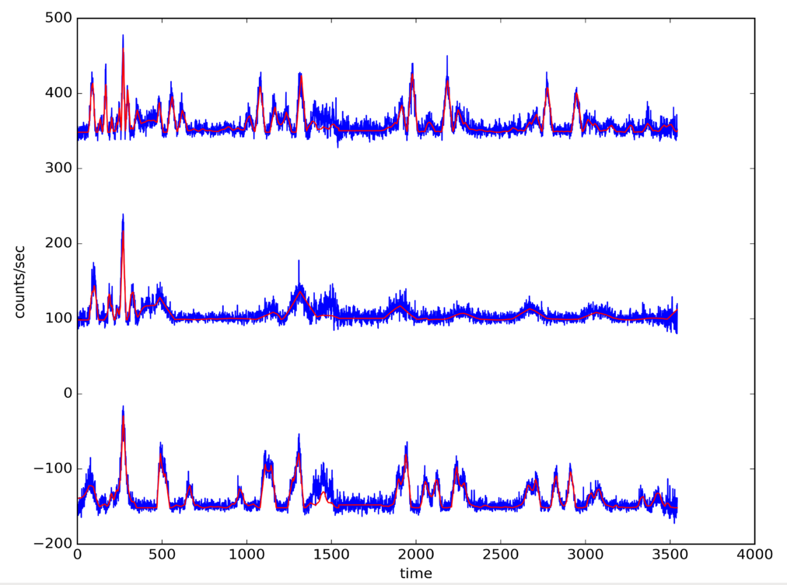
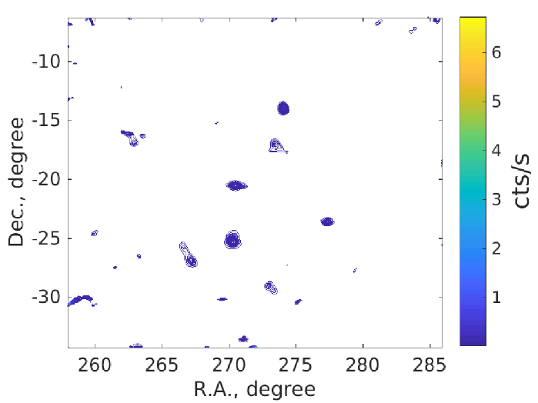
Scan light curve
July 16 on Galactic center (LE 1-6 keV)
Direct Demodulation Method
(Li & Wu 1993)
Notes:
Galactic center is quite crowd; peaks are blended; fit becomes slow; two method to cross check

Slide 15
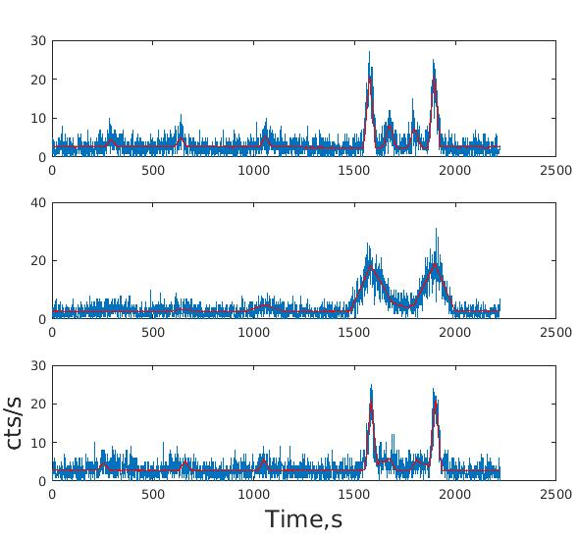
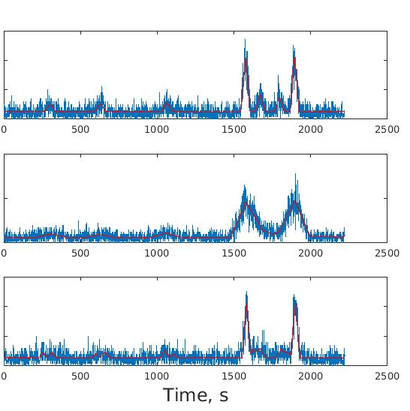
Candidate new source
S/N=7.1σ, flux~7mCrab, χ² : 6481.8 → 6403.9
Need further confirmation.

Slide 16
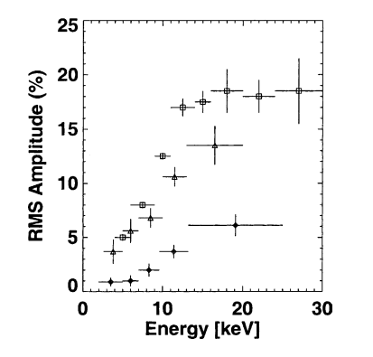
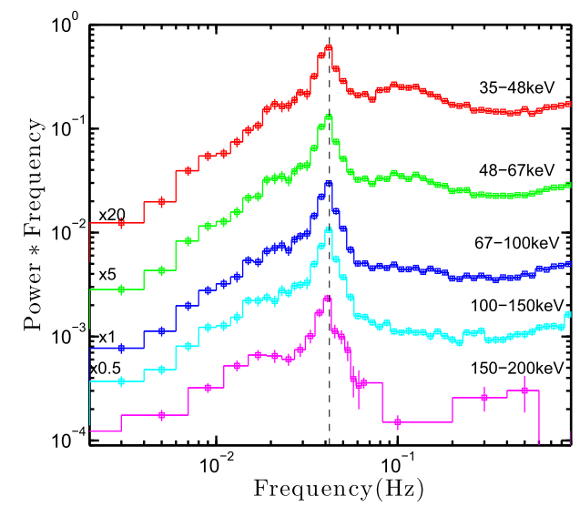
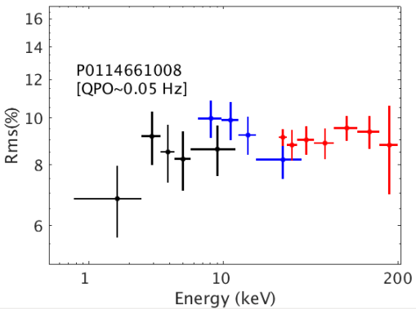
QPOs from BHXB up to 200 keV
(Kaaret 2004)
HXMT detected significant QPO signals from MAXI J1820+070 at energies up to 200 keV, providing a unique opportunity to study QPOs of the non-thermal X-ray emission.

Slide 17
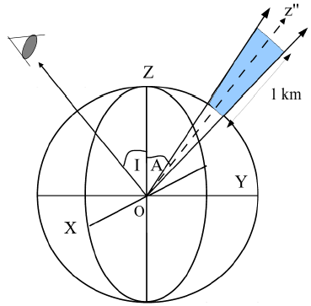

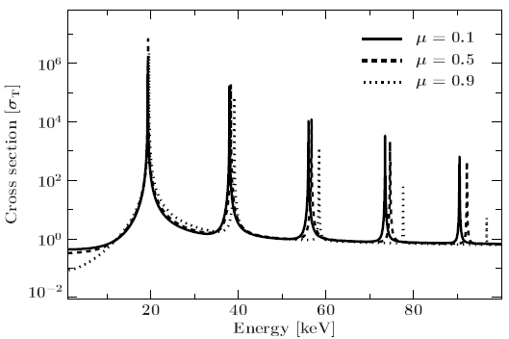
Neutron star cyclotron absorption lines
Magnetic field
Accretion column
Maitra 2016

Slide 18
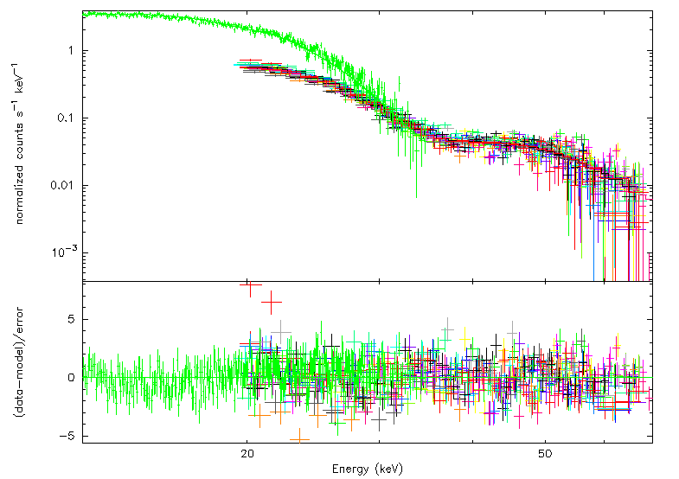
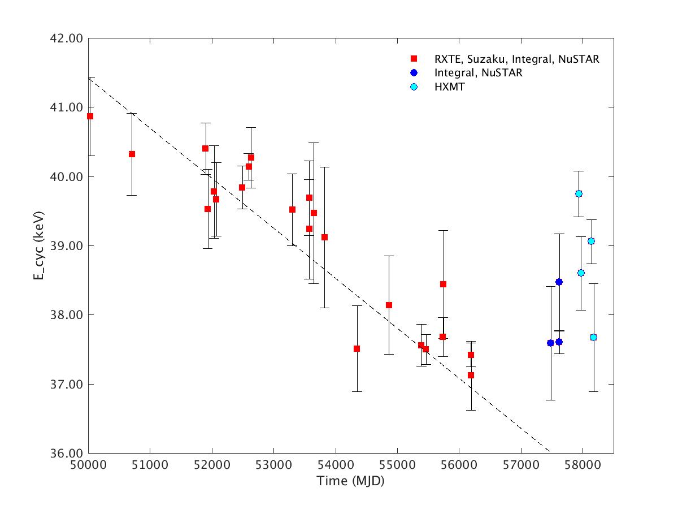
Cyclotron absorption line from Her X-1
Her X-1
40 keV
Recent cyclotron line energy increase observed with Integral and NuStar confirmed with Insight-HXMT

Slide 19
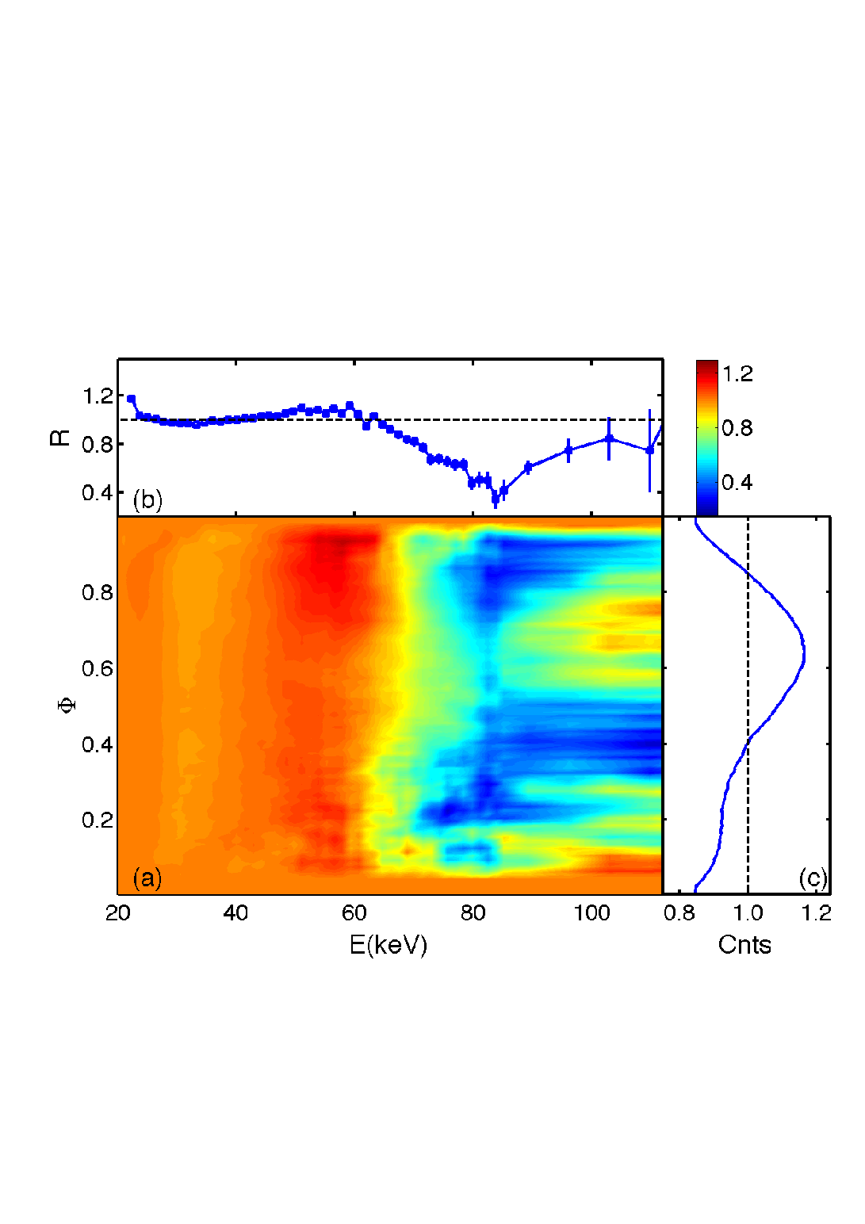
~85 keV Cyclotron line from GRO J1008-57
Preliminary
The strongest magnetic field (7*10¹² G)
directly detected
(a) Ratio between GRO J1008-57 and Crab (b) Residuals of the spectral ratio in phase 0.5-0.9 fitted by a continuum model.（c）Pulse profile.

Slide 20
X-ray burster 4U 1636-536: Corona cooling revealed with single short type-I X-ray burst
Previously tens of bursts were stacked to see corona cooling
Corona does not cover the neutron star completely, is cooled down and heated up very quickly ~1 s: too short for viscous process, compatible with magnetic field reconnection.
(Chen et al. 2018)

Slide 21

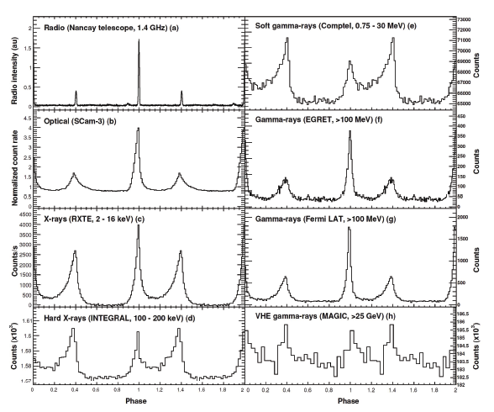
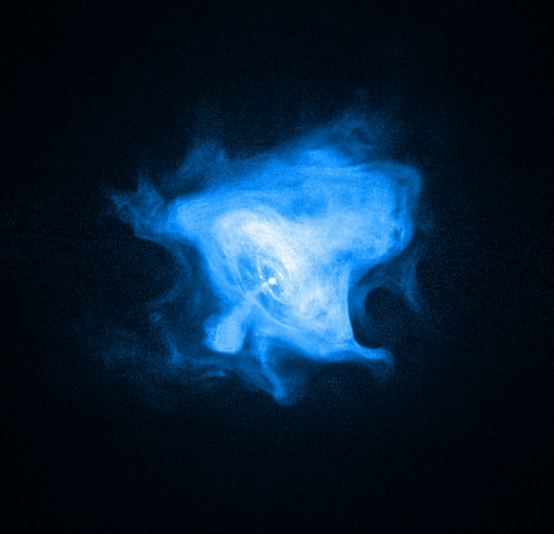
The Crab pulsar
SN1054, Typical double peaks
  (Abdo et al.2010, Ge et al. 2012)
Abdo et al. 2010

Slide 22


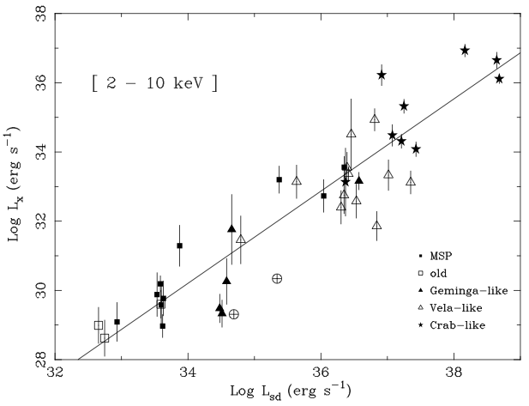
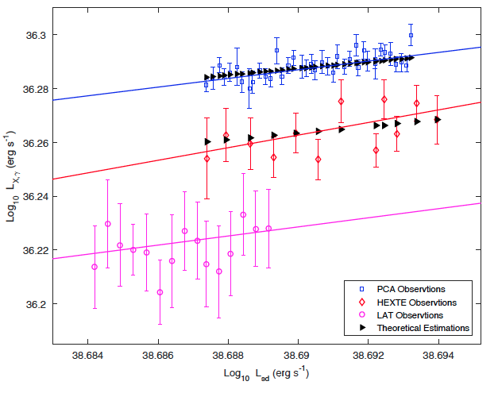

Long term evolution of its X-ray flux
Lx
L_{sd}
Statistical correlation of many X-ray pulsars
Possenti al. 2002
Crab pulsar
Yan et al. 2018

Slide 23
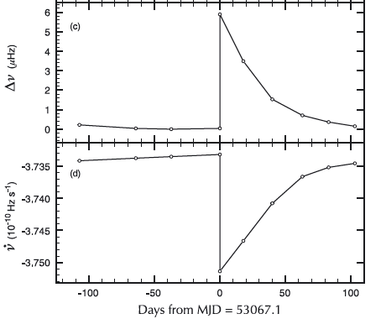
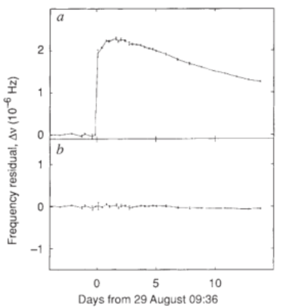
1st resolved spin-up of Crab Glitch
Lyne et al. 1992

Slide 24
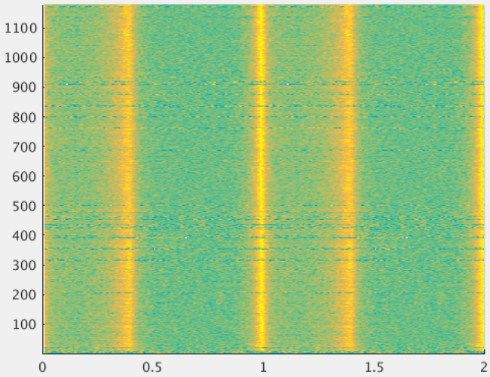
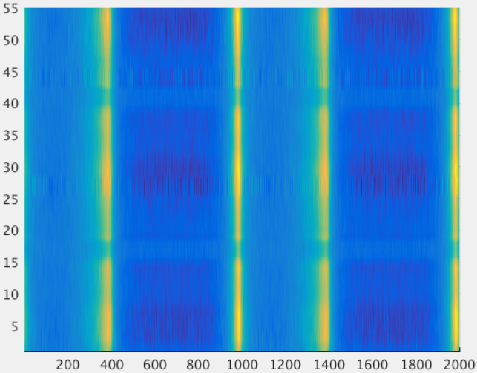
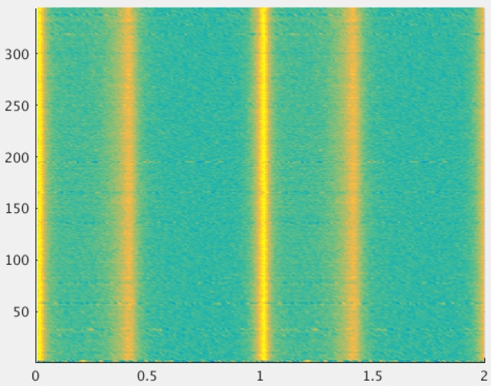
Insight-HXMT observations of the Crab pulsar
ME:
5-30 keV
Crab pulsar
HE:
20-250 keV
Time
(days)
LE:
1-15 keV
Phase
Calibration source for Insight-HXMT: launched on 2017-06-15
Phase

Slide 25


Coordinated observation with Radio
XAO
25m radio telescope
Time System of Insight-HXMT works properly

Slide 26


The largest glitch: Shaw et al. 2017

Slide 27


Parameters of the Glitch
Fitting residuals

Slide 28

Pulse profile: no obvious change
Radio
band
Shaw et al.2018

Slide 29

Pulsed X-ray flux reported
Swift/BAT
MAXI/ISS
Shaw et al.2018

Slide 30


No evolution of pulse X-ray emission
m
R=flux/<flux before glitch>
Pulsed emission no change after glitch: profile or flux
=L_{magnetic dipole}

Slide 31
IHEP’s Future Space Missions
Missions Approved/Funded:
  IHEP-participated missions: SVOM/GRM, EP/FXT
    Engineering model, space qualified model
  IHEP-led mission: GECAM (Mission of Opportunity for GW EM)
    Phase B → Phase C: launch 2020
  IHEP-led mission: eXTP (Flagship mission)
    Phase A → Phase B: launch in 2025?
Mission Under Review:
  IHEP-led mission: HERD (Flagship mission and the largest experiment physically on China’s Space Station)
    Concept and prototype study
    Ready for approval!
  IHEP-led mission: POLAR-2

Slide 32




SVOM (Space Variable Object Monitor)
GRM
VT
IHEP
30 keV-5 MeV
400-650 nm, 650-950 nm
MXT
Eclairs
0.3-5 keV
4-250 keV
450-900 nm
400-1700 nm
GWAC
GFTs
PI: Prof. Jianyan Wei, National Astronomical Observatories of China

Slide 33

The Einstein Probe (EP) mission
The first mission that uses Lobster-eye optics to monitor transients in the soft X-ray band.
Proposed in 2012, selected in the end of 2017
Launch date: 2022
FXT
Mission Features
Very wide FoV 1.1 sr (3600 sq. deg.) grasp: ~10,000 deg².cm²
Good angular resolution (~5’) and positioning accuracy (<1’)
Soft X-ray band: 0.5-5 keV
Sensitivity: >1 order of magnitude higher than current telescoeps
Autonomous X-ray follow-up (<10 arcsec localisation)
Fast alert data downlink and fast uplink for ToO (TBC)
PI: Prof. Weimin Yuan, National Astronomical Observatories of China

Slide 34

GECAM
--A leading mission in multi-messenger GW astronomy era
Sciences
  GW GRB, Fast Radio Bursts (FRB), High Energy Neutrinos (HEN), GRB, Magnetar
Performance (better than existing ones)
  100% all-sky FOV，high sensitivity，wide energy band, good localization
Innovations
  Two small satellites, ALL-TIME ALL-SKY
  BeiDou navigation system, real-time data
Progress Fast
  Proposed in Mar. 2016, soon after GW150914
  Review for Phase B on Nov. 1st, 2018
  To launch in 2020, life time>3 yrs
GECAM 2020
payload
Spacecraft
electronics
Payload
electronics
propeller
telemetry
Attitude
control
PI: Prof. Shaolin Xiong (IHEP)

Slide 35

eXTP: enhanced X-ray Timing and Polarimetry
--The next international flagship X-ray mission
Next Generation Flagship Observatory
Important Sciences
  Black holes, Neutron stars, etc.
  Extreme Physics
Cutting-edge technology
  Large eff. Area (~3.8 m²@6 keV)
  High spectral resolution (<180 eV@6 keV)
  Polarimetry
Phase B 2019.01 -2020.12: budget allocated ~2025 launch
Payload | Configuration | Eff. area (m²) | Timing res. (μs)
Spectroscopic Focusing Array (SFA) | 9 telescopes | 0.54m²@1keV | 10
Large Area Detector (LAD) | 40 modules | 3.4m²@8keV | 10
Polarimetry Focusing Array (PFA) | 4 telescopes | 380cm²@3keV | 500
Wide Field Monitor (WFM) | 6 cameras | 3.2 Sr （FOV） | 10
PI: Shuang-Nan Zhang (IHEP)

Slide 36

White papers on eXTP
Five refereed papers have been accepted for publication in a special issue of SCIENCE CHINA Physics, Mechanics & Astronomy and are available on arXiv.
S.-N. Zhang, A. Santangelo, M. Feroci, Y.P. Xu, et al., The enhanced X-ray Timing and Polarimetry mission - eXTP
A. L. Watts, W.F. Yu, J. Poutanen, S. Zhang, et al., Dense matter with eXTP
A. De Rosa, P. Uttley, L.J. Gou, Y. Liu, et al., Accretion in Strong Field Gravity with eXTP
A. Santangelo, S. Zane, H. Feng, R.X. Xu, et al., Physics and Astrophysics of Strong Magnetic Field systems with eXTP
J. J. M. in 't Zand, B. Enrico, J.L. Qu, X.D. Li, et al., Observatory science with eXTP

Slide 37
Spectral-Timing Mapping EOS with eXTP
Neutron or Quark Star?
General Relativity
Detailed simulations carried out to evaluate fitting procedure and accuracies (Lo et al. 2013, ApJ).
Few % accuracy needs ~10⁶ photons: 3-4m² area crucial.
Multiple same-source cross-checks.
eXTP
Using only known sources, eXTP’s pulse profile modelling measurements will map the M-R relation and hence the EOS.

Slide 38

















International Partners in eXTP
is considering eXTP MoO.

Slide 39



POLAR-2: Successor of POLAR
Based on POLAR (2016-201717: 6 months, on China’s TG-2 spacelab)
Proposed to China’s Space Station: ~2024
POLAR results: Zhang, S.N. et al. 2019, in press

Slide 40




HERD (High Energy cosmic-Ray Detector)
Mission concept
  A flagship and landmark scientific experiment
  onboard China's Space Station ~2025
  Large China-Europe collaboration
Sciences
  Indirect DM search with unprecedented sens.
  Precise CR spectrum and composition measurements up to the knee energy
  Gamma-ray monitoring and survey
Unique capabilities
  Direct PeV CR observation with best energy res.
  Gamma-ray sky monitor: GeV - TeV
  Largest geometric factors for electrons and cosmic rays
PI: Shuang-Nan Zhang (IHEP)

Slide 41
Summary
Insight-HXMT is China’s 1st X-ray astronomy satellite.
  1-15, 5-30, 20-250 keV and 200-5000 keV (ASM mode)
Insight-HXMT PV & calibration: June 15 to Nov. 15, 2017
  1/3 total time in Galactic plane scan and monitoring
  Many bright sources observed: BHs & NSs
  Many ToOs executed: ~hours response time possible
  ~100 GRBs/year (0.2 to 3 MeV)
Has started regular science operation for 4+ years
AO-2 for GTO and GO (International) released
  Props. due on 2019-03-15; Observs. to start on 2019-04-01
IHEP is involved/leading several future space missions on high energy astrophysics
  SVOM/GRM, EP/FXT, GECAM, eXTP, POLAR-2, HERD
http://www.hxmt.org/ for all information.

