Slide 1
Strangeon matter in kilonova
Xiaoyu Lai 来小禹
Hubei University of Education 湖北第二师范学院
2019/01/06
XIAMEN-CUSTIPEN WORKSHOP ON THE EOS OF DENSE NEUTRON-RICH MATTER
IN THE ERA OF GRAVITATIONAL WAVE ASTRONOMY
2019/01/03-2019/01/07

Slide 2
Outline
Strangeon stars
Merging strangeon stars
Summary

Slide 3
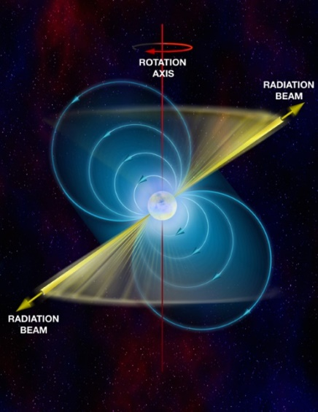
crust
u
d
Neutron stars
d
u
d
u
d
d
?
d
Gigantic nucleus (u+d)
Pulsar-like compact stars
u
d
d
u
Strange quark matter:
Deconfined u + d + s
d
u
Quark stars
d
s
s
s
u
s
d
d
Gigantic “strange nucleon”
u
s
d
s
u
d
u
Strangeon matter : Non-perturbative → Confined u+d+s → strangeons
u
u
Strangeon stars
s
d
s
d
u
u
u
u
s
s
d
d
s
Gigantic “strange nucleus”
d
d
s
s
d
u
s
d
u

Slide 4
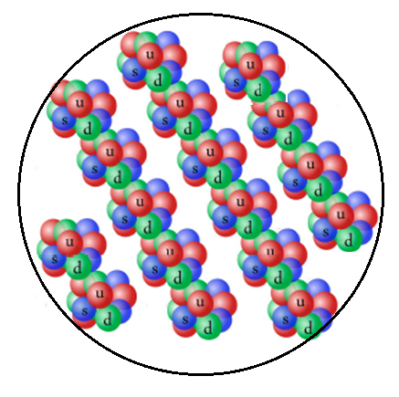
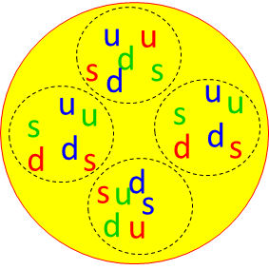
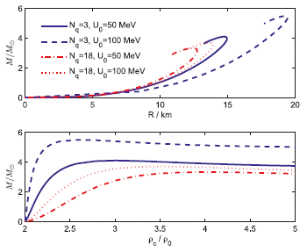
About strangeon stars
Strangeon stars are in solid state
Stiff EOS → High maximum mass
Lai & Xu 2009ab, Guo et al. 2014, Lai et al. 2013
Just before coalescence during merger, strangeon stars could “melt” due to tidal heating
(Lai & Xu, 2009)

Slide 5
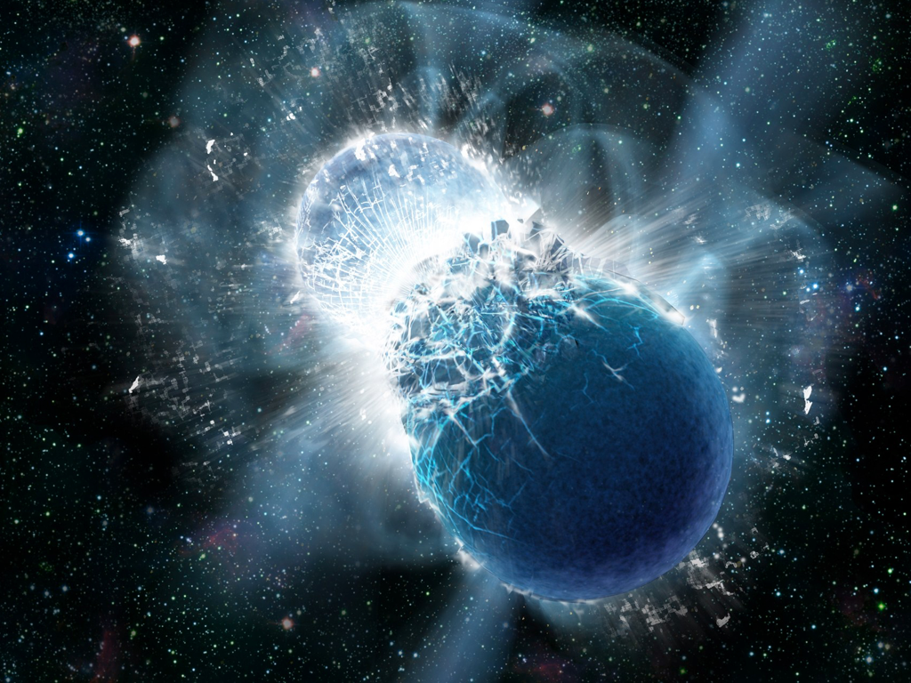
Merging strangeon stars
Nucleosynthesis ?
“kilonova” event ?
Strangeon nuggets
1. Baryon number A= ?
2. Distribution of A ?

Slide 6
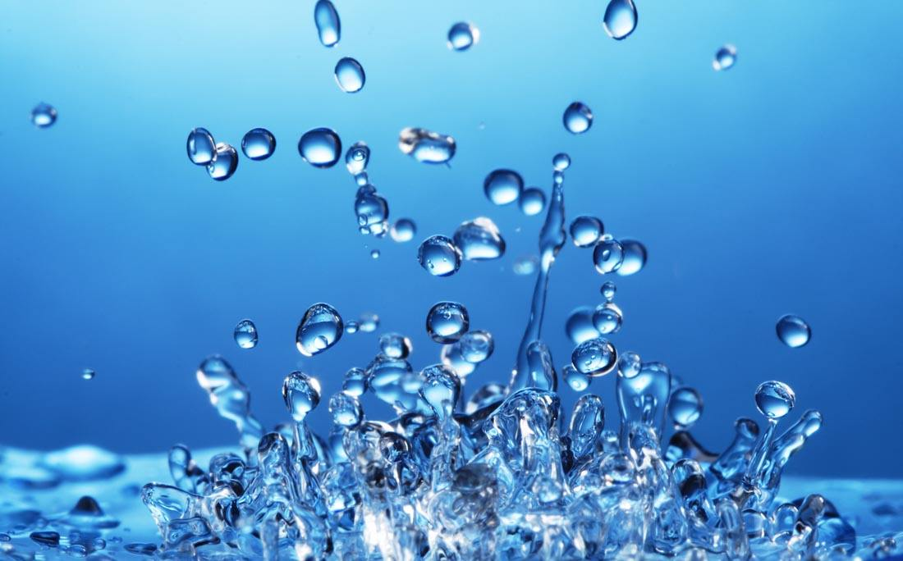
Estimate the maximum size of strangeon nuggets
$$2σr=\frac{GMm}{R^{2}}$$
$$m≈ρr^{3}$$
$$r≈\sqrt{\frac{σR^{2}}{ρGM}}\sim 1 μm \sqrt{\frac{σ}{10 MeV {fm}^{−2} }}$$
(M$\sim 1.4 M_{⨀}, R\sim 10 km$)
$$r≫Compton wavelength of electrons$$
$$A_{max}\sim {10}^{27}$$
$${0<A<A}_{max}$$
Stable or unstable under 3 flavors → 2 flavors ?

Slide 7
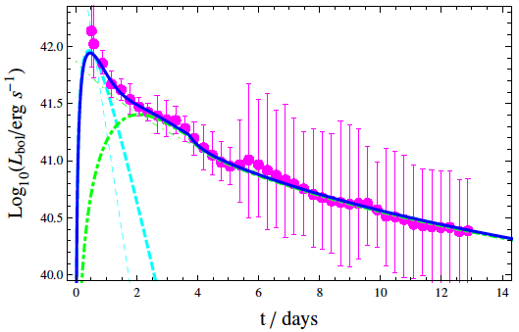
Merging strangeon stars: strangeon kilonova?
Spin-down of
the remnant star
Delayed energy injection
Lai et al. 2018

Slide 8
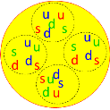
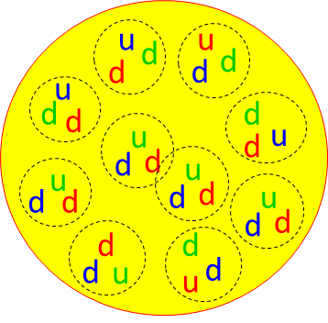
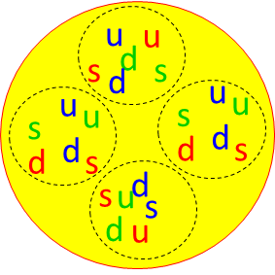
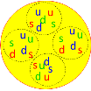
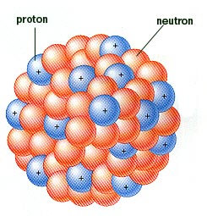
Merging strangeon stars: nucleosynthesis
Decay
3 flavors → 2 flavors
Strangeon nuggets
(unstable)
Neutron-rich nuggets
Fragment (fission)
R-process nuclei without R-process !
“Standard kilonova”
Neutron-rich nuclei

Slide 9
Summary
If pulsar-like compact stars are strangeon stars
Global structure of pulsars
The Gravitational wave signals of merger
The “kilonova” event

