Slide 1
What’s the central engine after GW170817?
Zigao Dai
School of Astronomy and Space Science, Nanjing University
Workshop on Dense Neutron-Rich Matter in GW Era
Xiamen, 4-7 January 2019

Slide 2
Central objects post NS-NS mergers
M_{s}>M_{diff,max}
M_{max}<M_{s}<M_{diff,max}
M_{s}: gravitational mass of merger remnant
M_{TOV}: maximum mass for non-rotating NS
M_{max}: maximum mass with uniform rotation
M_{diff,max}: maximum mass with differential rotation

Slide 3
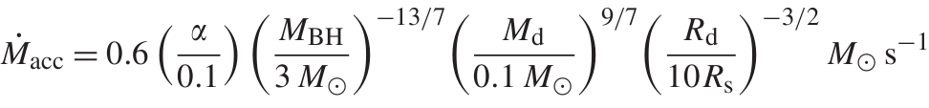
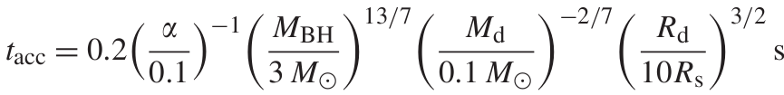
(I) Black holes + disks
Forming an accretion disk in a NS-NS merger: 0.03-0.3M_{ʘ} (Rosswog et al. 1999, 2000, 2001)
Forming an accretion disk in a NS-BH merger: 0.1-0.3M_{ʘ}, depending on q=M_{NS}/M_{BH} (Janka et al. 1999; Davies et al. 2005)
Neutrino-dominated accretion rate and disk’s lifetime (Narayan et al. 2001; Liu et al. 2015a):

Slide 4
Launching a jet
Neutrino-driven jet (Goodman et al. 1987; Eichler et al. 1989; Narayan et al. 2001; Di Matteo et al. 2002; Liu et al. 2015b): neutrino annihilation efficiency ∼0.01-0.001, E∼10⁴⁹(M_{disk}/0.1M_{ʘ}) erg.
Magnetically-driven (BZ) jet (Narayan et al. 1992; Meszaros & Rees 1997): E∼10⁵¹(M_{disk}/0.1M_{ʘ}) erg.

Slide 5
(II) Millisecond pulsars
A transient hypermassive or supramassive NS (Kluzniak & Lee 1998; Baumgarte et al. 2000; Shapiro 2000; Rosswog & Davies 2002; Rosswog & Ramirez-Ruiz 2002; Rosswog et al. 2003; Shibata et al. 2006; Duez et al. 2006)
A post-merger stable massive NS or a strange quark star (Dai & Lu 1998a, 1998b; Dai et al. 2006; Fan & Xu 2006; Gao & Fan 2006; Zhang 2013)
A short GRB could be due to differential rotation in the interior (Kluzniak & Ruderman 1998; Dai & Lu 1998b) or an accretion disk (Zhang & Dai 2008, 2009, 2010).

Slide 6
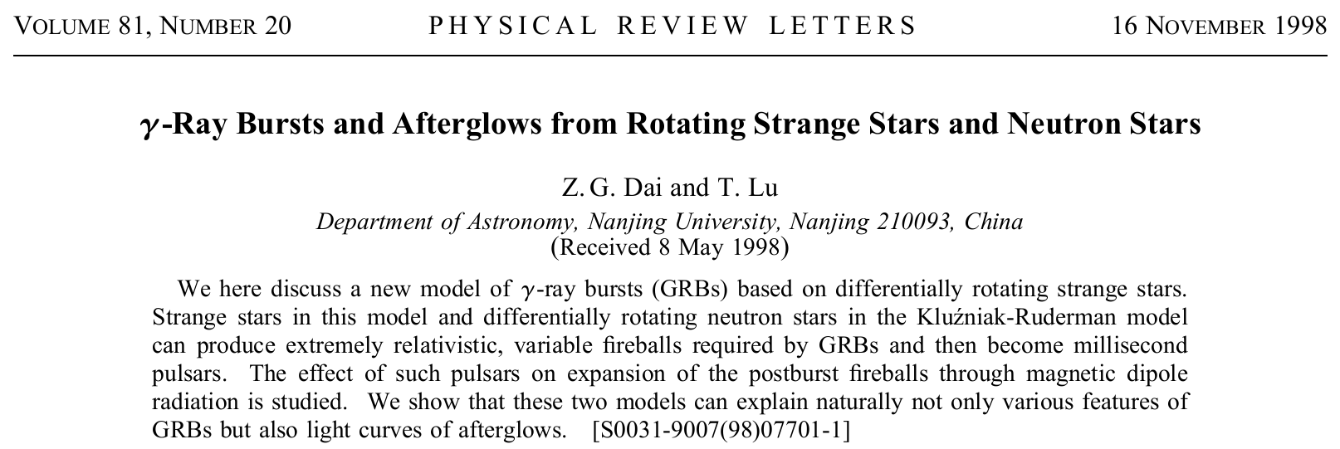
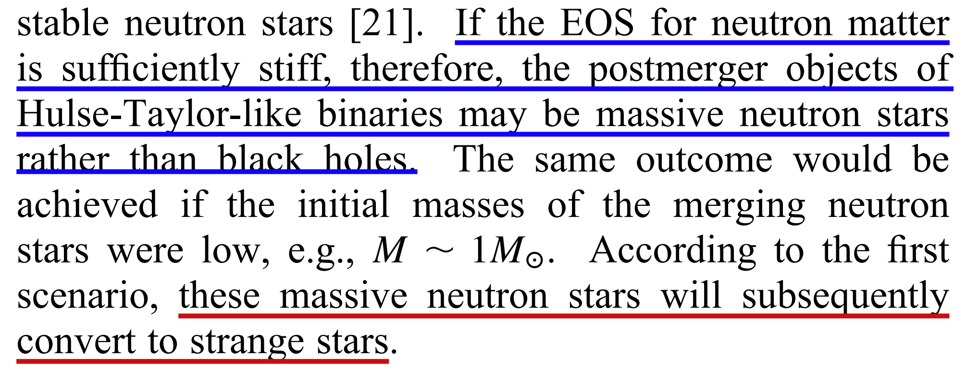

Slide 7
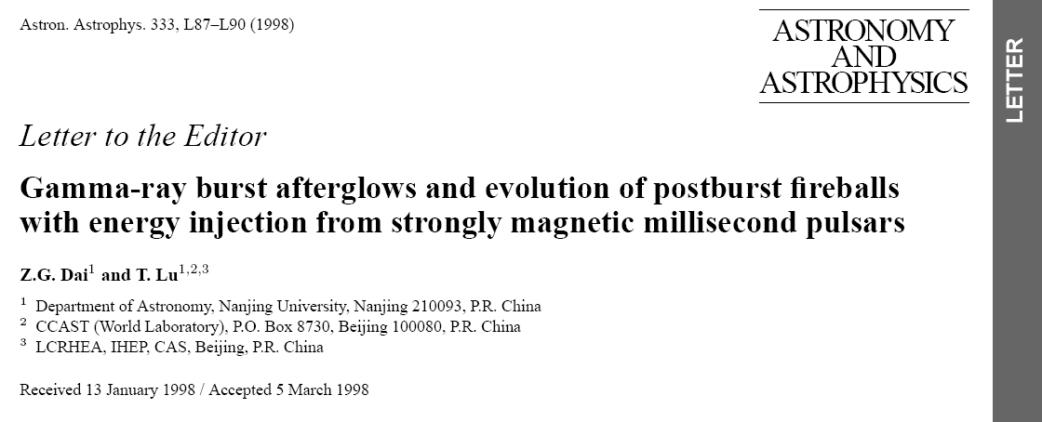
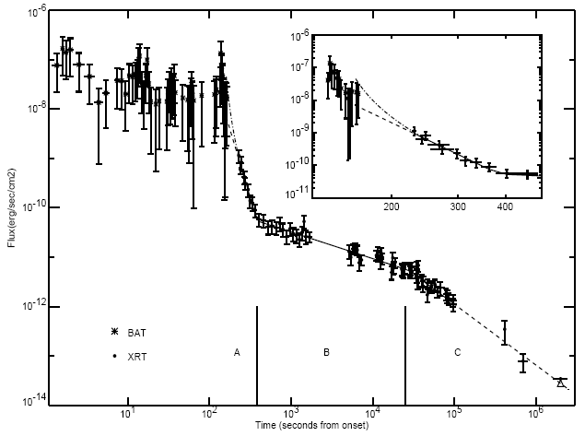

Temporal plateaus
Injected energy ≈ E/2

Slide 8
Following pulsar energy-injection model (Dai & Lu 1998, A&A, 333, L87), numerical simulations by some groups (e.g., Fan & Xu 2006 for short GRB051221A; Dall’Osso et al. 2011) provided fits to shallow decay of some GRB afterglows with different slopes.

Slide 9
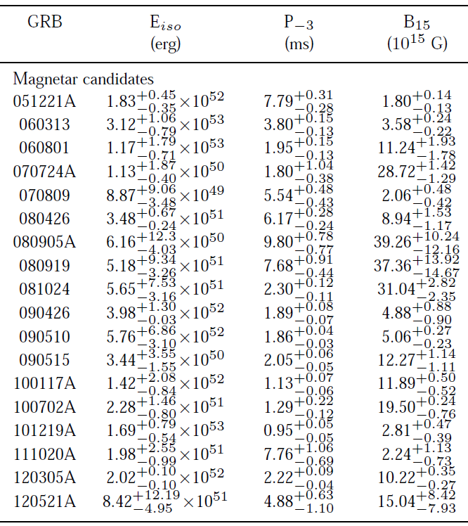
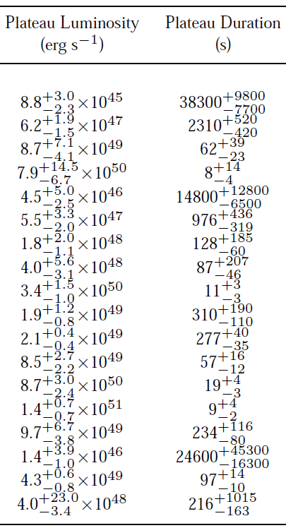
Rowlinson et al. (2013): magnetar sample for short GRBs

Slide 10
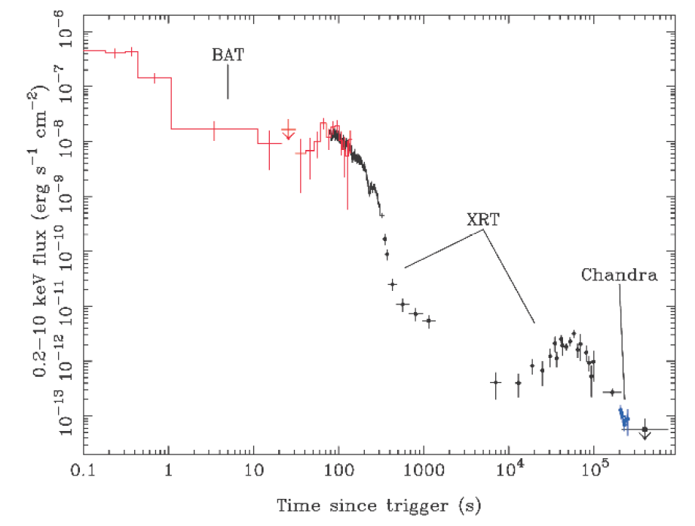
X-ray flares
Short GRB050724: Barthelmy et al. 2005, Nature, 438, 994

Slide 11
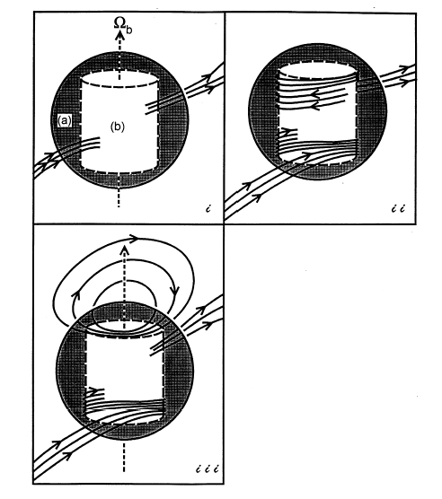
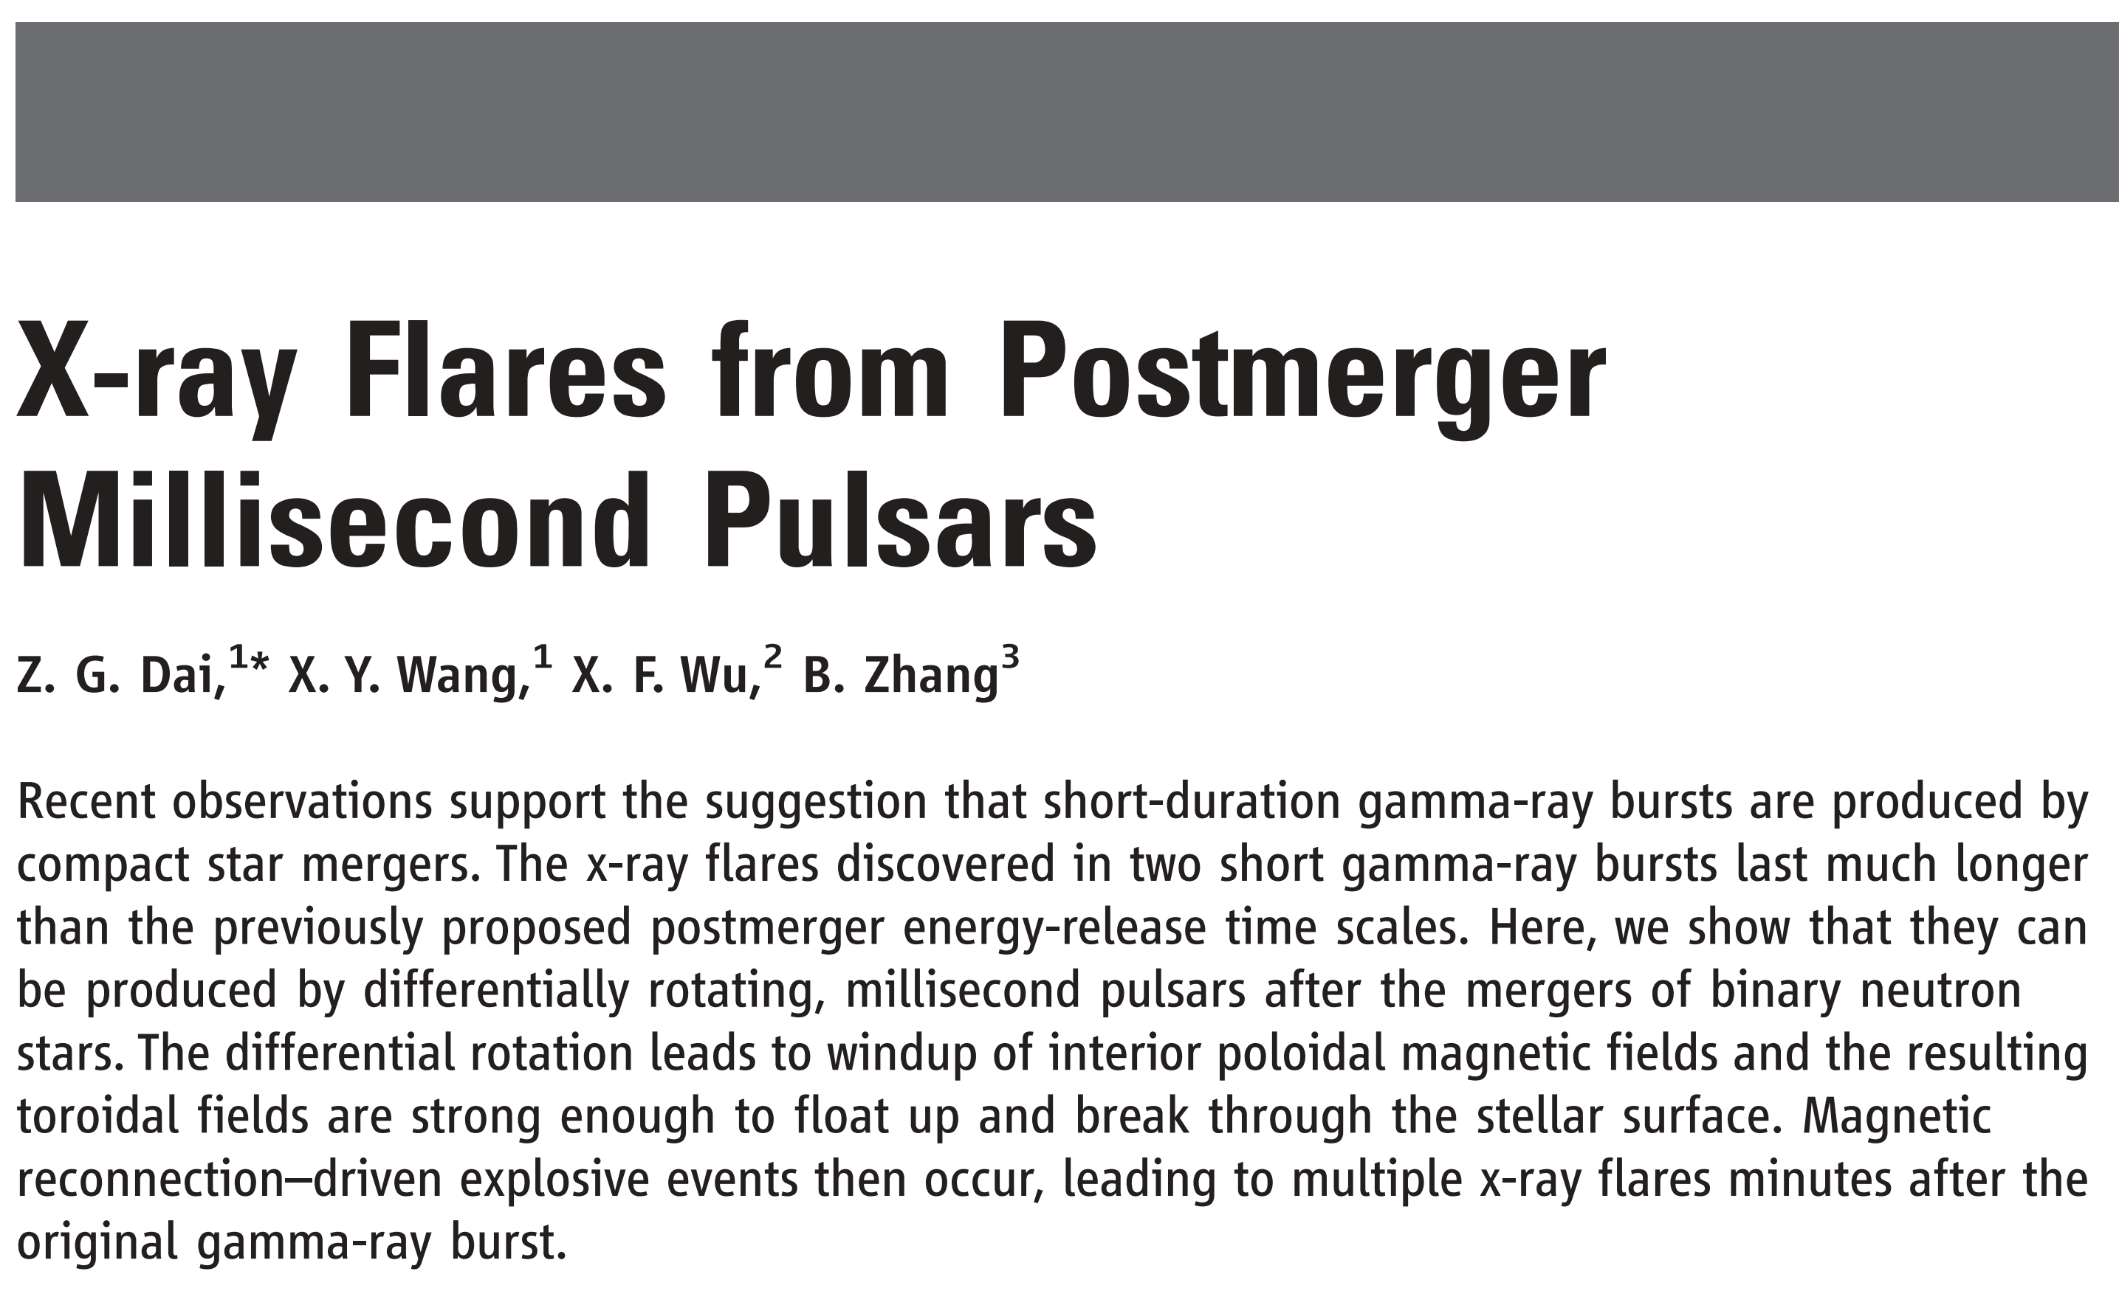
Kluzniak & Ruderman (1998)
To explain late-time X-ray flares, both a low poloidal magnetic field and an ultrastrong toroidal field are required!
Dai et al. 2006, Science, 311, 1127

Slide 12
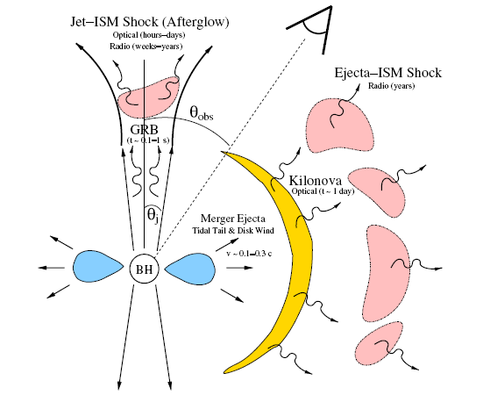
EM signals from post-merger BHs
Short GRBs and afterglows
Multiwavelength transients
Durations ∼ seconds, days, weeks, years
Radioactively-powered kilonovae
Li & Paczyński 1998
Dark optical transients
Duration ∼ a few days
Forward shock emission
Nakar & Piran 2011
Radio afterglows
Duration ∼ years
Metzger & Berger 2012

Slide 13
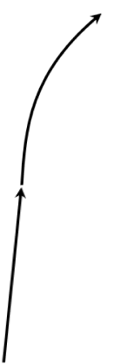




EM signals from post-merger pulsars
afterglow
Short GRBs and afterglows
Long-lasting activity
→ plateaus and flares
Dai & Lu 1998; Dai et al. 2006
Short GRB
X-ray
Wind dissipation-induced emission
Radio, optical,
X-rays
1000 to 10000 s
Dai 2004; Zhang 2013
ejecta
Rotationally-powered mergernovae
X-ray
Luminous optical transients
Duration ∼ days
MNS
Yu, Zhang & Gao 2013
Poynting flux
Forward shock emission
e⁺e⁻ pairs
Luminous transients
Durations ∼ hours, days, months, years
Gao, Ding, Wu, Zhang & Dai 2013
Wang & Dai 2013; Wu et al. 2014
From Wu Xuefeng

Slide 14
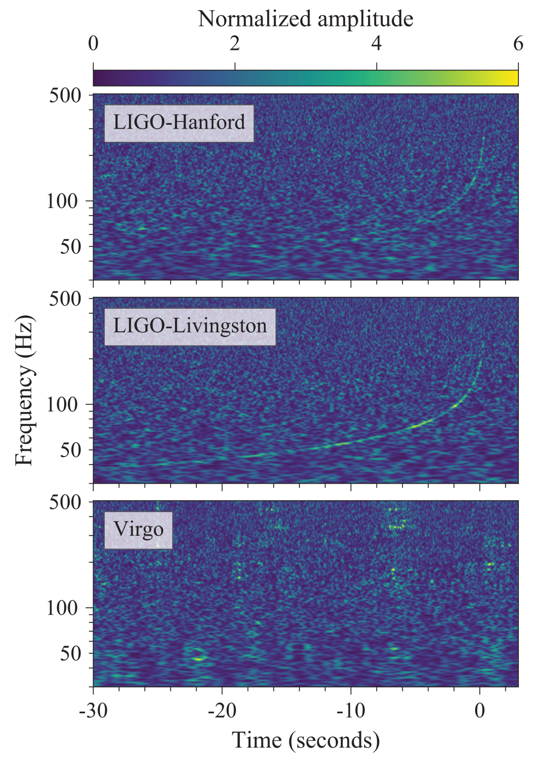
GW170817
Abbott et al. 2017, PRL, 119, 161101

Slide 15
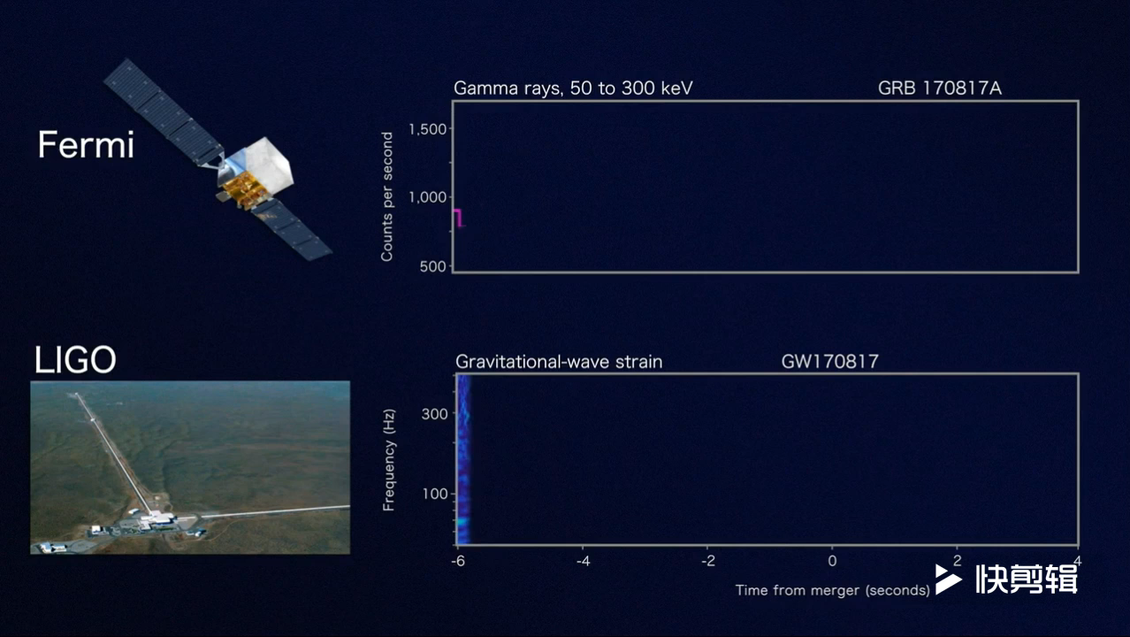
(1) GRB170817A

Slide 16
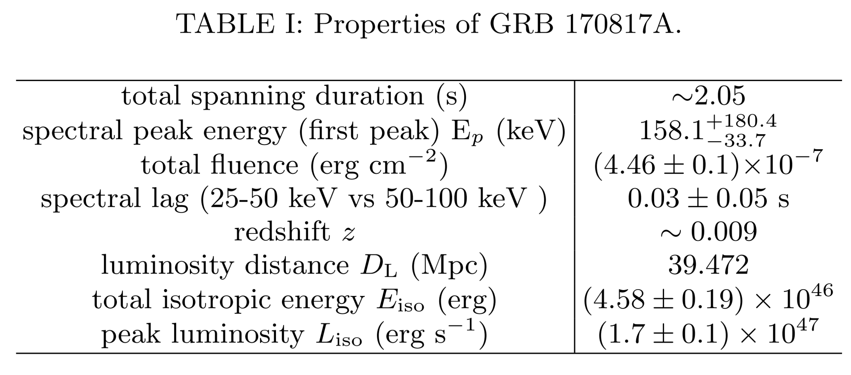
Properties of GRB 170817A
Zhang, B.-B. et al. 2018, Nature Communications, 9, 447

Slide 17
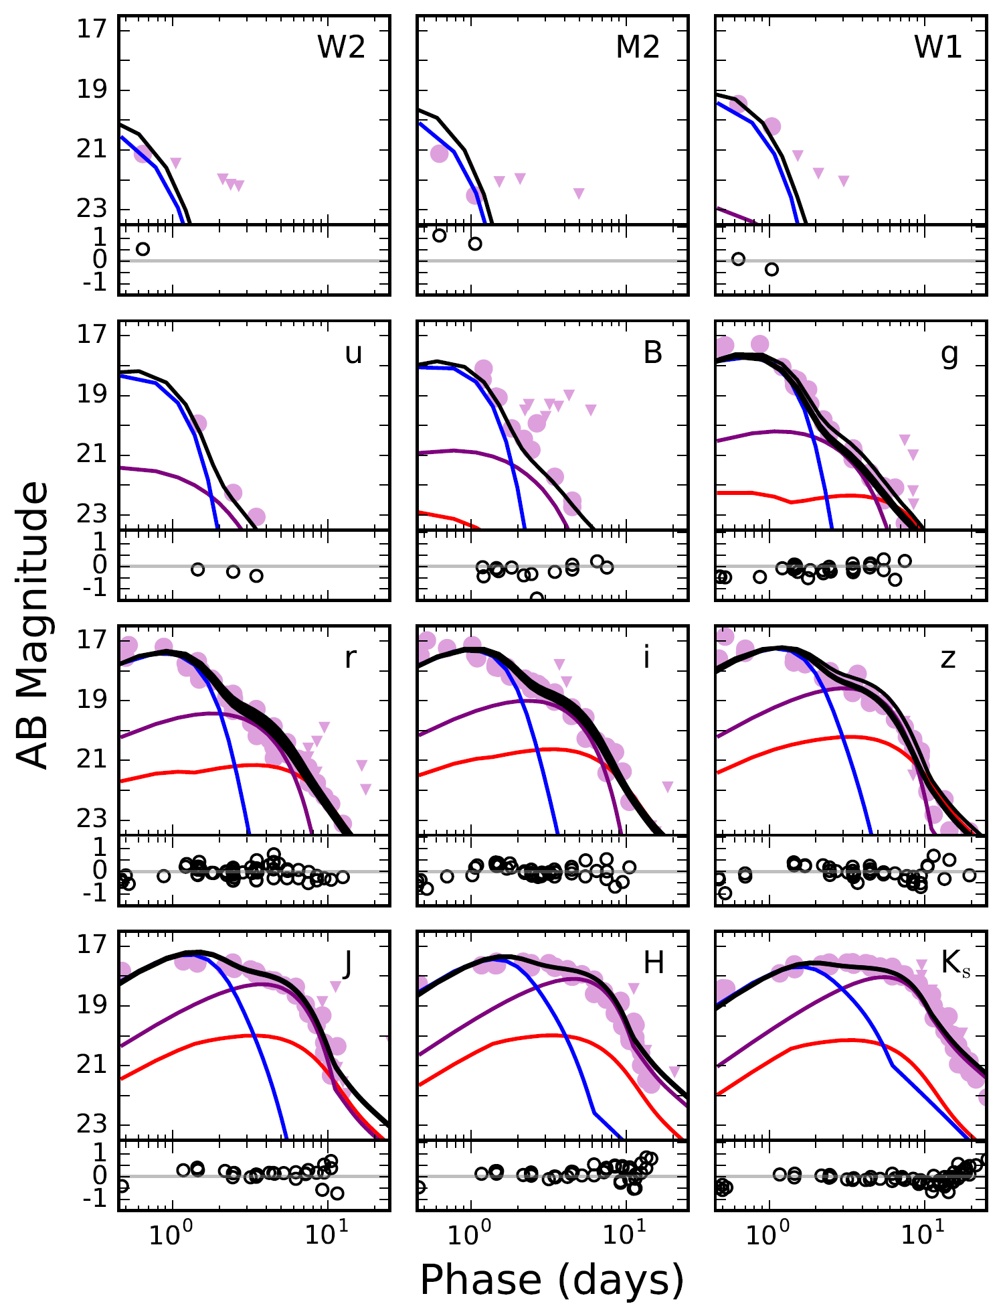
(2) Kilonova AT2017gfo
Villar et al. (2017, ApJL, 851, L21) modeled the complete UVOIR dataset for kilonova:
① a blue lanthanide-poor component (≈0.5cm²/g, M_{ej}≈0.016M⊙ &v_{ej}≈0.27c);
② an intermediate opacity purple component (≈3cm²/g, M_{ej}≈0.040M⊙ & v_{ej}≈0.14c);
③ a red lanthanide-rich component (≈10cm²/g, M_{ej}≈0.009M⊙ & v_{ej}≈0.08c).
M_{ej,tot}≈0.065M⊙, too large!

Slide 18
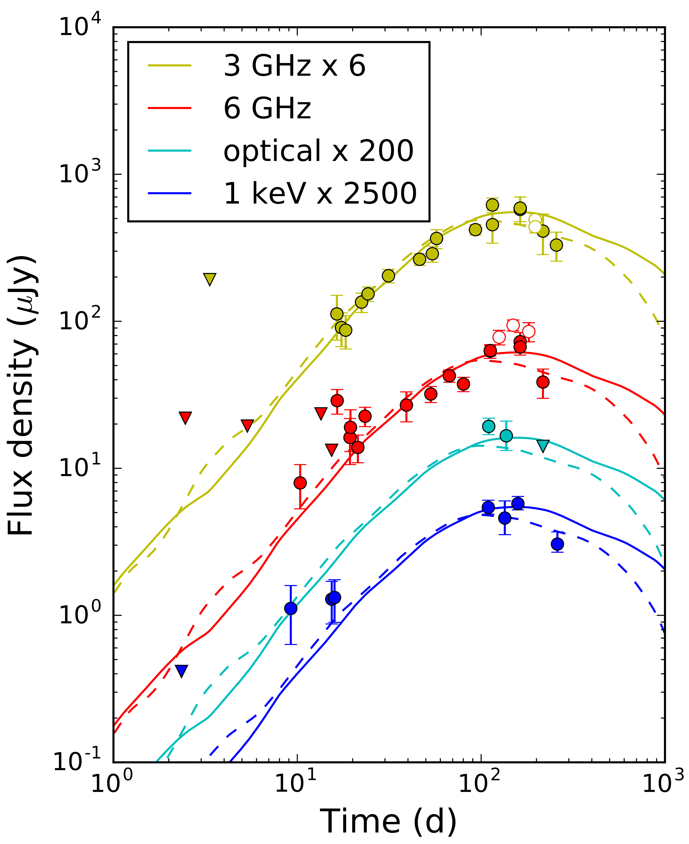
(3) Broadband afterglow
Brightening via energy injection:
Central,
angular, & radial
VLA, Chandra & HST: Alexander et al. 2018, ApJL, 863, L18

Slide 19
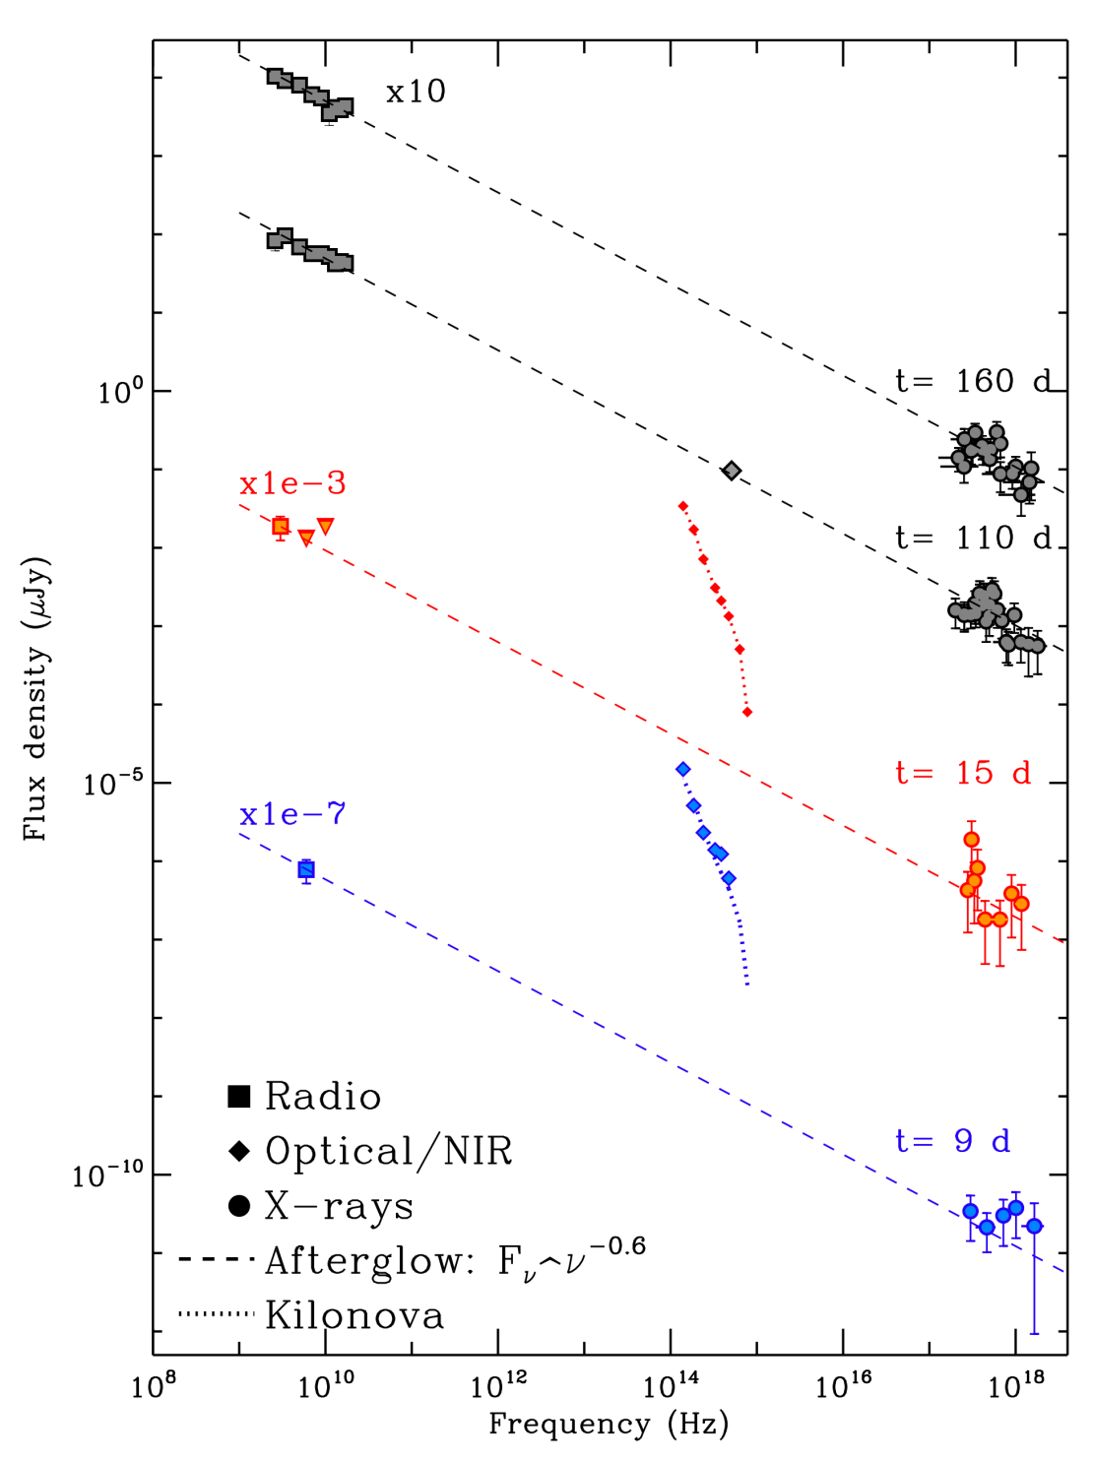
Margutti et al. 2018, ApJL, 856, L18： Evolution of the broadband SED from 9 d to 160 d since merger.
SED: F_{ν}∝ν^{-0.6}

Slide 20
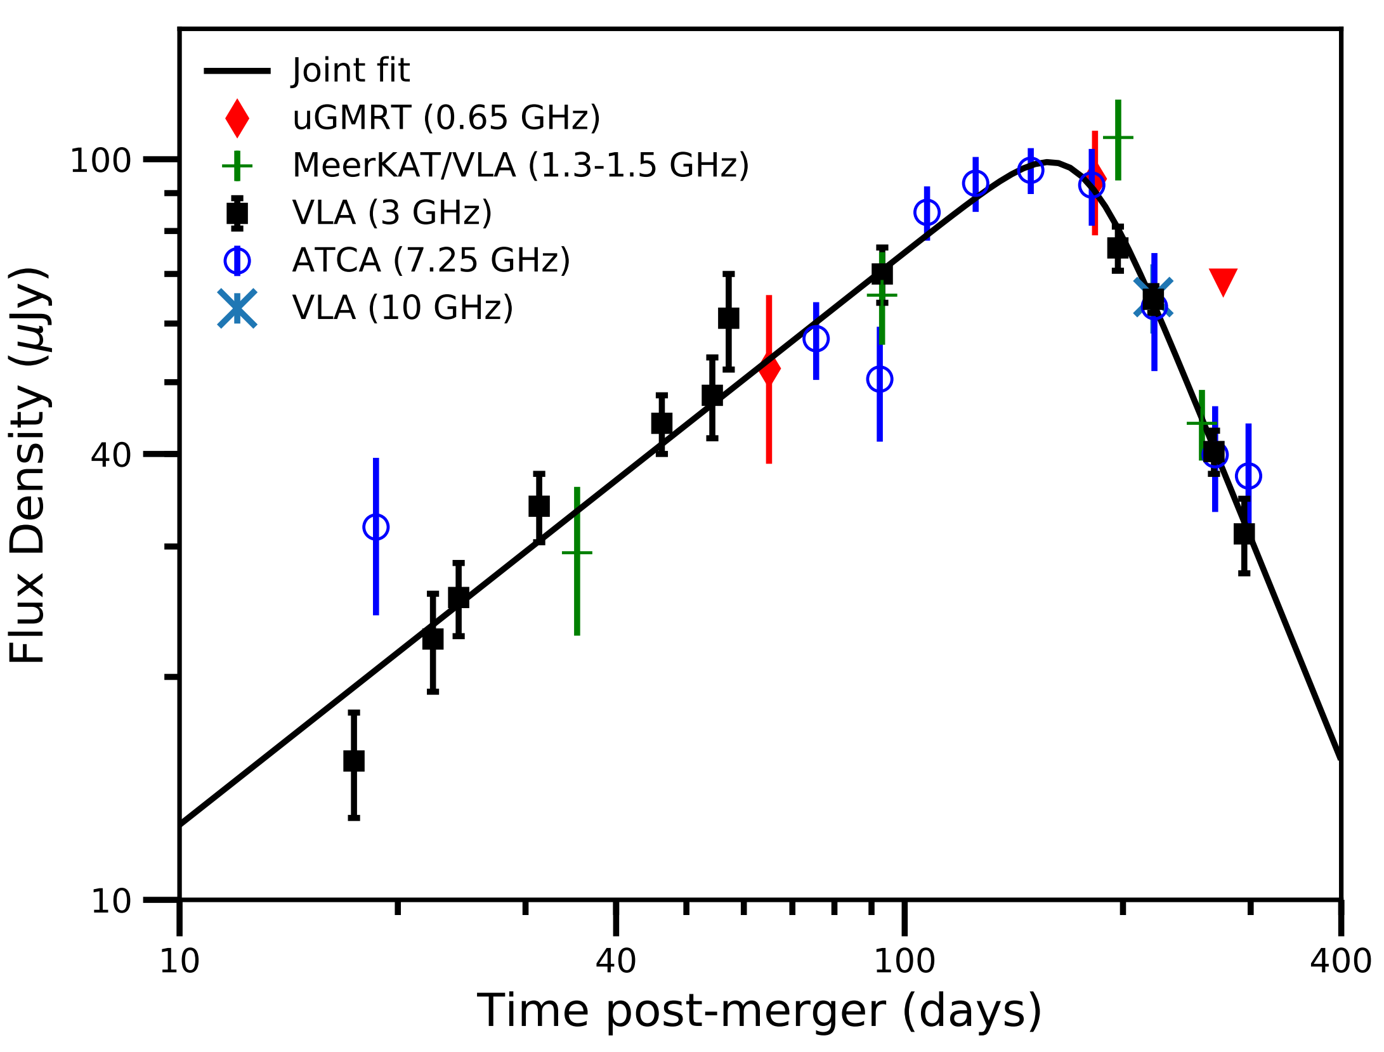
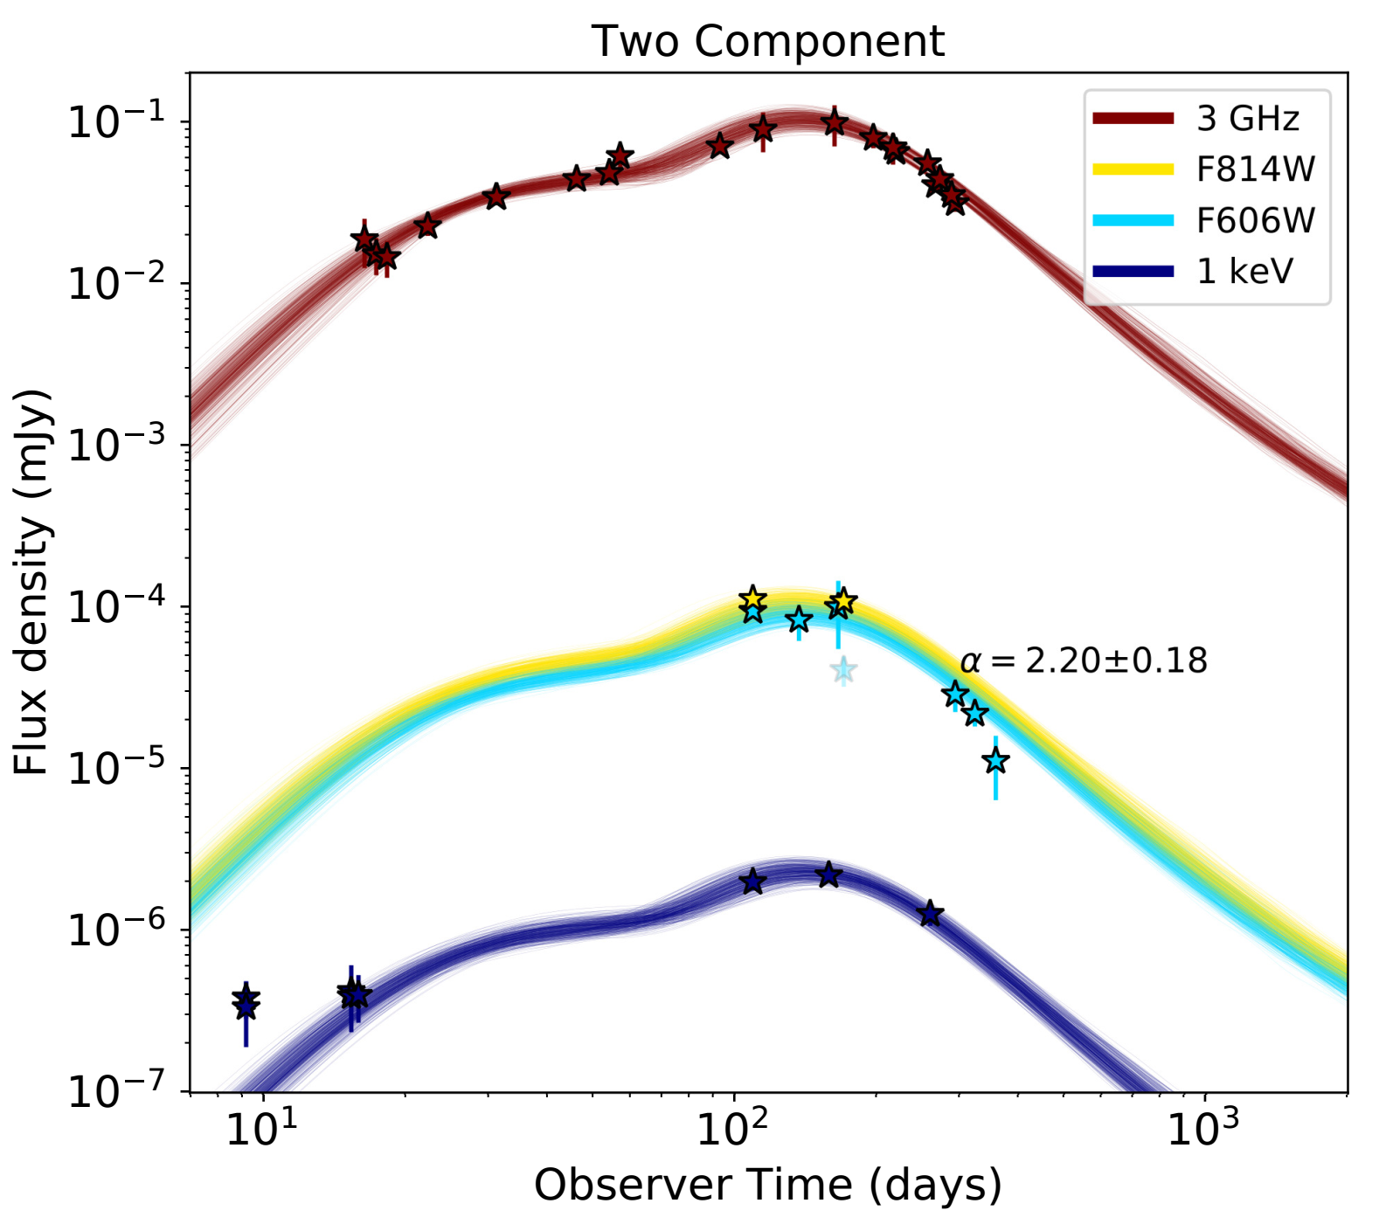
A Strong Jet Signature in Late-Time Lightcurves
F_{ν}∝t^{-p} after jet break
t^{-2.2}
Radio: Mooley et al. 2018, ApJL, 868, L11
Optical: Lamb et al. 2018, arXiv:1811.11491

Slide 21
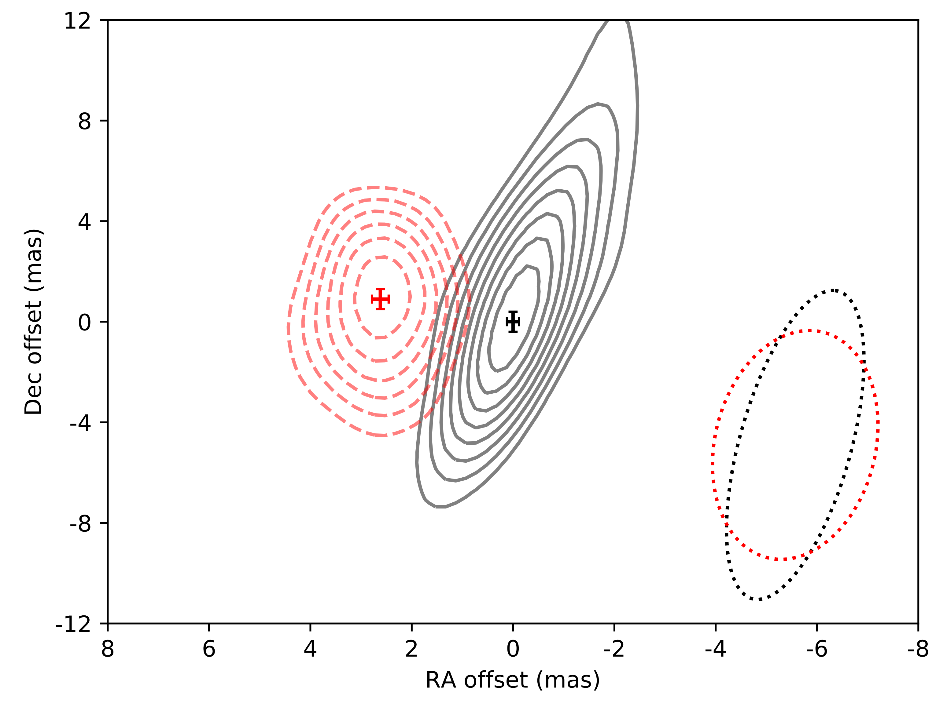
Superluminal motion of a relativistic jet in GW170817 by VLBI observations: Mooley et al. 2018, Nature, 561, 355
Γ ≈ 4
75 & 230 days post-merger

Slide 22
GW170817/GRB 170817A
Why off-axis?
High detection rate
Low-luminosity GRB
Faint afterglow
Superluminal motion
Dominated kilonova
But structured jet or two-component jet
Standard picture (Metzger & Berger 2012)

Slide 23
A NS remnant is possible, but
To see a faint afterglow, the spin-down luminosity is low or its conversion efficiency is low, requiring B_{p} is not strong, say, B_{p}<10¹¹ G (Pooley, Kumar et al. 2018; Ai, Gao, Dai et al. 2018, ApJ, 860, 57).
To see an afterglow only in 150 days, most of the rotational energy should be carried off by GWs for B_{p}∼10¹⁴ G (requiring a remnant ellipticity ε∼10⁻³)
or B_{p}<10¹¹G and ε<10⁻⁴ (Ai, Gao, Dai et al. 2018).

Slide 24
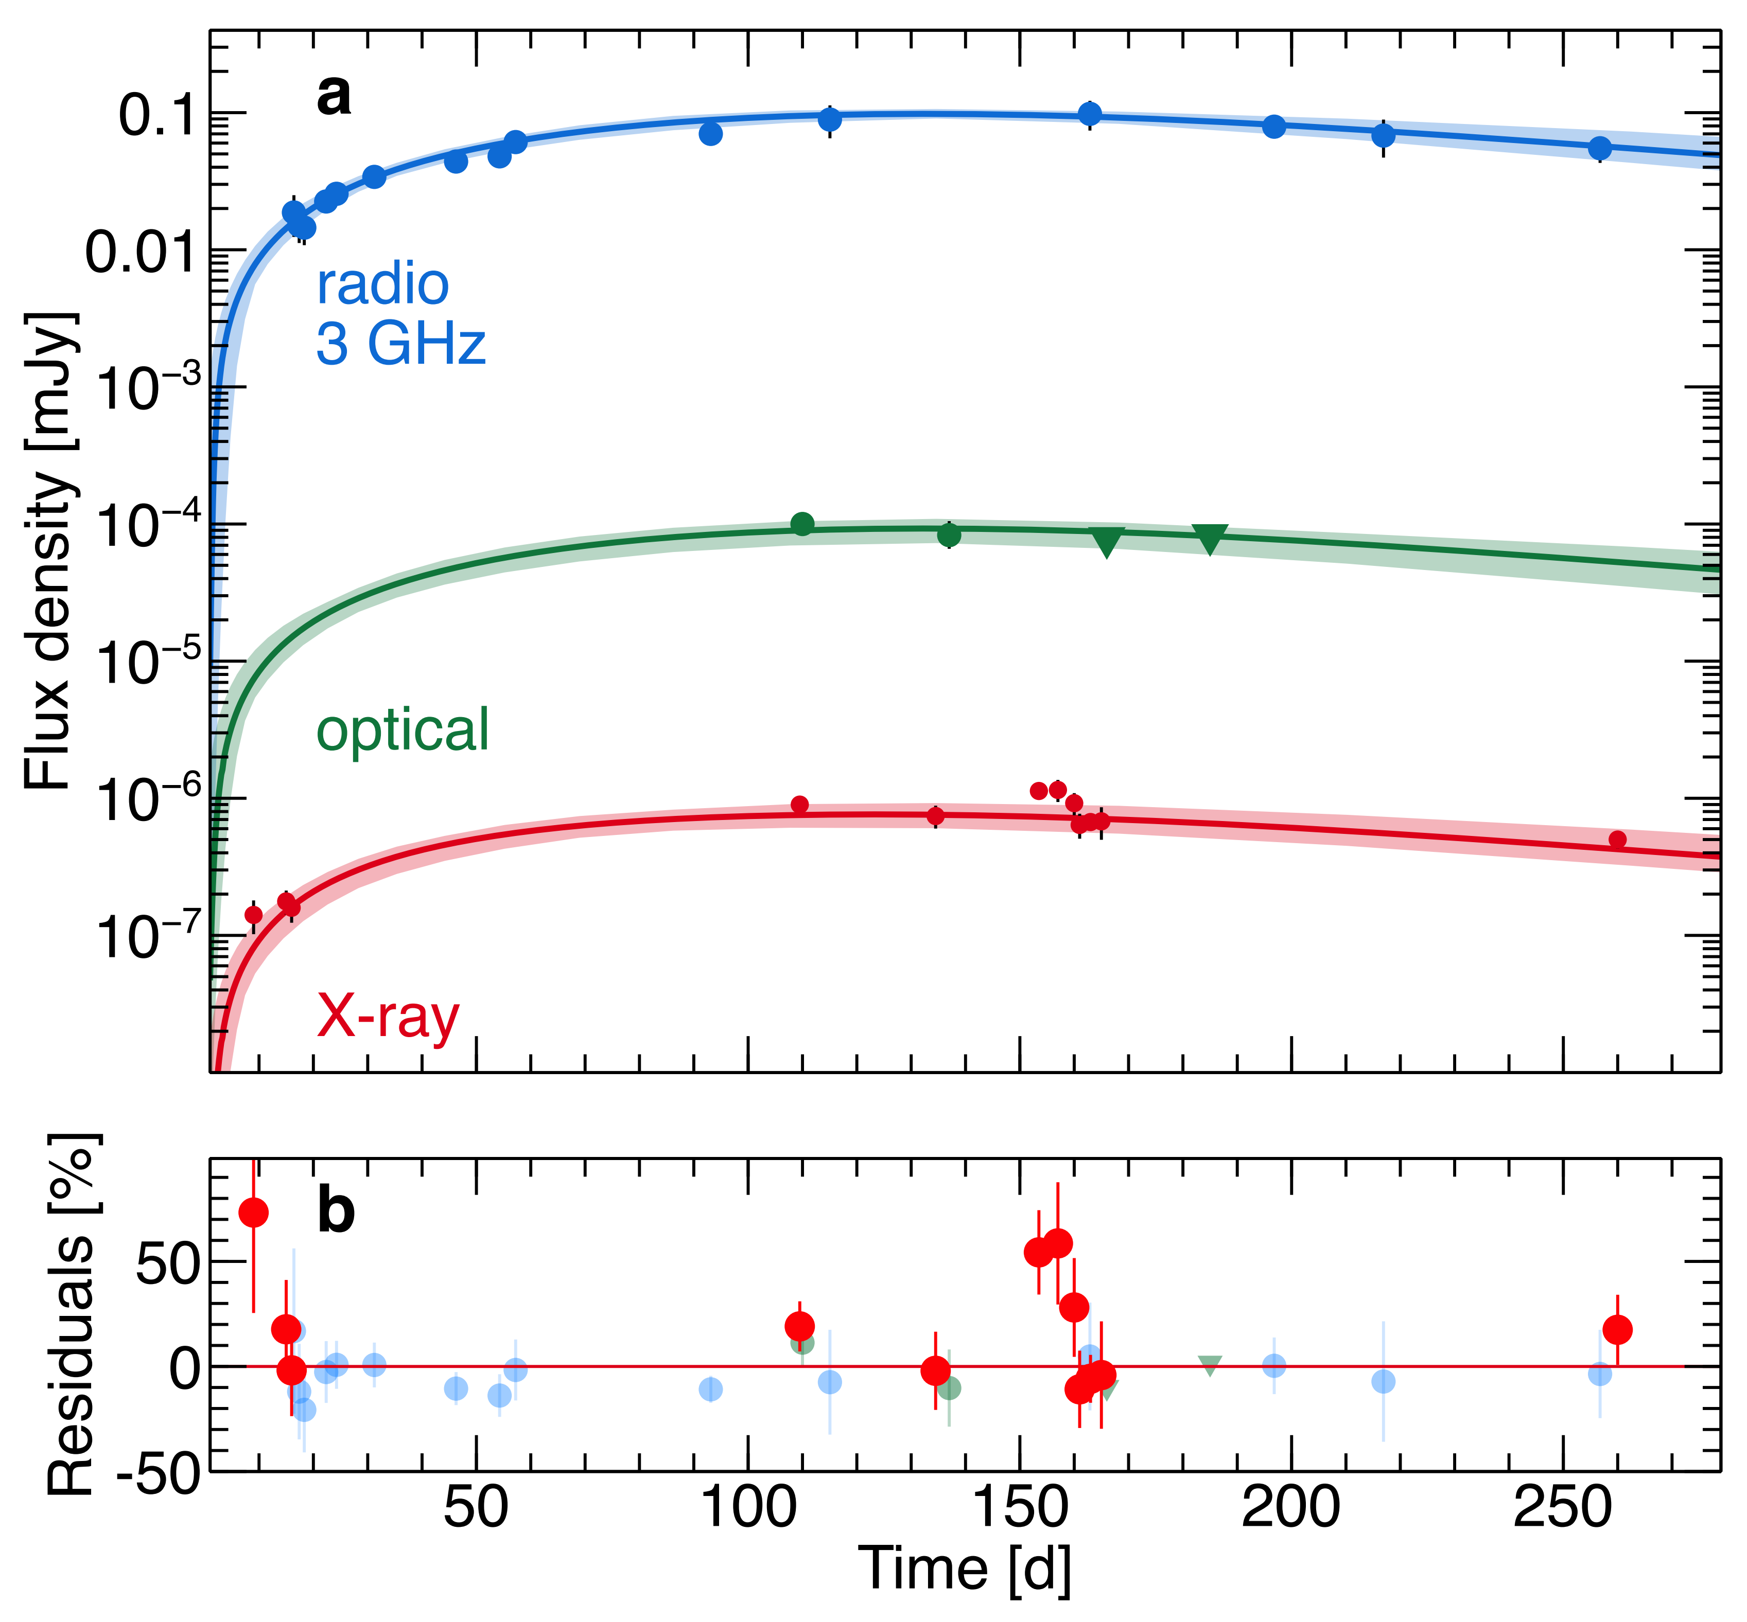
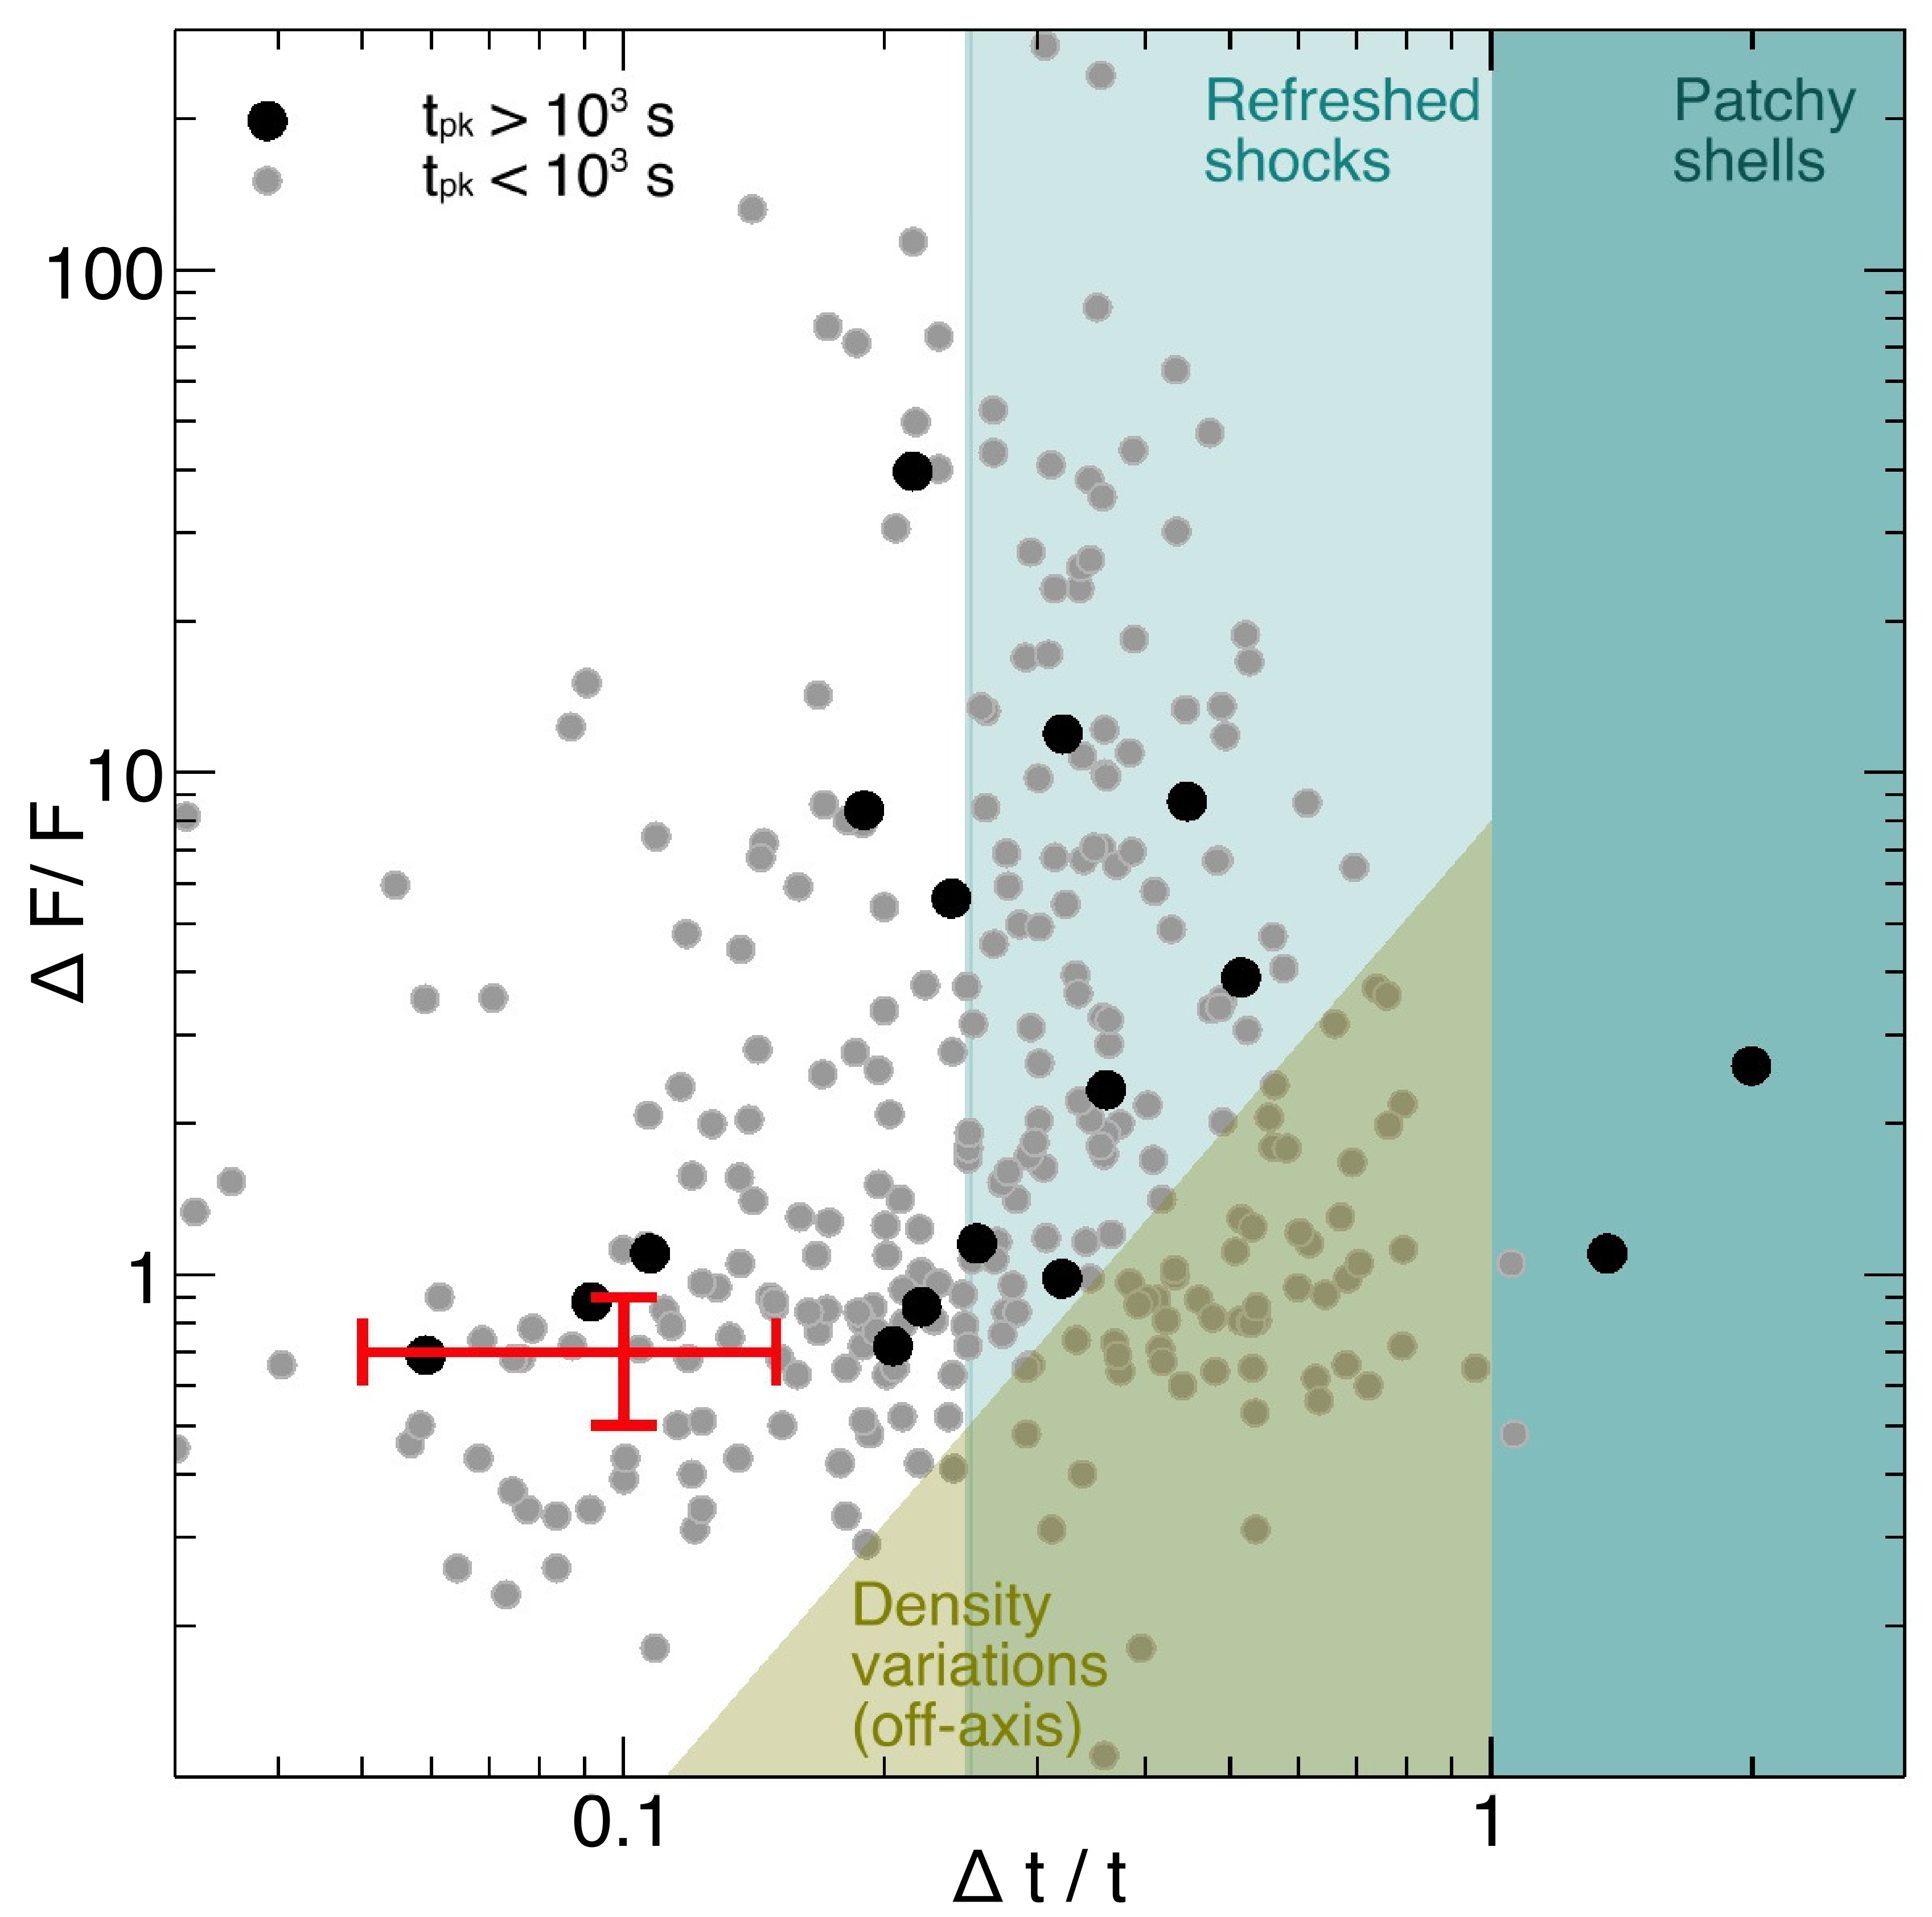
A NS remnant is further required
An X-ray flare (L_{pk}∼2×10³⁹ erg/s) detected by Chandra at ∼160 days post-merger requires late activity of the GW170817 remnant, ruling out a BH based on the t^{-5/3} fallback accretion rate (Piro, Troja, Zhang et al. 2019).
Possible signature for a long-lived NS remnant (Dai et al. 2006, Science, 311, 1127).
Piro, Troja, Zhang et al. 2019, MNRAS, 483, 1912

Slide 25
Models for kilonova AT2017gfo
Radioactively-powered models, but their inconsistencies: (1) The estimated mass for red kilonova (∼0.01-0.1M_{ʘ}) is more massive than the theoretical prediction (<0.01M_{ʘ}) for dynamical ejecta; (2) The ejecta velocity required for blue kilonova (>0.1-0.3c) is too high for postmerger ejecta found in numerical simulations (∼0.05c) (Shibata et al. 2017).
Pulsar-powered models: a long-lived NS remnant (Yu, Liu & Dai 2018; Ai, Gao, Dai et al. 2018; Li, Liu, Yu & Zhang 2018).

Slide 26
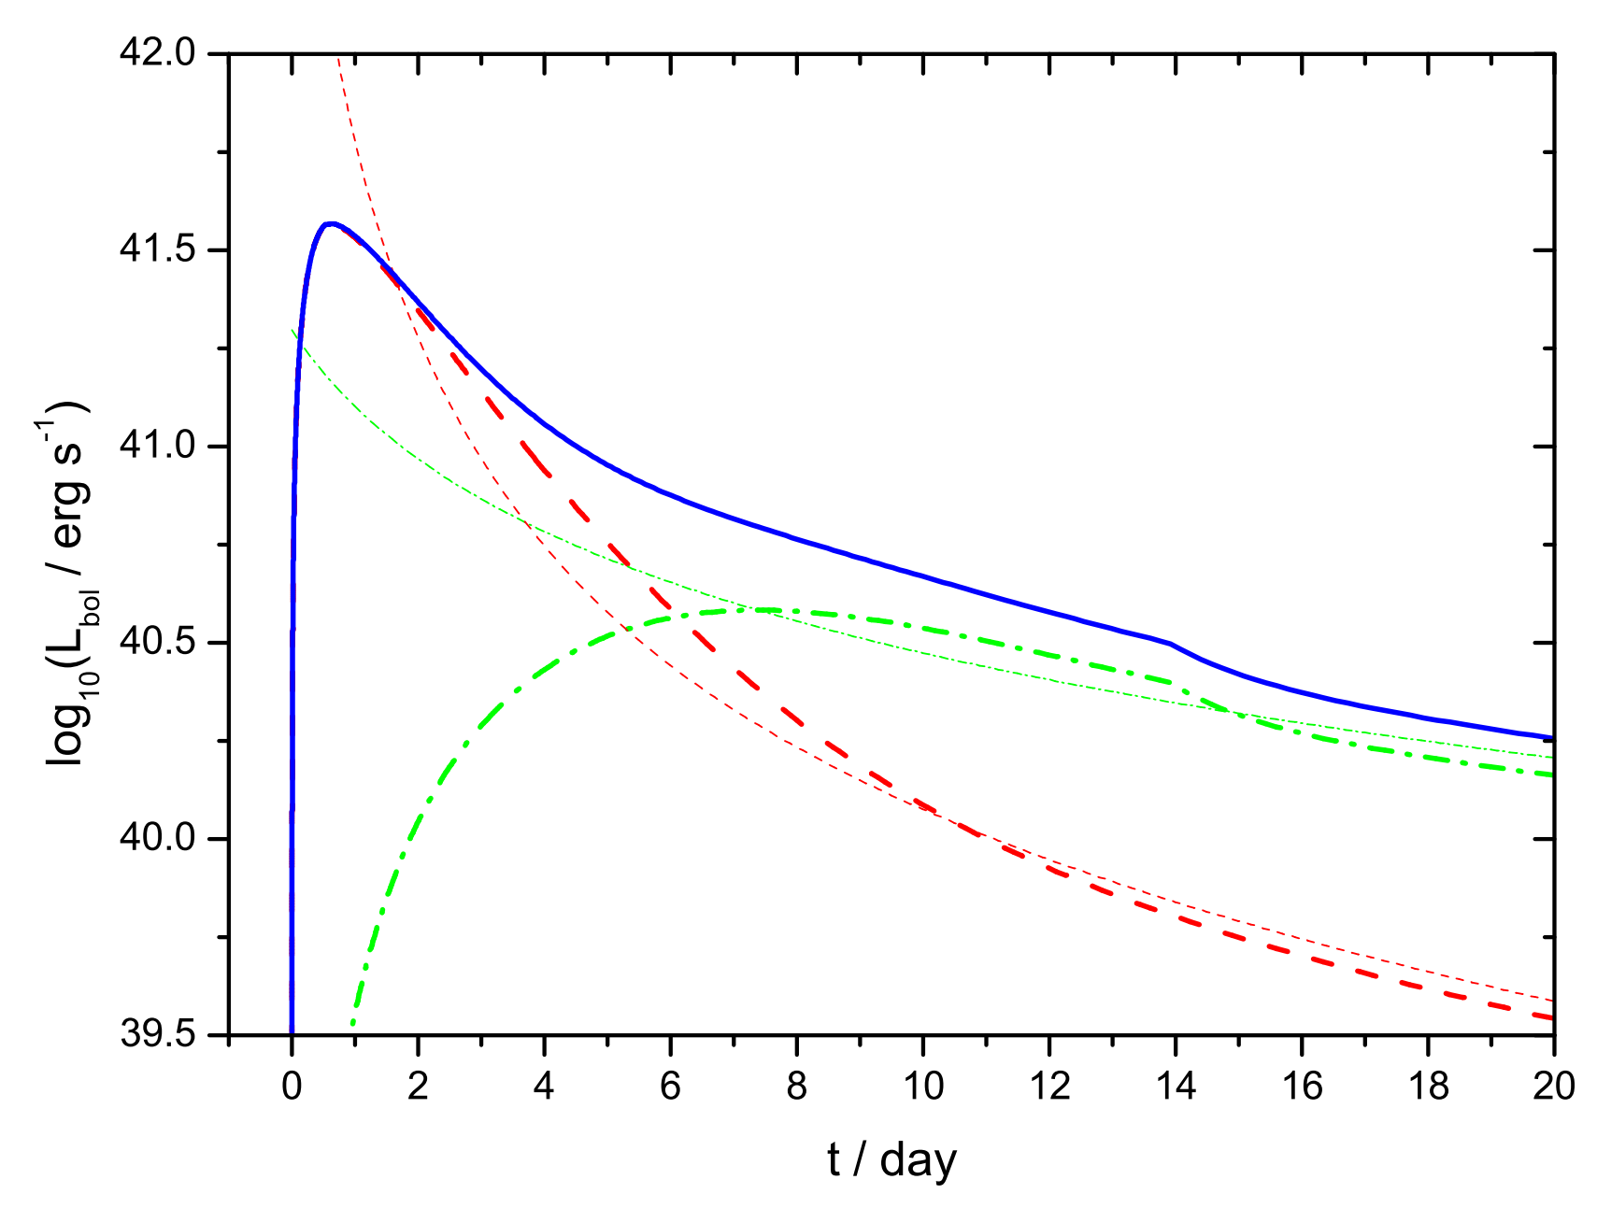
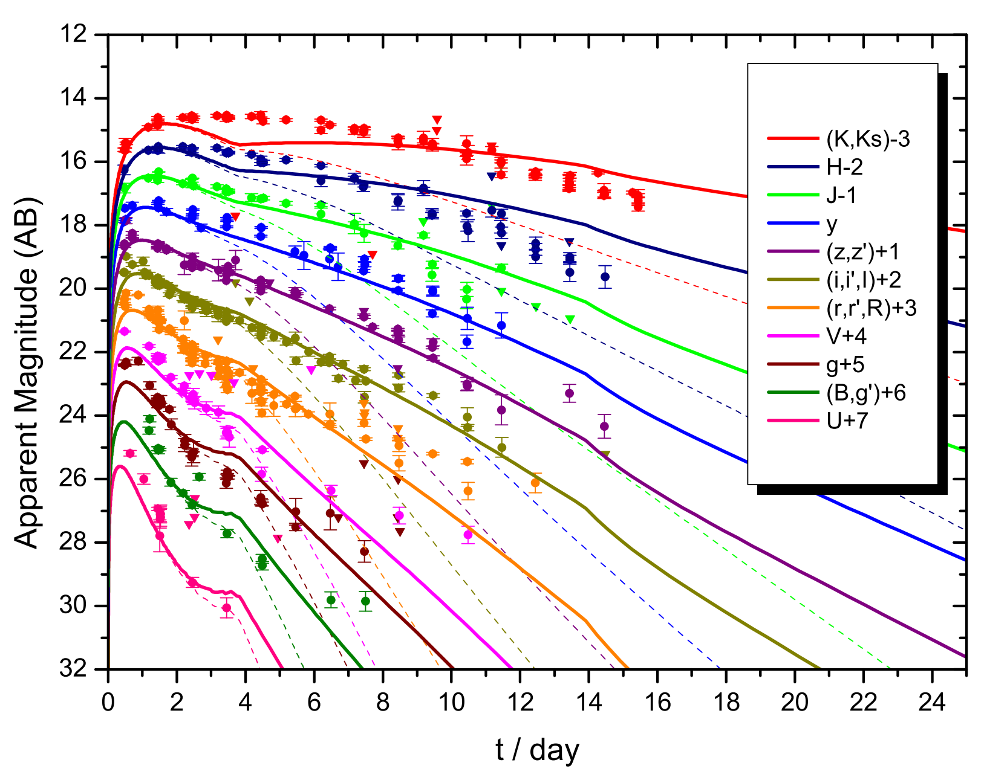
Yu, Liu & Dai 2018, ApJ, 861, 114: A long-lived neutron star remnant after GW170817, in a hybrid-energy model.
The ejecta parameters: opacity κ=0.97 cm²/g, mass M_{ej}=0.03M⊙, velocity v_{min}=0.10c, v_{max}=0.40c, & δ=1.46.

Slide 27
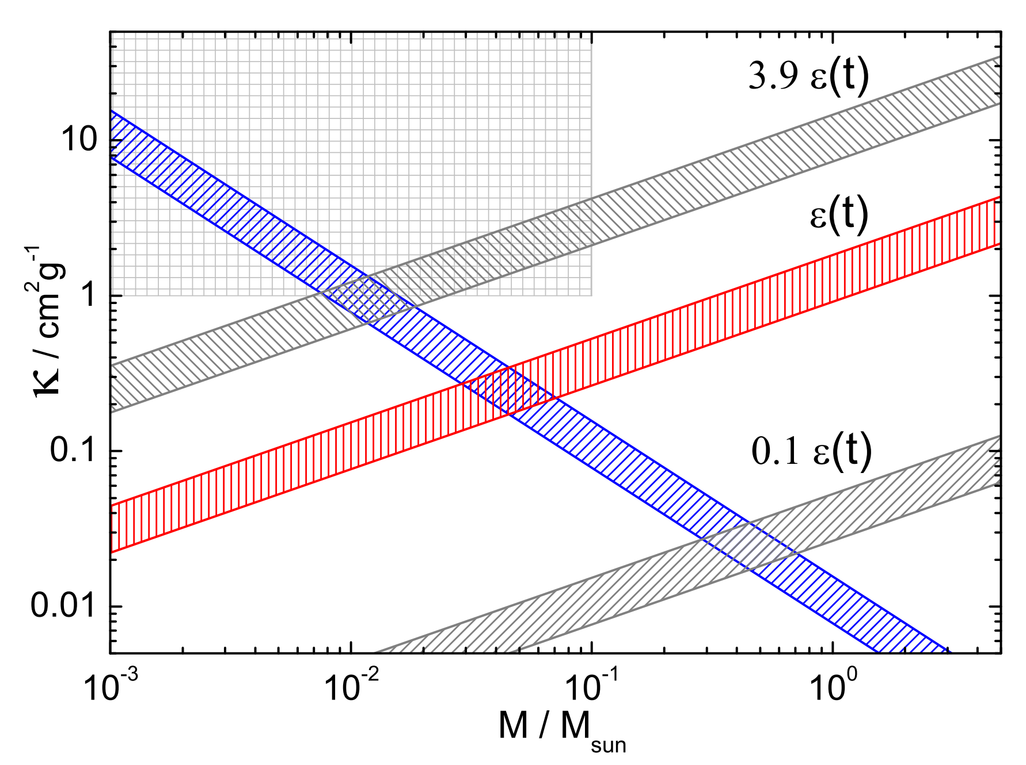
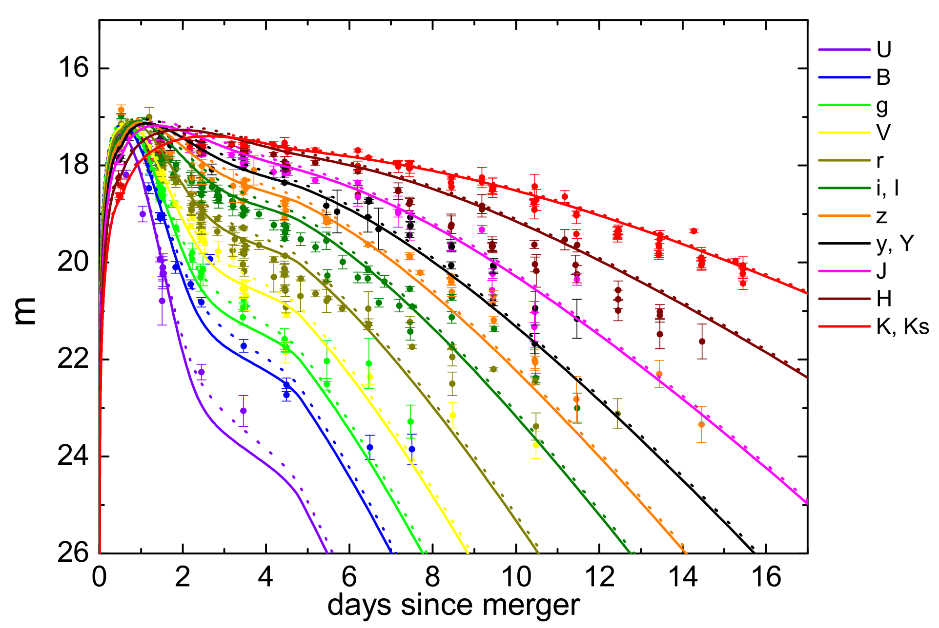
No radioactivity, only pulsar power
The high expansion velocity could increase the opacity significantly due to bound-bound transitions (Karp+77).
But, a high Y_{e} in ejecta could suppress nucleosynthesis of heavy elements.
Need central engine power.
t_{p}=1 day
L_{p}=10⁴²erg/s
Li, Liu, Yu & Zhang, ApJL, 861, L12: M_{ej}≈0.006M_{ʘ}

Slide 28
Models for broadband afterglow
Jet with angular distribution (Structured jet; Lazzati et al. 2017; Ruan et al. 2018; Lyman et al. 2018; Troja et al. 2018; Resmi et al. 2018; Gill & Granot 2018; Alexander et al. 2018)
Cocoon with radial distribution (Mass as a function of Γβ; Mooley et al. 2018; Nakar & Piran 2018; Troja et al. 2018; Nakar, Gottlieb, Piran et al. 2018; Gill & Granot 2018)
Pulsar-powered relativistic jet (Geng, Dai, Huang et al. 2018)

Slide 29
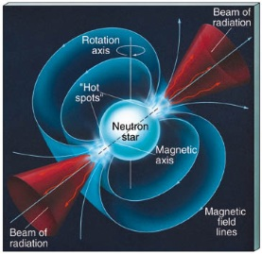
Relativistic Pulsar Wind Nebula
Shocked ambient medium or ejecta (zone 2)
Ambient medium or ejecta (zone 1)
Shocked wind (zone 3)
A relativistic e⁻e⁺ wind (zone 4)
Forward shock
^{Black hole}
Reverse shock
Contact discontinuity
Dai 2004, ApJ, 606, 1000
Dai et al. 2017, ApJL, 838, L7

Slide 30
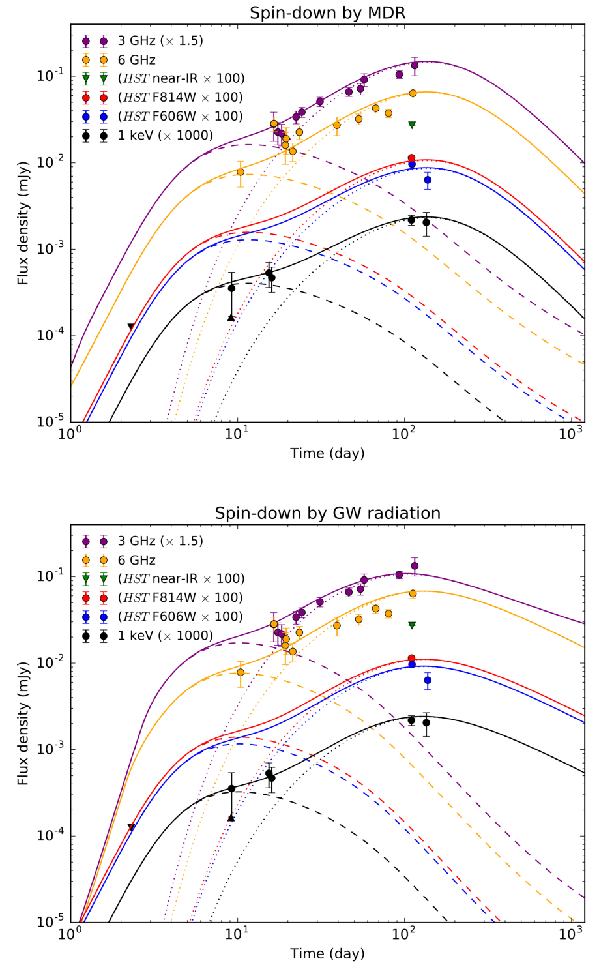
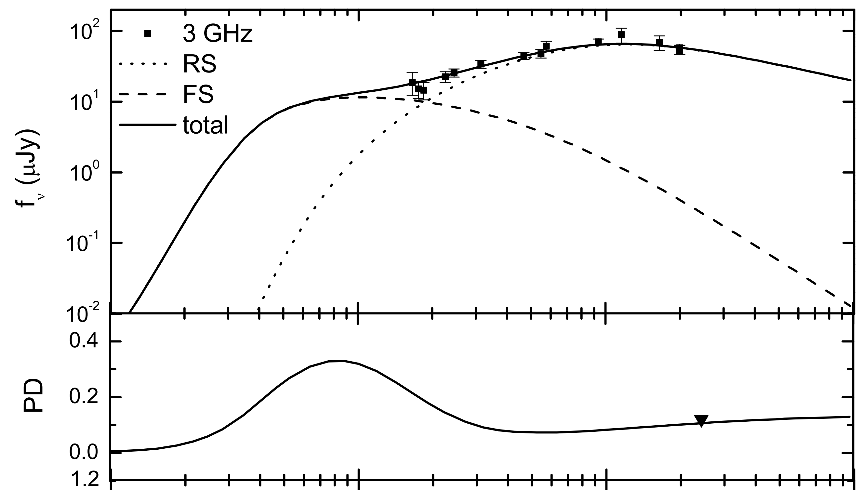
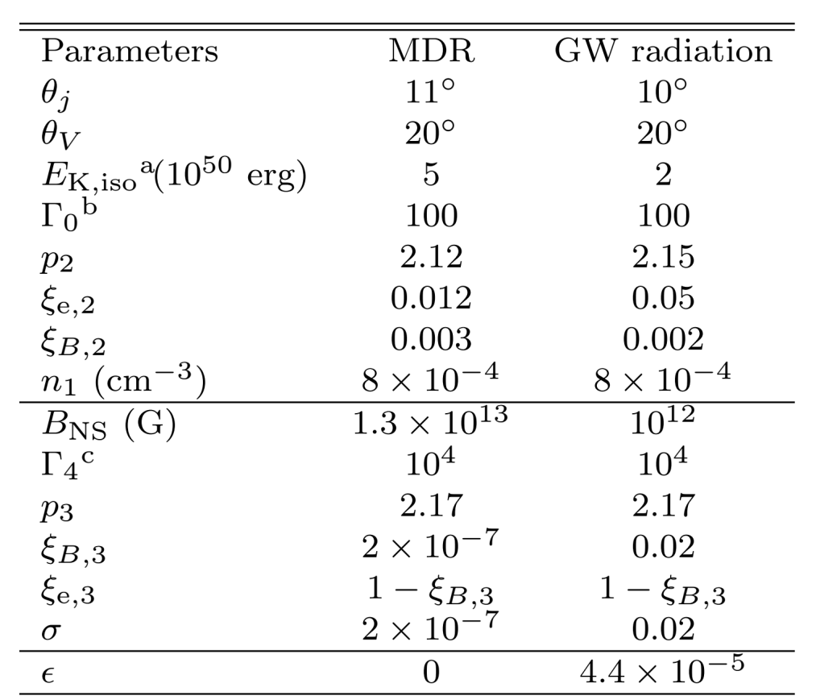
Pulsar-powered relativistic jet (Geng, Dai, Huang et al. 2018, ApJL, 856, L33)
This model is also consistent with position and polarization measurements (Lan, Geng, Wu & Dai 2019, ApJ, in press)

Slide 31
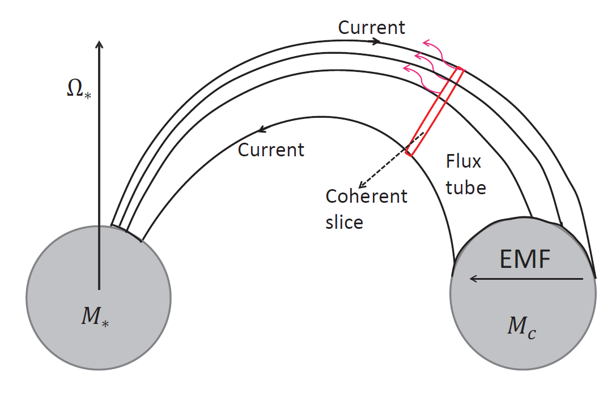

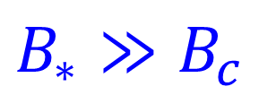

Fast radio bursts from binary NS inspiral
E = v×B/c
Field lines
Hall Voltage
Wang, Yang, Wu, Dai & Wang 2016, ApJ Letters, 822, L7

Slide 32
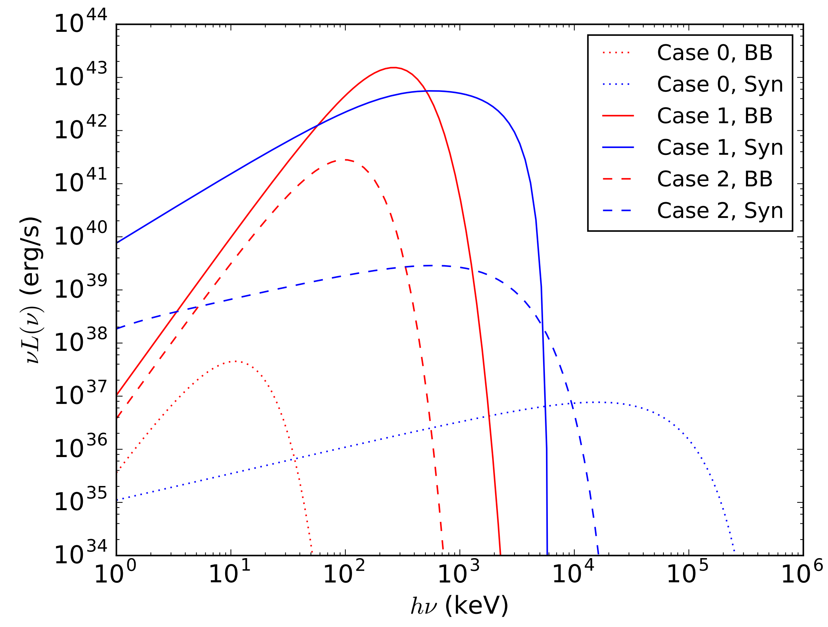
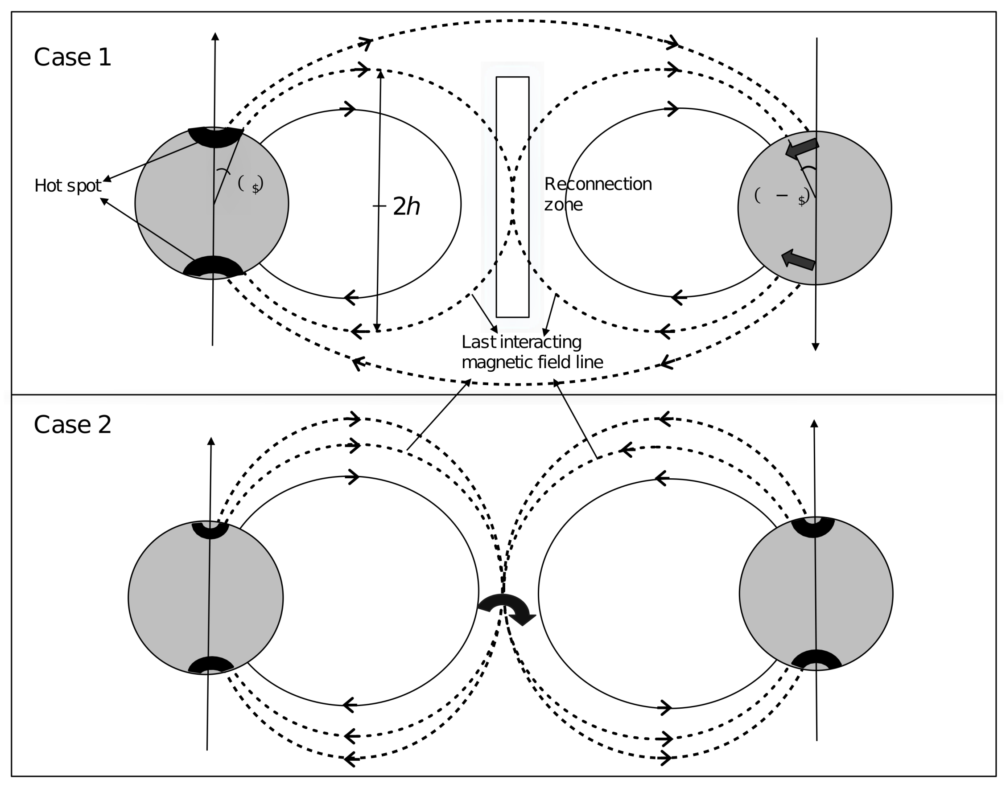
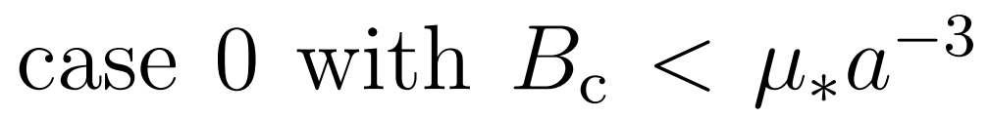
Pre-merger emission (X-ray precursor)
Wang, Peng, Wu & Dai 2018, ApJ, 868, 19: precursor spectra for B=10¹²G

Slide 33
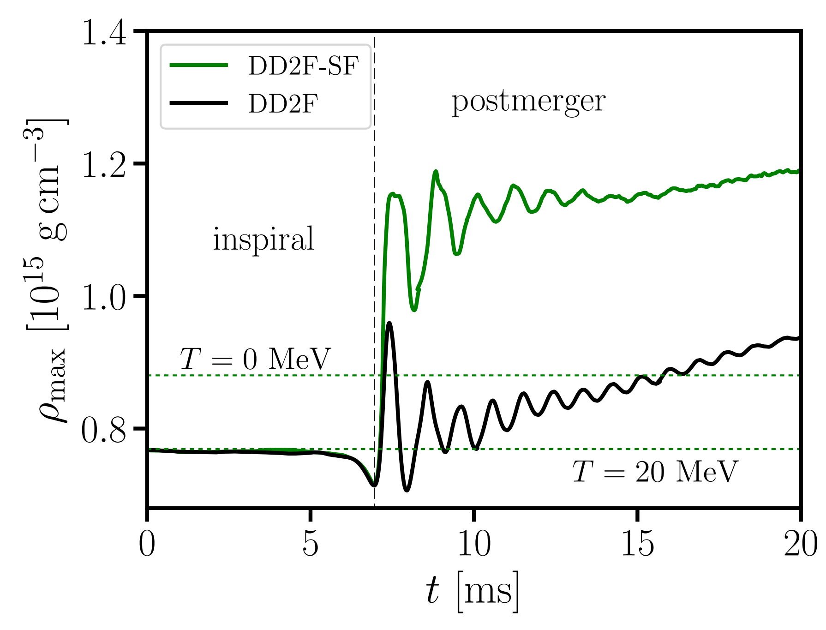
GWs from postmerger radially pulsating NSs
Dai 2018, arXiv:1810.05448
Maximum density variation implies a radial pulsation;
Radial pulsation amplitude α ∼ 0.03-0.1;
Stellar interior temperature kT >10-20 MeV.
Bauswein et al. 2018, arXiv:1809.01116

Slide 34
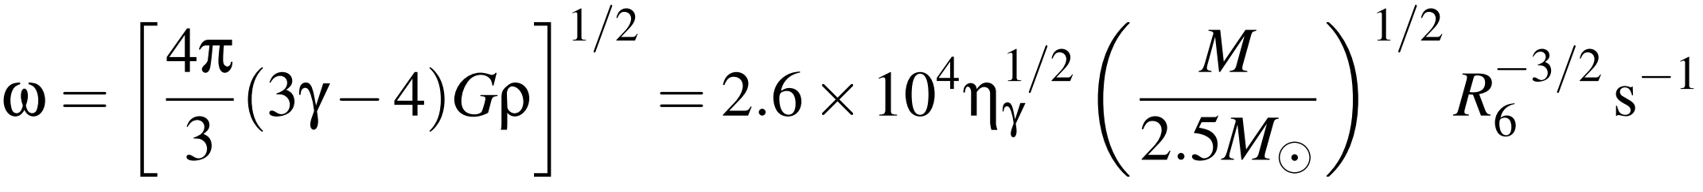
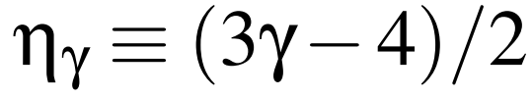
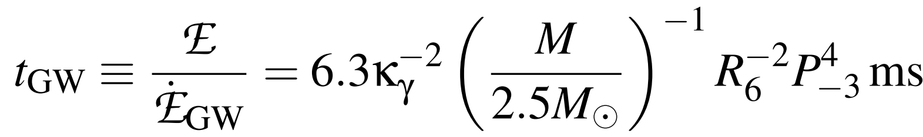

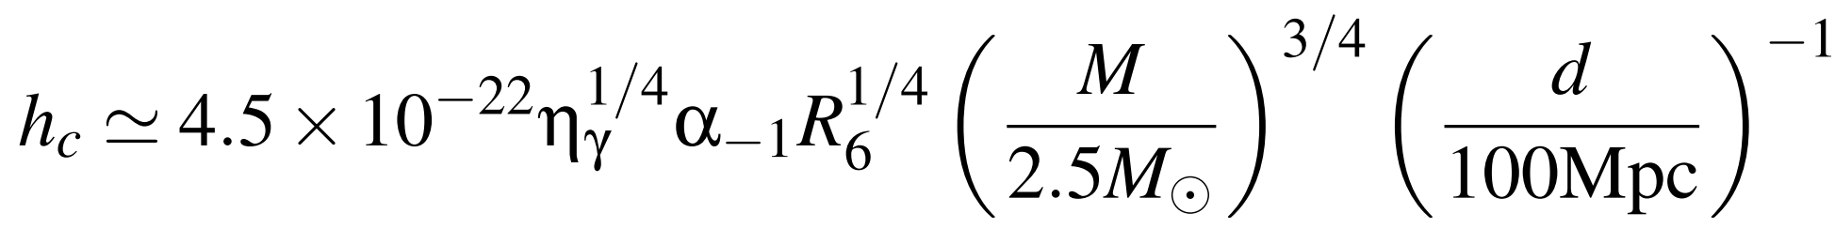
Damping mechanisms and implications
Damping mechanisms: GWs, bulk viscosity, and pulsational magnetic radiation. GWs damp radial pulsations efficiently.
GWs make a leading contribution to the high-frequency spectrum.
If α∼0.1, detectable rate ∼20/yr for aLIGO and ∼7×10⁴/yr for ET;
If α∼0.03, detectable rate ∼0.6/yr for aLIGO and ∼2×10³/yr for ET.
α, P_{NS}, and M-R relation would be constrained with detected GWs.

Slide 35
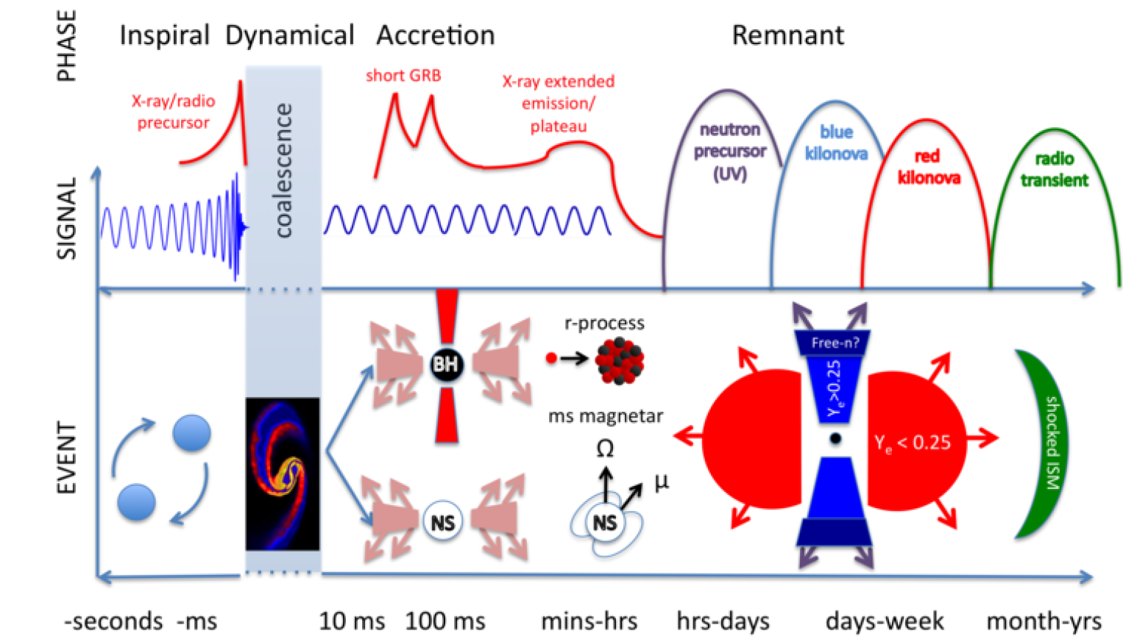
Triplets: GWB, FRB, GRB
Fernández & Metzger (2016)
Dai & Lu 1998, Phys. Rev. Lett., 81, 4301; Dai et al. 2006, Science, 311, 1127

Slide 36
Summary
GW170817 and its EM counterparts show that NS-NS mergers should be a physical origin of short GRBs.
A long-lived NS remnant (∼2.5M_{ʘ}) provides an understanding of all the EM counterparts including an XRF and must rule out many (soft) equations of state for NS matter.
GWB/GRB/FRB (and X-ray precursor), kilonova, and afterglow would provide probes of NS-NS merger process.
Thank you very much!

