Slide 1
The More The Merrier: Multi-Messenger Science with Gravitational Waves
[with focus on EOS constraints using Binary NS Mergers]
Xiamen-CUSTIPEN Workshop, Xiamen
January 4th 2019

Slide 2
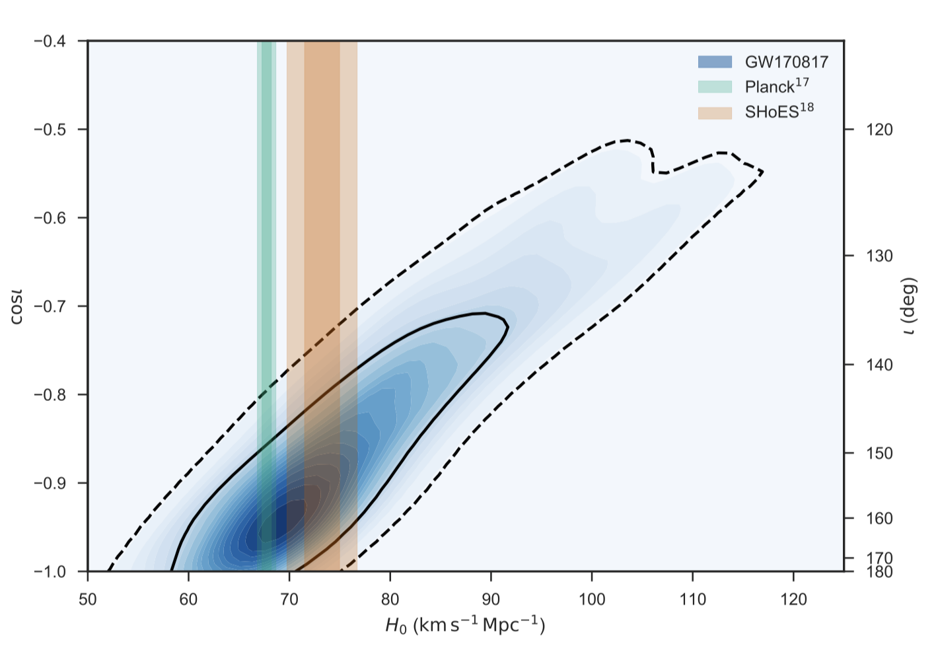
Binary NS Merger Science:
LIGO + (2017)
or Why study them?
GW sources for LIGO, Virgo, …
progenitors of GRBs, kilonovae
r-process nucleosynthesis
constraining EOS (LIGO17, …)
‘standard sirens’ / H0 (Schutz86, LIGO17, Guidorzi+17)
tests of GR, e.g. speed of gravitational waves (LIGO17)
binary stellar evolution, NS formation channels
multi-messenger

Slide 3
Binary NS Merger Science:
LIGO + (2017)
or Why study them?
GW sources for LIGO, Virgo, …
progenitors of GRBs, kilonovae
r-process nucleosynthesis
constraining EOS (LIGO17, …)
‘standard sirens’ / H0 (Schutz86, LIGO17, Guidorzi+17)
tests of GR, e.g. speed of gravitational waves (LIGO17)
binary stellar evolution, NS formation channels
multi-messenger

Slide 4
Merger Remnant:
schematics of a merger:
dependent on binary mass
dependent on EOS
GW loss timescale
inspiral
merger

Slide 5
Merger Remnant:
$$M$$
$${∼(1.3−1.6) M}_{TOV}$$
GW loss timescale
$${∼1.2 M}_{TOV}$$
inspiral
$$M_{TOV}$$
merger
(see also Bartos+13)

Slide 6
Merger Remnant:
$$M$$
reminder:
$M_{TOV}$ = maximum mass of cold, non-rotating NS
$$\frac{dP}{dr}=−\frac{G}{r^{2}}\left(m+4πr^{3}\frac{P}{c^{2}}\right)\left(ρ+\frac{P}{c^{2}}\right){\left(1−\frac{2Gm}{c^{2}r}\right)}^{−1}$$ where $m=∫4πr^{2}ρ dr$
$${∼(1.3−1.6) M}_{TOV}$$
GW loss timescale
$${∼1.2 M}_{TOV}$$
inspiral
$$M_{TOV}$$
merger
(see also Bartos+13)

Slide 7
Merger Remnant:
$$M$$
$${∼(1.3−1.6) M}_{TOV}$$
GW loss timescale
$${∼1.2 M}_{TOV}$$
inspiral
$$M_{TOV}$$
merger
(see also Bartos+13)

Slide 8
Merger Remnant:
$$M$$
dynamical time
prompt collapse
$${∼(1.3−1.6) M}_{TOV}$$
GW loss timescale
$${∼1.2 M}_{TOV}$$
inspiral
$$M_{TOV}$$
merger
(see also Bartos+13)

Slide 9
Merger Remnant:
$$M$$
prompt collapse
$$Ω(r)$$
$${∼(1.3−1.6) M}_{TOV}$$
HMNS
GW loss timescale
$${∼1.2 M}_{TOV}$$
dynamical time
inspiral
$$M_{TOV}$$
merger
differential rotation
(see also Bartos+13)

Slide 10
Merger Remnant:
$$M$$
prompt collapse
$$Ω(r)$$
$${∼(1.3−1.6) M}_{TOV}$$
HMNS
$$Ω$$
$${∼1.2 M}_{TOV}$$
GW loss timescale
dynamical time
SMNS
inspiral
viscous time
merger
$$M_{TOV}$$
differential rotation
rigid rotation
(see also Bartos+13)

Slide 11
Merger Remnant:
$$M$$
prompt collapse
$$Ω(r)$$
$${∼(1.3−1.6) M}_{TOV}$$
HMNS
$$Ω$$
$${∼1.2 M}_{TOV}$$
GW loss timescale
dynamical time
SMNS
inspiral
viscous time
merger
$$M_{TOV}$$
differential rotation
spin-down time
NS
rigid rotation
final remnant
(see also Bartos+13)

Slide 12
Multi-messenger EOS Constraints:
how to use to constrain NS EOS?
$$M$$
prompt collapse
$$Ω$$
$${∼(1.3−1.6) M}_{TOV}$$
HMNS
$$Ω$$
$${∼1.2 M}_{TOV}$$
dynamical time
SMNS
inspiral
viscous time
merger
$$M_{TOV}$$
differential rotation
spin-down time
NS
rigid rotation

Slide 13
Multi-messenger EOS Constraints:
merger outcome $⇔M_{tot}/M_{TOV}$
how to use to constrain NS EOS?
$$M$$
prompt collapse
$$Ω$$
$${∼(1.3−1.6) M}_{TOV}$$
HMNS
$$Ω$$
$${∼1.2 M}_{TOV}$$
dynamical time
SMNS
inspiral
viscous time
merger
$$M_{TOV}$$
differential rotation
spin-down time
NS
rigid rotation

Slide 14
Multi-messenger EOS Constraints:
merger outcome $⇔M_{tot}/M_{TOV}$
GW signal $⇒$ total binary mass, $M_{tot}$
$M_{tot}=M_{chirp} q^{−3/5}{\left(1+q\right)}^{6/5}$

Slide 15
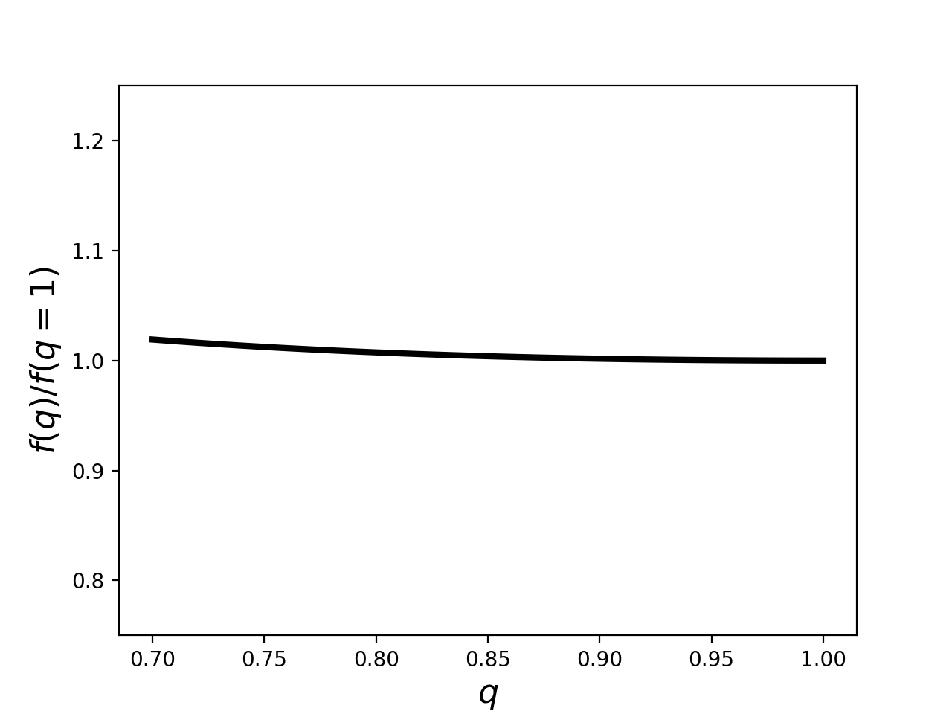
Multi-messenger EOS Constraints:
merger outcome $⇔M_{tot}/M_{TOV}$
GW signal $⇒$ total binary mass, $M_{tot}$
$M_{tot}=M_{chirp} q^{−3/5}{\left(1+q\right)}^{6/5}$
precisely measured
f(q) weakly dependent on q
less than 2% effect (for q>0.7)

Slide 16
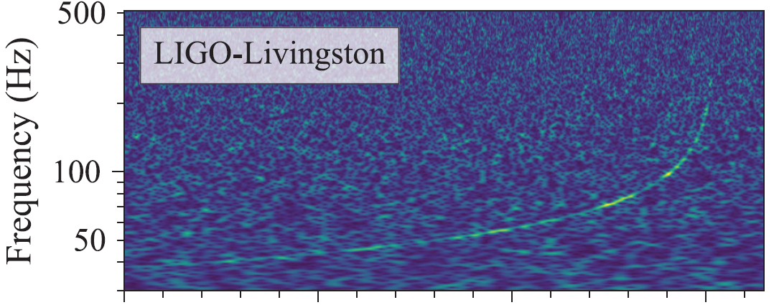
Multi-messenger EOS Constraints:
merger outcome $⇔M_{tot}/M_{TOV}$
GW signal $⇒$ total binary mass, $M_{tot}$
$M_{tot}=M_{chirp} q^{−3/5}{\left(1+q\right)}^{6/5}$
LIGO Virgo (2017)
Time

Slide 17
Multi-messenger EOS Constraints:
merger outcome $⇔M_{tot}/M_{TOV}$
GW signal $⇒$ total binary mass, $M_{tot}$
$M_{tot}=M_{chirp} q^{−3/5}{\left(1+q\right)}^{6/5}$
GW
LIGO Virgo (2017)
Time

Slide 18
Multi-messenger EOS Constraints:
merger outcome $⇔M_{tot}/M_{TOV}$
EM signature $⇒$ remnant fate (Bauswein+13; Metzger&Fernandez14; Metzger&Piro14; Kasen+15; …)
GW

Slide 19
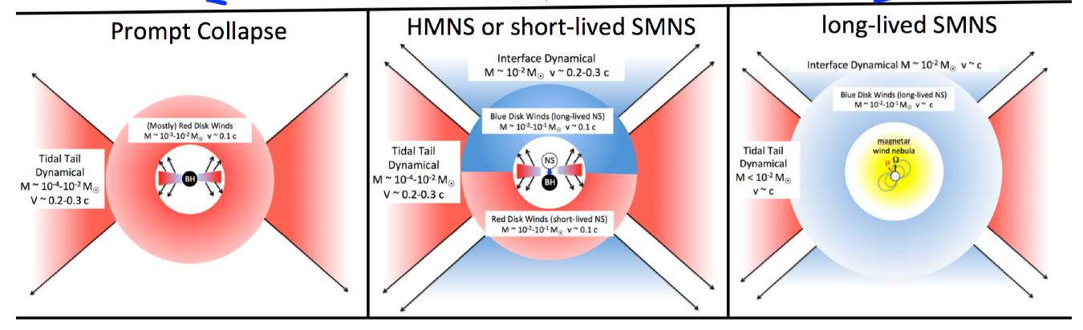
Multi-messenger EOS Constraints:
merger outcome $⇔M_{tot}/M_{TOV}$
EM signature $⇒$ remnant fate (Bauswein+13; Metzger&Fernandez14; Metzger&Piro14; Kasen+15; …)
GW
BM & Metzger (2017)

Slide 20
Multi-messenger EOS Constraints:
merger outcome $⇔M_{tot}/M_{TOV}$
EM signature $⇒$ remnant fate (Bauswein+13; Metzger&Fernandez14; Metzger&Piro14; Kasen+15; …)
EM
GW
BM & Metzger (2017)

Slide 21
Multi-messenger EOS Constraints:
merger outcome $⇔M_{tot}/M_{TOV}$
EM signature $⇒$ remnant fate (Bauswein+13; Metzger&Fernandez14; Metzger&Piro14; Kasen+15; …)
EM
GW
$⇒$EOS
BM & Metzger (2017)

Slide 22
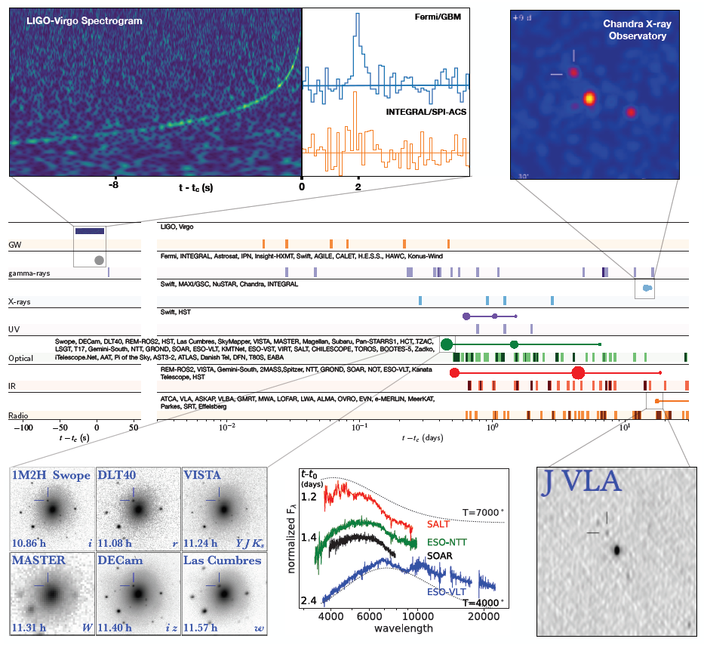
Application to GW170817: (I) remnant fate
LIGO + (2017)

Slide 23
Application to GW170817: (I) remnant fate
$$M$$
prompt collapse
$$Ω$$
$${∼(1.3−1.6) M}_{TOV}$$
HMNS
$$Ω$$
$${∼1.2 M}_{TOV}$$
dynamical time
SMNS
inspiral
viscous time
merger
$$M_{TOV}$$
differential rotation
spin-down time
NS
rigid rotation

Slide 24
Application to GW170817: (I) remnant fate
rule out long-lived SMNS or stable NS remnant
main argument: energetics
$$M$$
prompt collapse
$$Ω$$
$${∼(1.3−1.6) M}_{TOV}$$
HMNS
$$Ω$$
$${∼1.2 M}_{TOV}$$
dynamical time
SMNS
inspiral
viscous time
merger
$$M_{TOV}$$
differential rotation
spin-down time
NS
rigid rotation
for GW170817

Slide 25
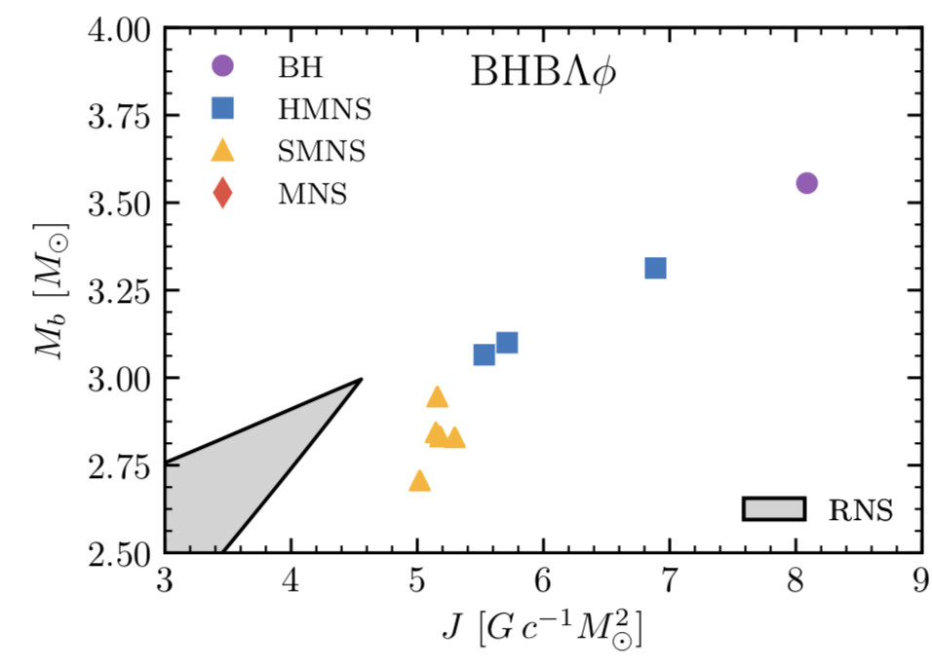
Application to GW170817: (II) energetics
$J_{remnant}∼J_{orbital}>J_{K, max}$
Radice+ (2018)
$$J_{K, max}$$
baryonic mass
angular momentum

Slide 26
Application to GW170817: (II) energetics
$J_{remnant}∼J_{orbital}>J_{K, max}$
$⇒$merger remnant maximally rotating
$E_{rot}=\frac{1}{2}IΩ^{2}∼{10}^{53} erg$ !
Radice+ (2018)
$$J_{K, max}$$
(Metzger,BM+15)
baryonic mass
angular momentum

Slide 27
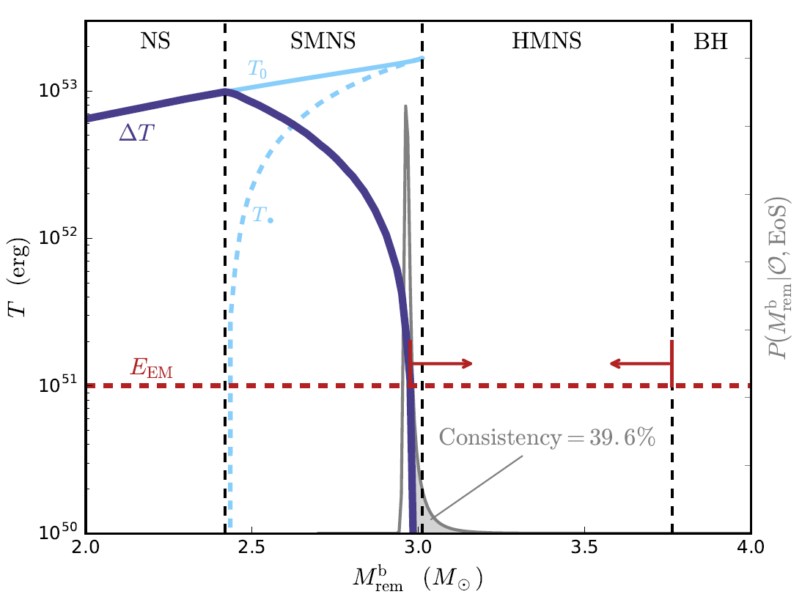
Application to GW170817: (II) energetics
BM & Metzger (2017)
$J_{remnant}∼J_{orbital}>J_{K, max}$
$⇒$merger remnant maximally rotating
$E_{rot}=\frac{1}{2}IΩ^{2}∼{10}^{53} erg$ !
rotational energy (erg)
(Metzger,BM+15)
(baryonic mass)
remnant mass ($M_{⊙}$)

Slide 28
Application to GW170817: (II) energetics
BM & Metzger (2017)
$E_{rot}=\frac{1}{2}IΩ^{2}∼{10}^{53} erg$ !
(Metzger,BM+15)
rotational energy (erg)
(baryonic mass)
remnant mass ($M_{⊙}$)

Slide 29
Application to GW170817: (II) energetics
BM & Metzger (2017)
$E_{rot}=\frac{1}{2}IΩ^{2}∼{10}^{53} erg$ !
for stable remnant: tapped by magnetic-dipole spin-down ($\dot{E}∼μ^{2}Ω^{4}/c^{3}$)
inconsistent with GW170817 kilonova + afterglow (unless unusual ellipticity invoked)
(Metzger,BM+15)
rotational energy (erg)
(Kiuchi+14, Metzger&Piro14, Siegel&Ciolfi16, …)
(baryonic mass)
remnant mass ($M_{⊙}$)

Slide 30
Application to GW170817: (II) energetics
BM & Metzger (2017)
$E_{rot}=\frac{1}{2}IΩ^{2}∼{10}^{53} erg$ !
for stable remnant: tapped by magnetic-dipole spin-down ($\dot{E}∼μ^{2}Ω^{4}/c^{3}$)
inconsistent with GW170817 kilonova + afterglow (unless unusual ellipticity invoked)
(Metzger,BM+15)
GW170817
rotational energy (erg)
(Kiuchi+14, Metzger&Piro14, Siegel&Ciolfi16, …)
(baryonic mass)
remnant mass ($M_{⊙}$)

Slide 31
Application to GW170817: (II) energetics
BM & Metzger (2017)
rule out NS or SMNS remnant
GW170817
rotational energy (erg)
(baryonic mass)
remnant mass ($M_{⊙}$)

Slide 32
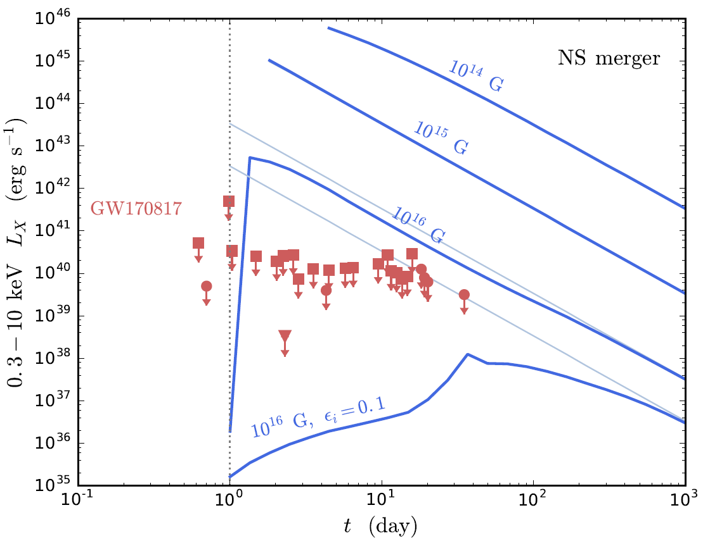
Application to GW170817: (II) energetics
BM + (2018b)
rule out NS or SMNS remnant
also strengthened by:
observed GRB $≲2s$ post merger
lack of X-rays from NS spindown (BM+18b, Pooley+18)
X-ray luminosity

Slide 33
Application to GW170817: (III) $M_{TOV}$ constraints
threshold masses EOS dependent
ruling out long-lived NS
$⇒$ upper limit on $M_{TOV}$
$$M$$
BH
$${1.5 M}_{TOV}$$
HMNS
$${1.2 M}_{TOV}$$
GW170817 $M_{tot}^{ }$
$$2.7M_{⊙}$$
SMNS
$$M_{TOV}$$
$$2.2M_{⊙}$$
NS

Slide 34
Application to GW170817: (III) $M_{TOV}$ constraints
threshold masses EOS dependent
ruling out long-lived NS
$⇒$ upper limit on $M_{TOV}$
$$M$$
BH
$${1.5 M}_{TOV}$$
HMNS
$${1.2 M}_{TOV}$$
GW170817 $M_{tot}^{ }$
$$2.7M_{⊙}$$
SMNS
$$M_{TOV}$$
$$2.2M_{⊙}$$
NS

Slide 35
Application to GW170817: (III) $M_{TOV}$ constraints
threshold masses EOS dependent
ruling out long-lived NS
$⇒$ upper limit on $M_{TOV}$
$$M$$
BH
$${1.5 M}_{TOV}$$
HMNS
GW170817 $M_{tot}^{ }$
$$2.7M_{⊙}$$
$${1.2 M}_{TOV}$$
SMNS
$$2.2M_{⊙}$$
$$M_{TOV}$$
NS

Slide 36
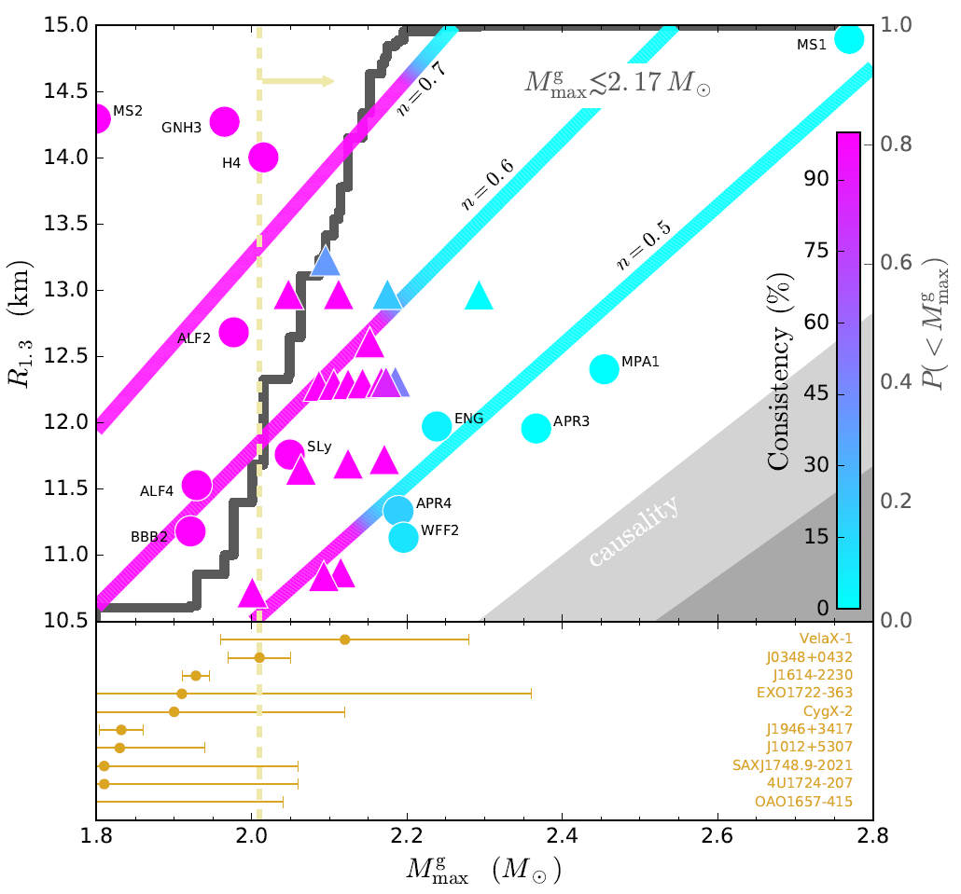
Application to GW170817: (III) $M_{TOV}$ constraints
BM & Metzger (2017)
find $M_{TOV}≲2.17M_{⊙}$ (BM&Metzger17)
NS radius (km)
cumulative probability $<M_{max}$
known NS masses
(gravitational mass)
NS maximal mass ($M_{⊙}$)

Slide 37
Application to GW170817: (III) $M_{TOV}$ constraints
BM & Metzger (2017)
find $M_{TOV}≲2.17M_{⊙}$ (BM&Metzger17)
NS radius (km)
cumulative probability $<M_{max}$
known NS masses
(gravitational mass)
NS maximal mass ($M_{⊙}$)

Slide 38
Application to GW170817: (III) $M_{TOV}$ constraints
BM & Metzger (2017)
find $M_{TOV}≲2.17M_{⊙}$ (BM&Metzger17)
relies only on qualitative categorization (HMNS / SMNS / …)
not sensitive to quantitative kilonova modeling uncertainties
NS radius (km)
cumulative probability $<M_{max}$
known NS masses
(gravitational mass)
NS maximal mass ($M_{⊙}$)

Slide 39
Additional Multi-Messenger Constraints:
Coughlin, Dietrich, BM + (submitted)
(but model dependent)
additional constraints from fitting kilonova ejecta properties
identify ejecta source (dynamical / disk winds)
ejecta mass & velocity depend on binary parameters and EOS
disk mass ($M_{⊙}$)
0.8
0.9
1.0
1.1
total mass / threshold mass for prompt collapse

Slide 40
Additional Multi-Messenger Constraints:
Coughlin, Dietrich, BM + (submitted)
(but model dependent)
additional constraints from fitting kilonova ejecta properties
identify ejecta source (dynamical / disk winds)
ejecta mass & velocity depend on binary parameters and EOS
disk mass ($M_{⊙}$)
EM
0.8
0.9
1.0
1.1
total mass / threshold mass for prompt collapse
GW
EOS: $M_{thr}(R_{ns},M_{TOV})$

Slide 41
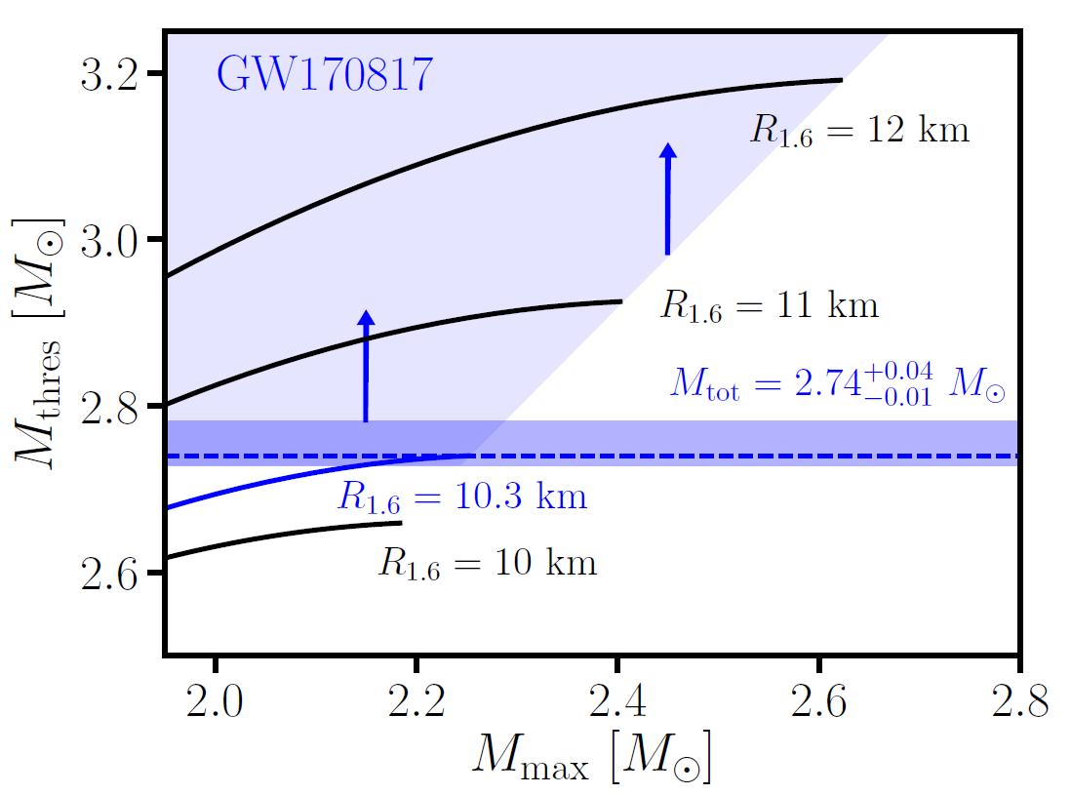
Additional Multi-Messenger Constraints:
Bauswein + (2017)
lack of prompt-collapse
from merger simulations: $M_{thr}≈f\left(\frac{M_{TOV}}{R_{1.6}}\right)M_{TOV}$ (Bauswein+13) + causality: $M_{thr}>1.22M_{TOV}$
$M_{thr}>2.74M_{⊙} ⇒ R_{1.6}>10.3 km$ (Bauswein+17)
threshold for prompt-collapse increases with larger NS radius

Slide 42
Future Outlook:
rich landscape
(bright future)

Slide 43
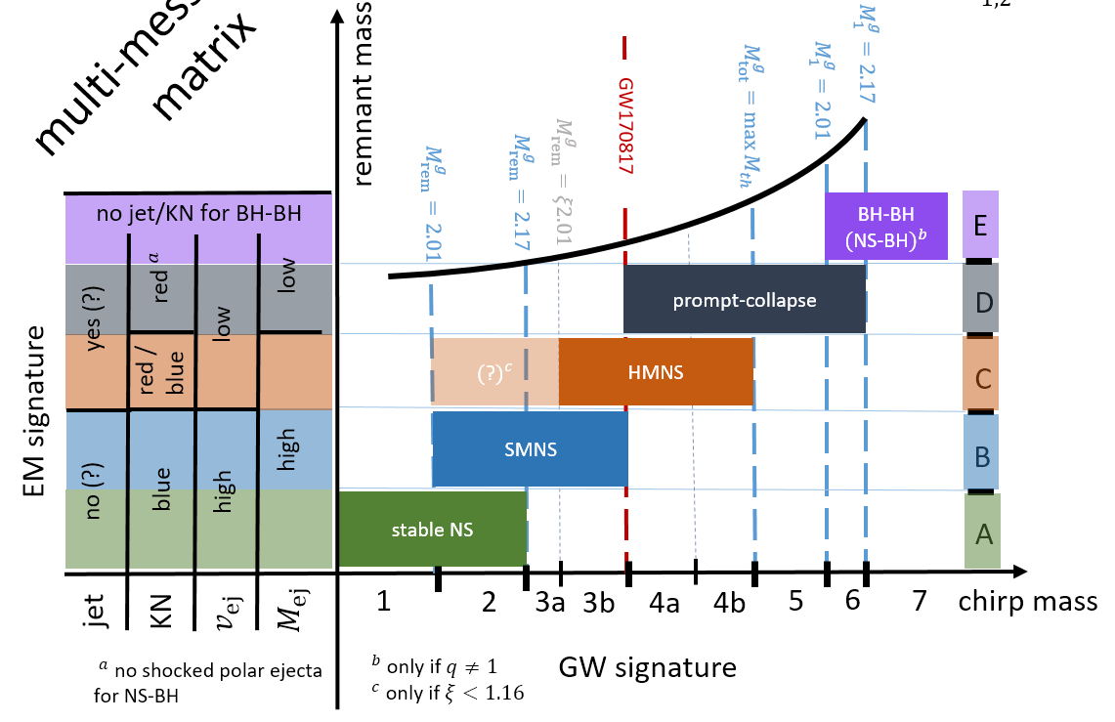
Future Outlook:
BM + (in prep)
Multi-Messenger Matrix
rich landscape
(bright future)

Slide 44
Future Outlook:
BM + (in prep)
Multi-Messenger Matrix
rich landscape
(bright future)
EOS learning opportunities

Slide 45
Future Outlook:
BM + (in prep)
Multi-Messenger Matrix
rich landscape
(bright future)
EOS learning opportunities

Slide 46
Future Outlook:
BM + (in prep)
Multi-Messenger Matrix
rich landscape
(bright future)
EOS learning opportunities

Slide 47
Future Outlook:
BM + (in prep)
Multi-Messenger Matrix
rich landscape
(bright future)
EOS learning opportunities
&
predictions!

Slide 48
Future Outlook:
BM + (in prep)
Multi-Messenger Matrix
rich landscape
(bright future)
EOS learning opportunities
&
predictions!

Slide 49
Future Outlook:
NS / SMNS
prompt / HMNS
for Galactic distribution of binary NSs (Kiziltan+13)
~32%
BM + (in prep)
~3%
EOS learning opportunities
&
~27%
~38%
predictions!
SMNS
HMNS / SMNS

Slide 50
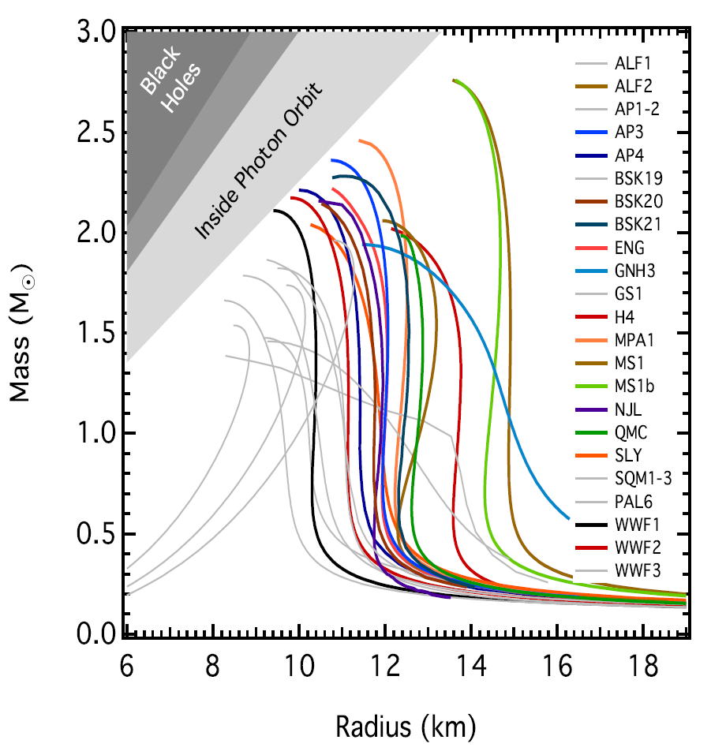
Ozel & Freire (2016)
Summary of EOS Constraints:
multi-messenger methods complementary to GW-only constraints (tidal deformability, post-merger signals, …)
future multi-messenger observations can further constrain EOS

Slide 51
Ozel & Freire (2016)
Summary of EOS Constraints:
multi-messenger methods complementary to GW-only constraints (tidal deformability, post-merger signals, …)
future multi-messenger observations can further constrain EOS
LIGO 18
De+18
GW-only
multi-messenger

Slide 52
Ozel & Freire (2016)
Summary of EOS Constraints:
BM & Metzger 17
multi-messenger methods complementary to GW-only constraints (tidal deformability, post-merger signals, …)
future multi-messenger observations can further constrain EOS
Bauswein+17
LIGO 18
Coughlin+
De+18
GW-only
multi-messenger

