Slide 1
Constraint on NS maximum mass from multi-messenger data of NS-NS mergers
Xiamen-CUSTIPEN Workshop on the EOS of Dense Neutron-Rich Matter in the Era of Gravitational Wave Astronomy
He Gao (高鹤)
Department of Astronomy, Beijing Normal University
北京师范大学－天文系
Collaborators: Bing Zhang, Zi-Gao Dai, Xue-Feng Wu, Yun-Wei Yu, Hou-Jun Lv, Ang Li, Zhou-Jian Cao, Shunke Ai…
2019-01-04
@Xiamen

Slide 2
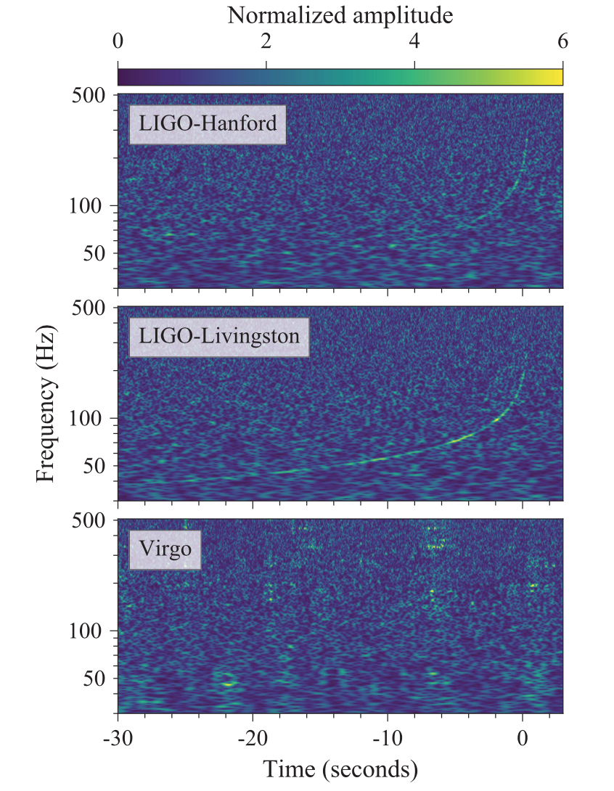
Era of GW Astronomy has been Opened
Multi-Messenger
GW detector triggered；
1.7s later, Fermi／GBM
Detect a Short GRB;
10 hours later, an optical
IR counterpart detected;
9 days later，Chandra find
a X-ray counterpart;
16 days later, VLA detected
a radio counterpart.
Abbott et al. 2017，PRL

Slide 3
NS M_{TOV} constraint from NS-NS mergers product
Merger remnant mass
Remnant being BN/NS
Tight constraints on M_{TOV}

Slide 4
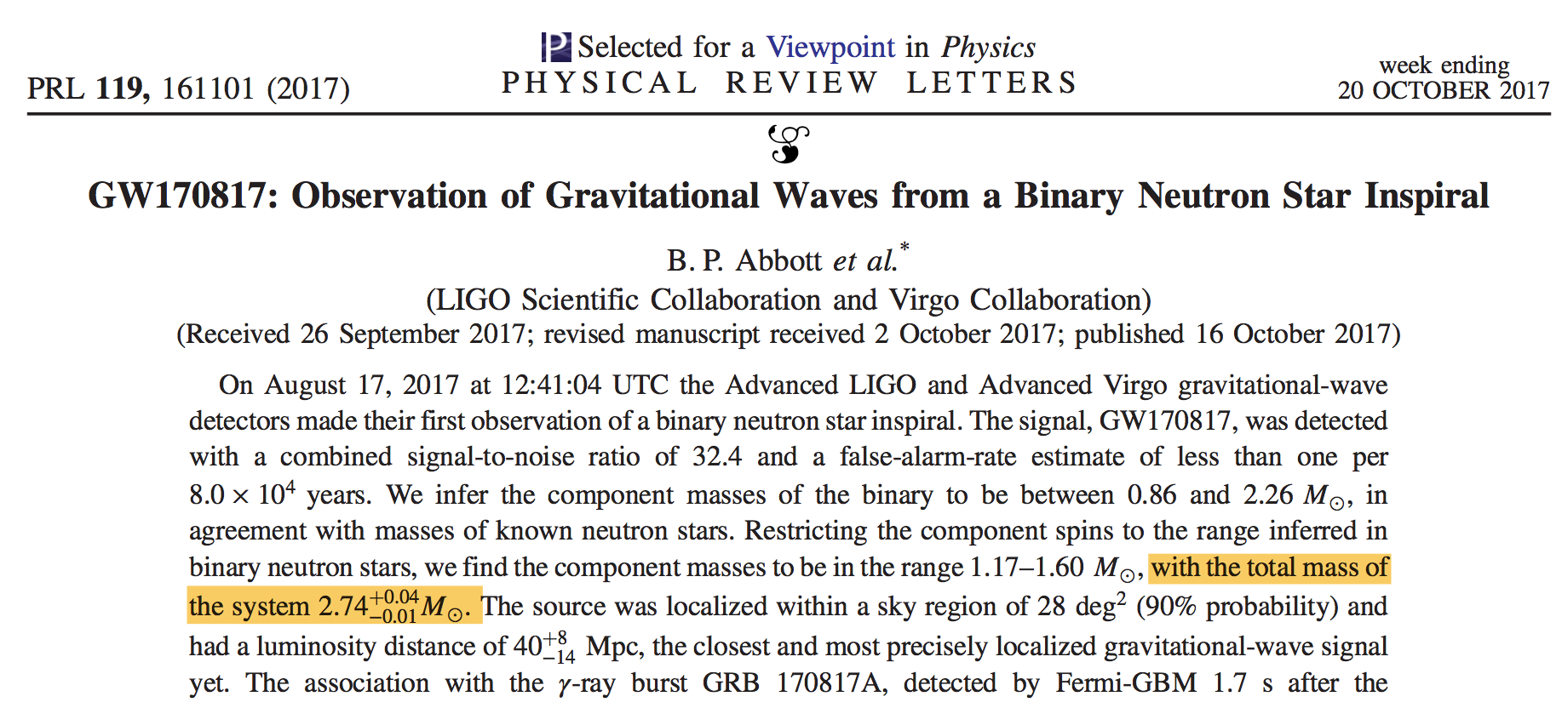
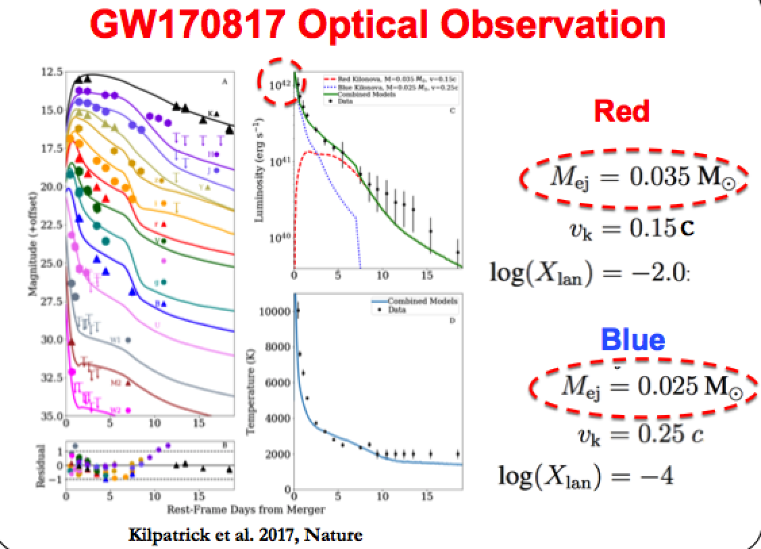
Merger Remnant Mass M_{s}
GW
M_{tot}
KN
M_{ej}
M_{s}=M_{tot}-M_{ej}

Slide 5
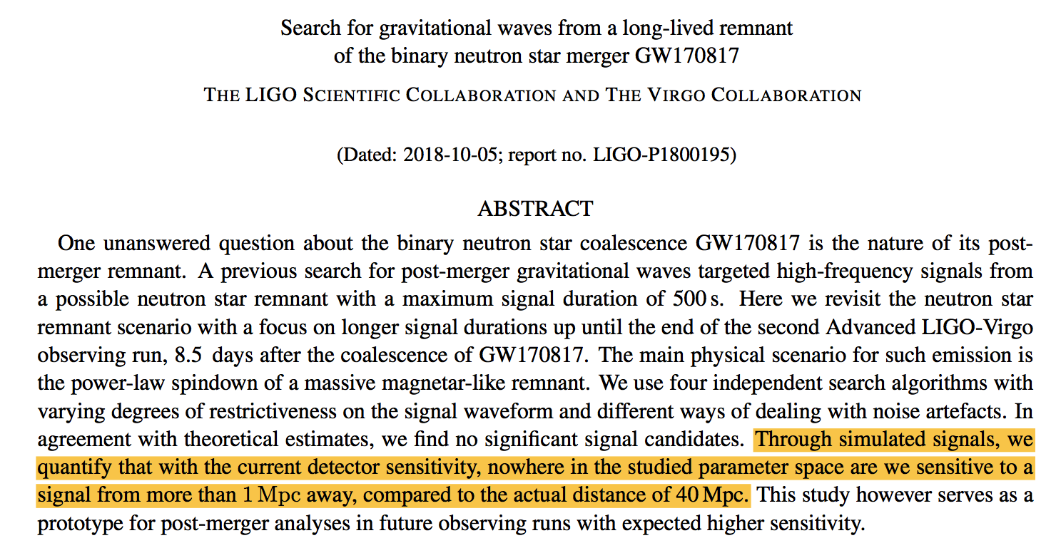
Current GW detectors cannot determine remnant being NS/BH

Slide 6
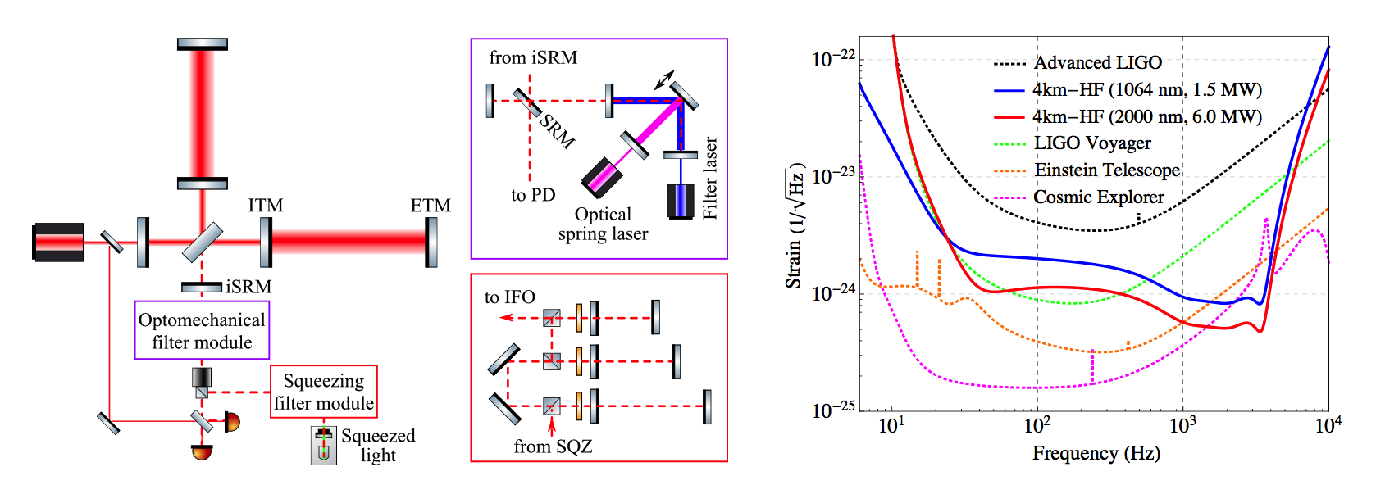
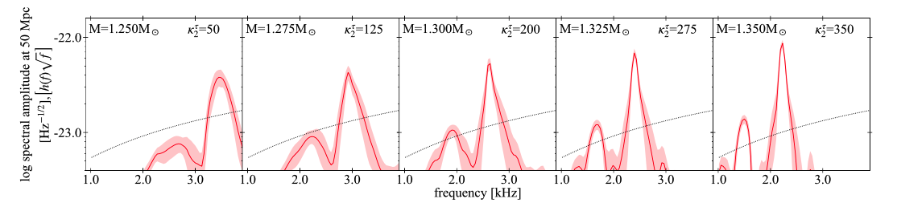
Improving GW detector or post-merger waveforms
3rd Generation Detector
kHz Detector
Miao et al. 2018, PRD
Fast and Reliable Waveforms
Easter et al. 2018

Slide 7
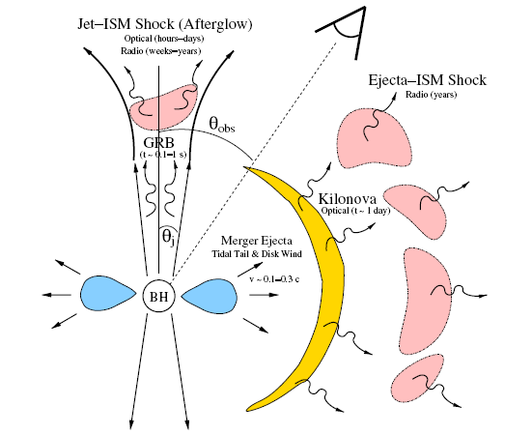
Identifiable EM signature : BH vs NS
BH
NS
Gao et al., 2013
Metzger & Berger, 2012
SGRB with plateau feature in X-ray afterglow
Kilonova becomes 10-100 times brighter

Slide 8
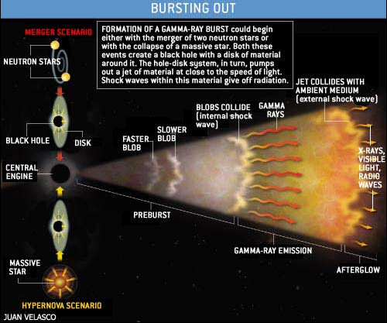
NS vs BH: SGRB with plateau feature in X-ray afterglow
Swift 10 years: 96 SGRBs
30/96 (32%) with plateau,
21/96 (22%) with “internal plateau”
“Smoking gun”
Internal plateau: plateau followed by a decay index steeper than 3.
plateau
t: 100-1000s
normal
zhang et al. 2016, ApJ

Slide 9
NS vs BH: Kilonova becomes 10-100 times brighter
21 SGRBs with internal plateau;
3/21 with high quality late data
and z measurement;
3/3 show brighter kilonova
GW170817
Gao et al. , 2017 ApJ, 837, 50

Slide 10
Identifiable EM signature : BH vs NS
BH
NS
Gao et al., 2013
Metzger & Berger, 2012
SGRB with plateau feature in X-ray afterglow
Kilonova becomes 10-100 times brighter

Slide 11
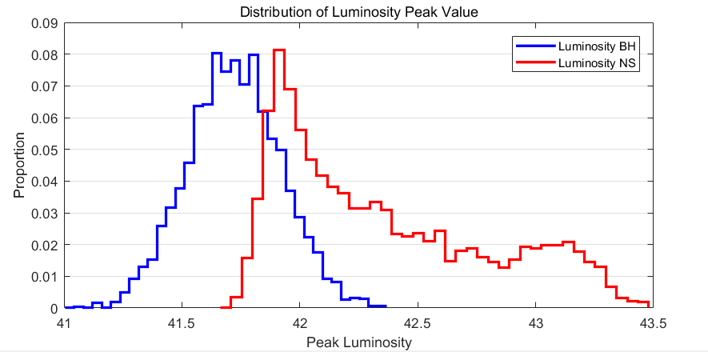
GW170817: cannot determine BH or NS
GW170817
Optical luminosity is just in between BH and NS cases
X-ray observation starts
too late

Slide 12
Future GW Cases
Einstein Probe： large FoV X-ray telescope
Optical transient with much lower or higher luminosity
Early X-ray afterglow observation

Slide 13

What if no more future GW cases?
NS-NS merger rates：110-3840 Gpc⁻³ yr⁻¹
Belczynski et al. 2018
There is a big tension between the current evolutionary predictions (<<100 Gpc⁻³ yr⁻¹) and the observation of the first NS-NS merger.
GW170817 was a statistical fluctuation
or
Evolutionary prediction was wrong
Abbott et al. 2018

Slide 14
Constraints on M_{TOV} with SGRB Data
Part of (or all) SGRBs are from NS-NS mergers
Given mass distribution of NS-NS systems
Internal plateau indicates supra-massive NS as merger remnant
M_{TOV}: maximum gravitational mass
for a nonrotating NS
NS
BH
SMNS
M_{max}: maximum gravitational mass
22%
EoS Parameterization
Lasky et al., 2014
M_{max}
M_{TOV}
α and β are functions of M_{TOV}, NS radius (R) and moment of inertia (I)

Slide 15
Constraints on M_{TOV} with SGRB Data
Part of (or all) SGRBs are from NS-NS mergers
Given mass distribution of NS-NS systems
Internal plateau indicates supra-massive NS as merger remnant
M_{TOV}: maximum gravitational mass
for a nonrotating NS
NS
BH
SMNS
M_{max}: maximum gravitational mass
22%
EoS Parameterization
Lasky et al., 2014
M_{max}
M_{TOV}
α and β are functions of M_{TOV}, NS radius (R) and moment of inertia (I)

Slide 16
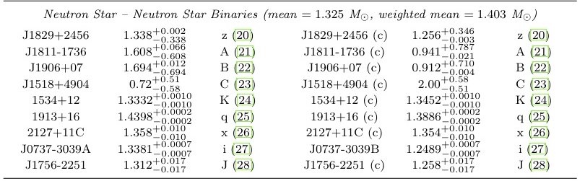
Mass Distribution of NS-NS Systems
Cosmological NS-NS systems have the same mass distribution as the observed Galactic system;
Lattimer & Prakash (2010)

Slide 17
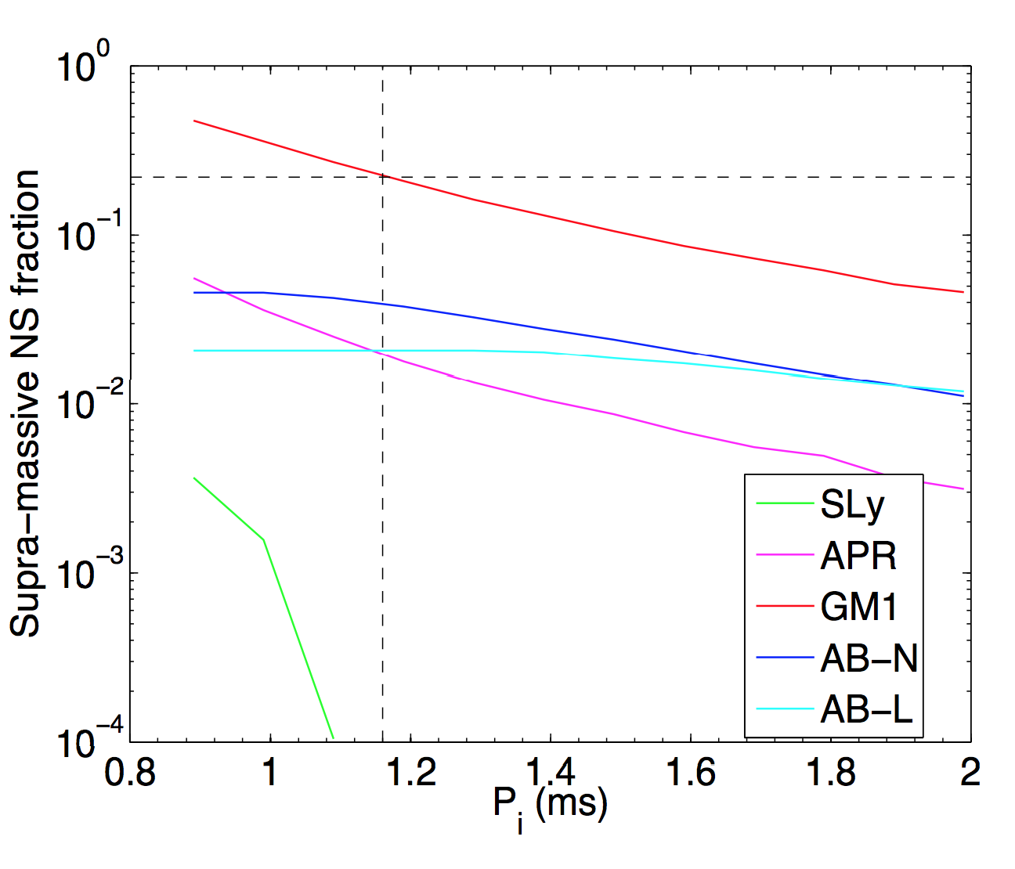
Constraints on M_{TOV} with SGRB Data
Gao et al., 2016 PRD, 93, 044065
EoS Parameterization
22%
maximum gravitational mass
maximum gravitational mass
for a nonrotating NS
spin period
Lasky et al., 2014
Lv et al. 2014

Slide 18
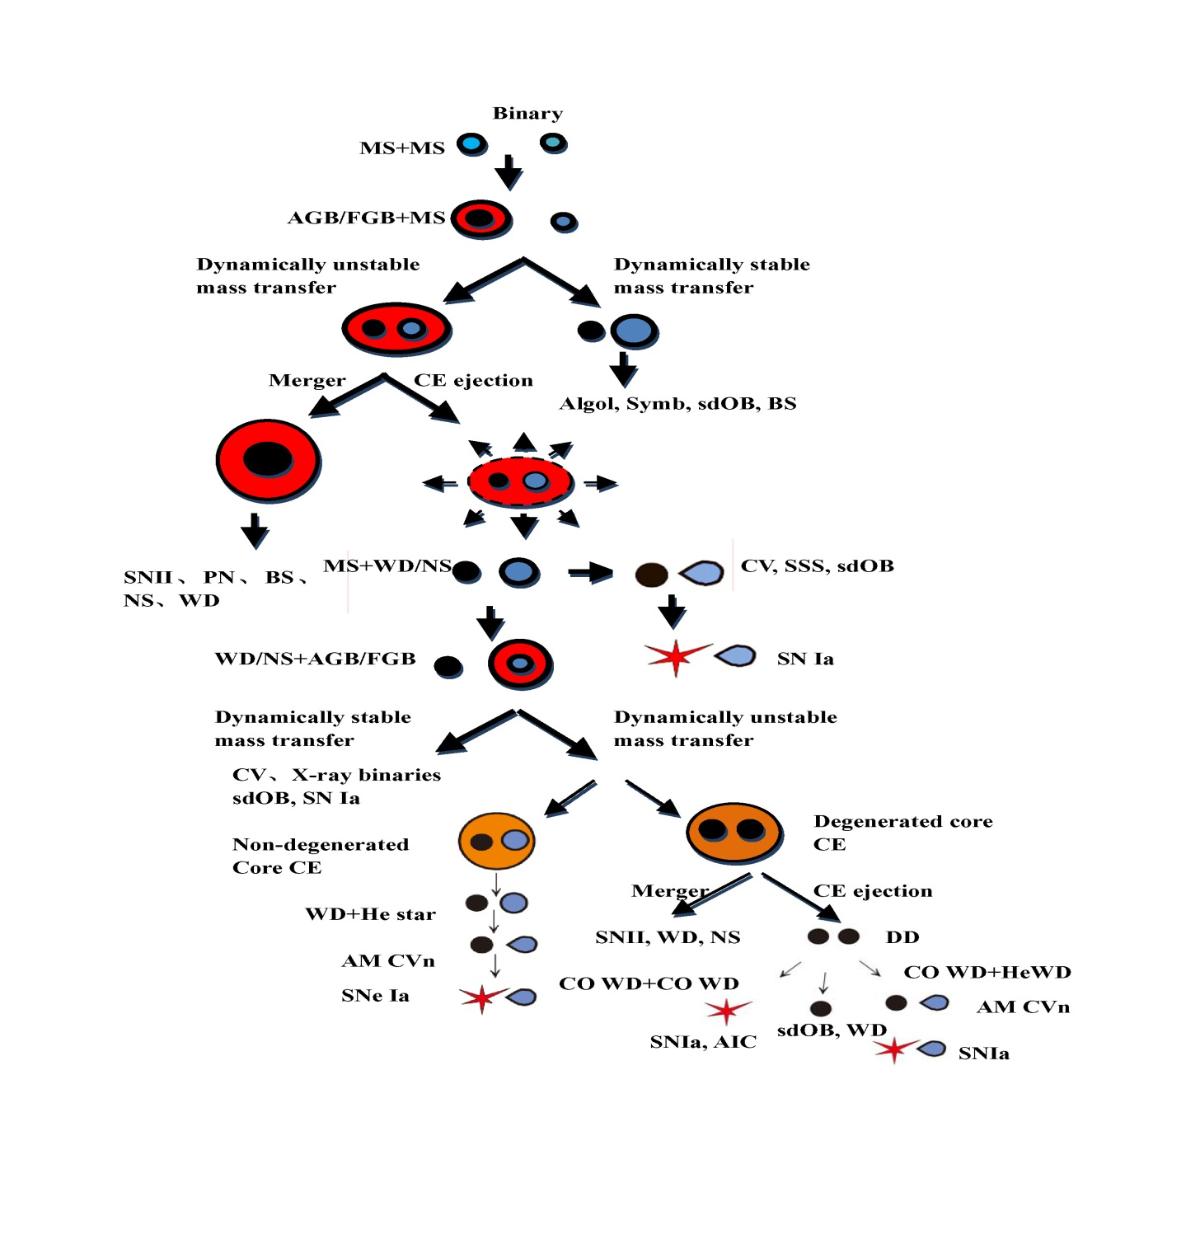
Mass Distribution of NS-NS Systems
Population Synthesis
Monte Carlo simulation results based on the NS-NS redshift distribution and population synthesis method are consistent with MW.

Slide 19
Summary
Era of GW Astronomy has been Opened
GW-EM joint detection of NS-NS merger event could make tight constraints on NS maximum mass
  GW+EM give remnant mass
  GW/EM determine remnant being BH/NS
Short GRB data only could also make constraints on NS maximum mass
  Known NS-NS mass distribution
  Fraction of SGRBs with Internal plateau
  Current data favors M_{TOV}~2.3-2.4M
Thanks for the attention！

